Slide 1
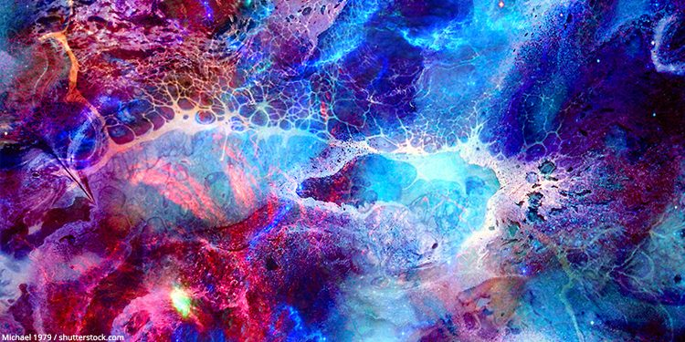
ART

Slide 2
I know you are probably thinking, we used to do this in Reception, but I would like you to be more creative rather than just sticking some paint on an apple and putting it on the paper.
I have included some ideas on the next few slides and I would love to see your creative flair shine through.

Slide 4
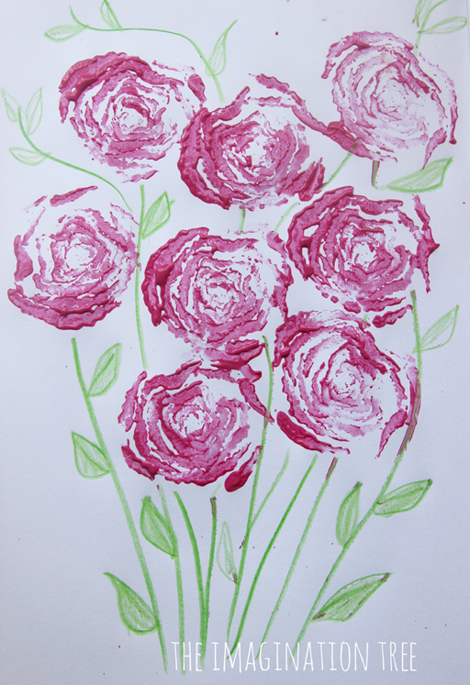
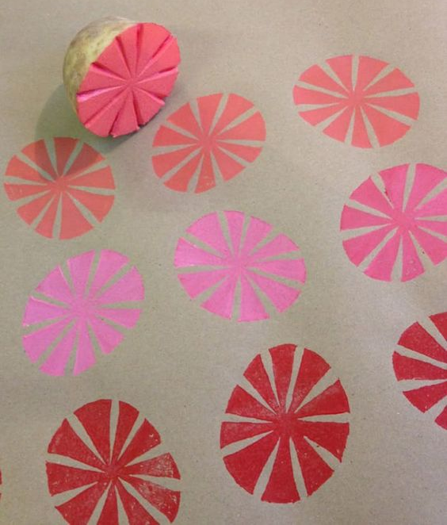

Slide 5
