Slide 2
Diving into Mastery Guidance for Educators
Each activity sheet is split into three sections, diving, deeper and deepest, which are represented by the following icons:
These carefully designed activities take your children through a learning journey, initially ensuring they are fluent with the key concept being taught; then applying this to a range of reasoning and problem-solving activities.
These sheets might not necessarily be used in a linear way. Some children might begin at the ‘Deeper’ section and in fact, others may ‘dive straight in’ to the ‘Deepest’ section if they have already mastered the skill and are applying this to show their depth of understanding.
Diving
Deeper
Deepest

Slide 3
Aim
Add and subtract amounts of money to give change, using both £ and p in practical contexts.

Slide 4
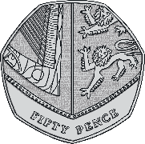
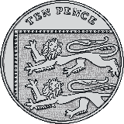
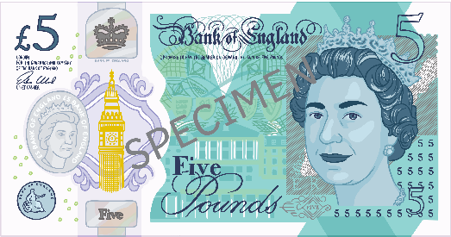
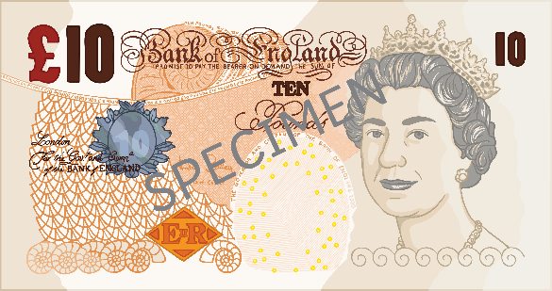
Pounds and Pence
Diving
Use <, > or = to make these statements correct.
<
=
I have thirteen pounds and five pence.
>

Slide 5
Pounds and Pence
Diving
How much money has been collected in the charity bucket?
£14 and 16 pence

Slide 6
Pounds and Pence
Deeper
Which amount is the odd one out? Explain why.
Amount A | Amount B | Amount C
£6 and 25 pence
£6 and 25 pence
£5 and 26 pence
Amount C is the odd one out as it totals £5 and 26 pence. This is different to amounts A and B as they both total £6 and 25 pence.

Slide 7
Pounds and Pence
Deeper
Mario has collected this amount of money for charity:
I collected £20 and 47 pence. I must have more money than Mario because I have a £20 note.
Is she correct? Explain your reasons.
She is incorrect. Even though she has a £20 note, her total is £20 and 47 pence. She has 7 pence less than Mario’s total of £20 and 54 pence.

Slide 8
Pounds and Pence
Deepest
Mario has these coins:
What is the smallest amount Mario can make using 3 of his coins?
Mario would need to use his 3 lowest value coins 20p, 5p and 2p. The smallest amount Mario can make is 27 pence.
What is the greatest amount Mario can make using 3 coins?
Mario would need to use his highest value coins £2 and 2 £1 coins. The greatest amount Mario can make is £4.

Slide 9
Pounds and Pence
Deepest
Mario has these coins:
How many different amounts could Mario can make using 2 coins?
£2 + £1 = £3
£2 + 20p = £2 and 20 pence
£2 + 5p = £2 and 5 pence
£2 + 2p = £2 and 2 pence
£1 + £1 = £2
£1 + 20p = £1 and 20 pence
£1 + 5p = £1 and 5 pence
£1 + 2p = £1 and 2 pence
20p + 5p = 25 pence
20p + 2p = 22 pence
5p + 2p = 7p

Slide 10
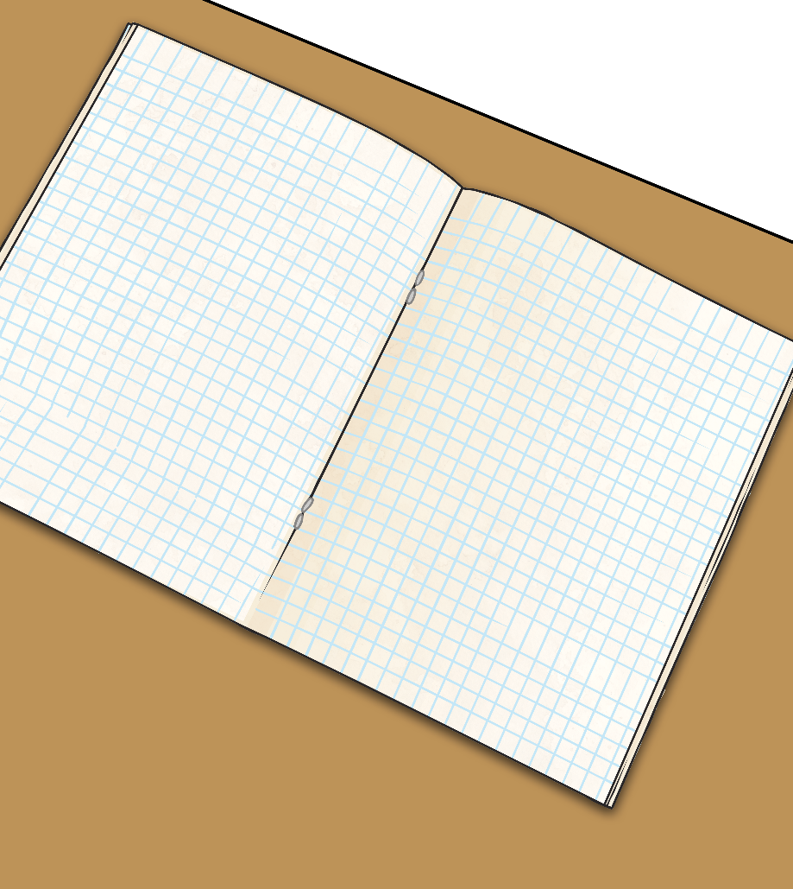
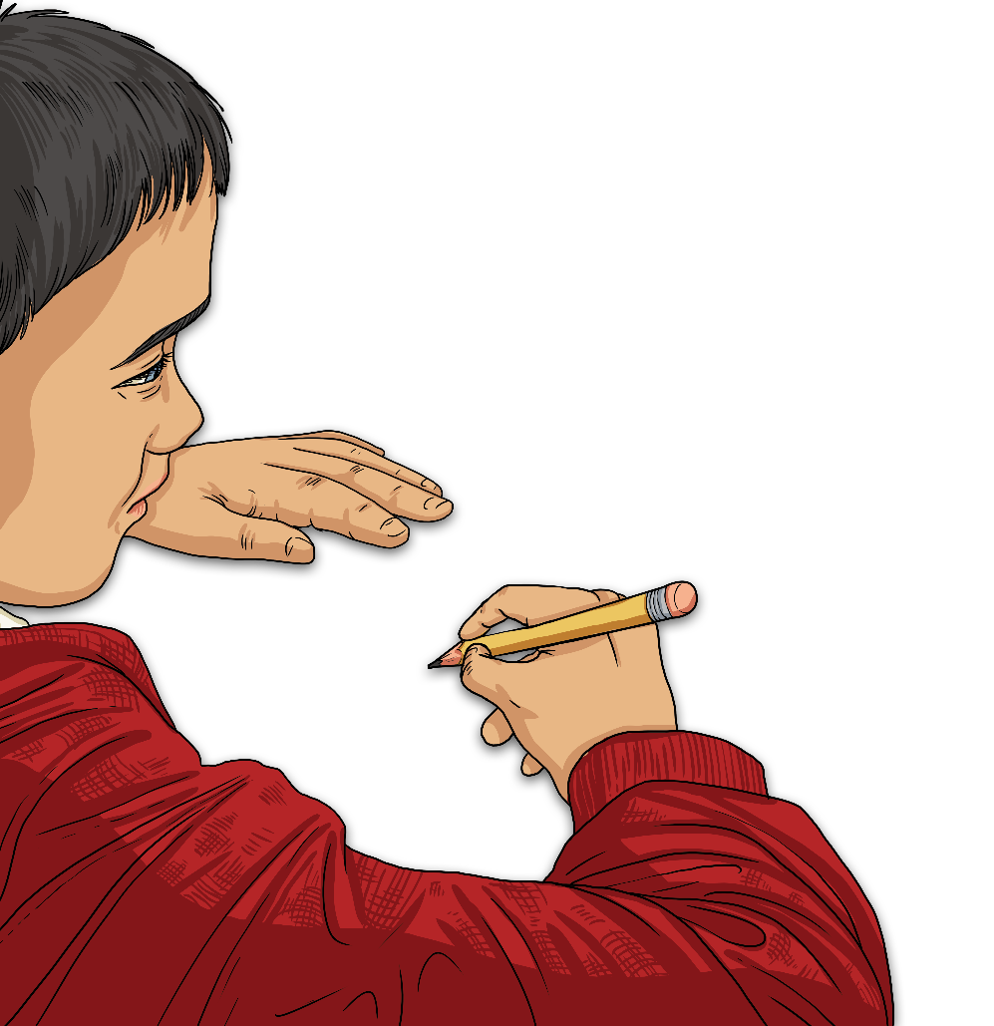
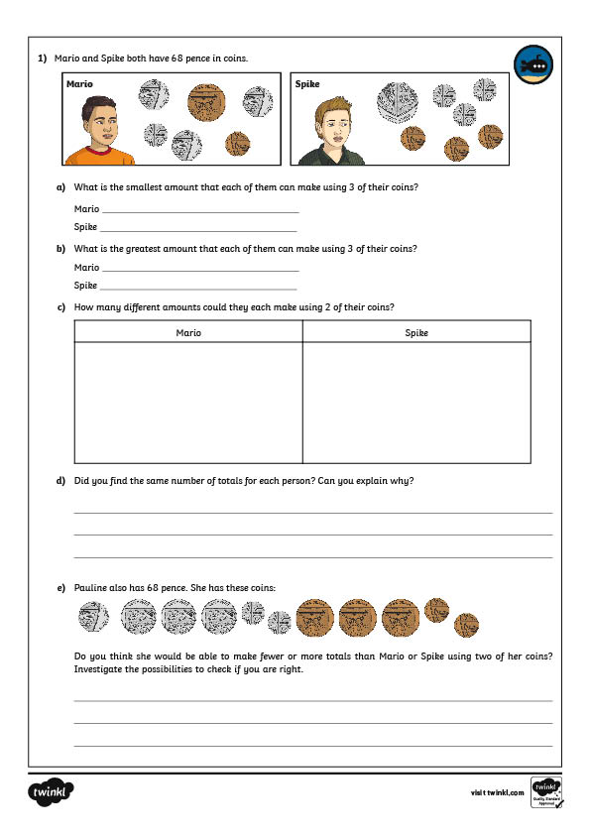
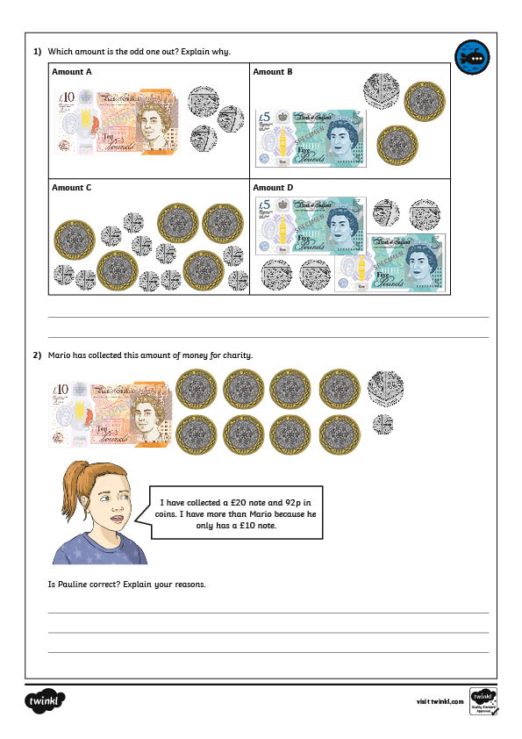
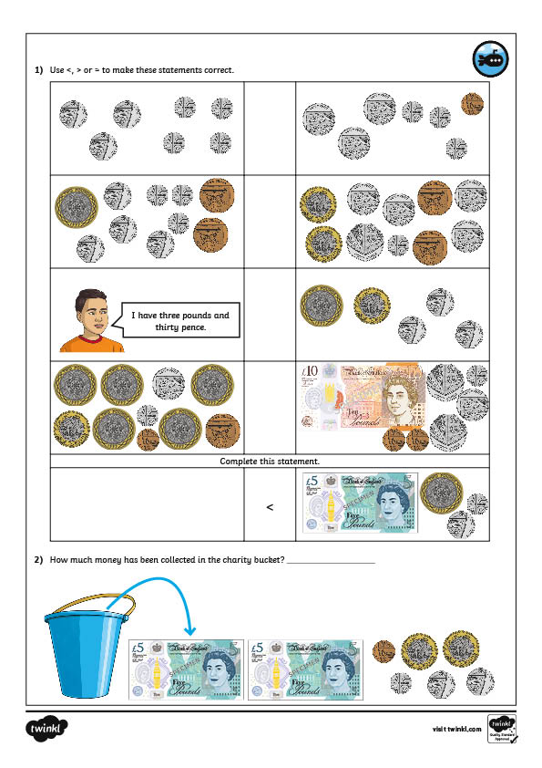
Pounds and Pence
Dive in by completing your own activity!

Slide 11
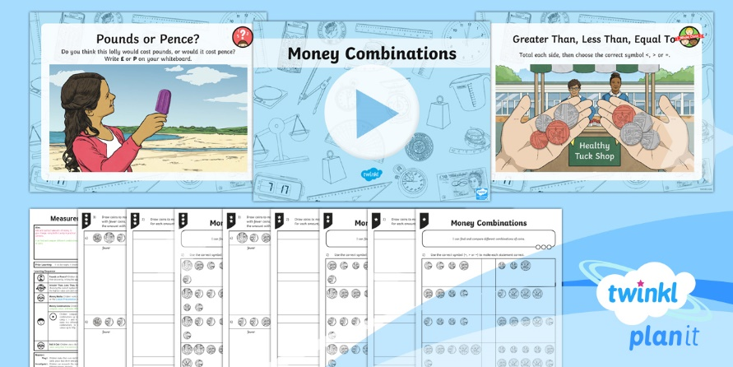
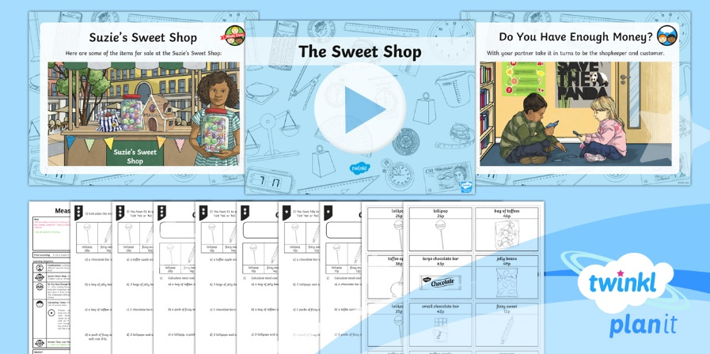
Need Planning to Complement this Resource?
National Curriculum Aim
Add and subtract amounts of money to give change, using both £ and p in practical contexts.
For more planning resources to support this aim, click here.
Twinkl PlanIt is our award-winning scheme of work with over 4000 resources.

