Slide 1
Ancient Egypt - Daily Life
Life during the time of Ancient Egypt was very different to now!

Slide 2
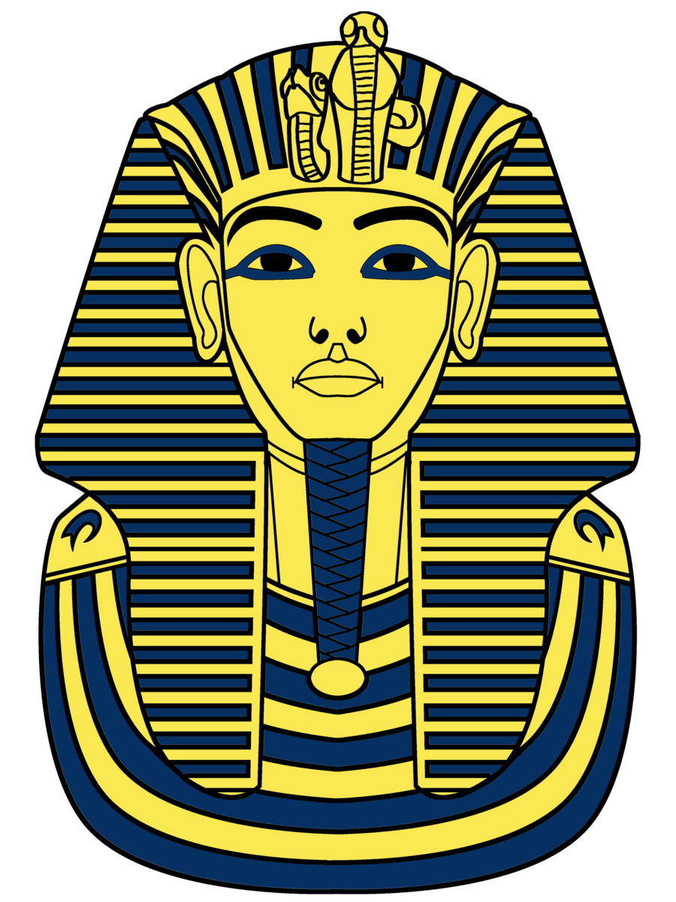
What is Ancient Egypt?
Ancient Egypt was one of the greatest civilisations.
Lasted from 3100 BC to 30 BC.
It was more advanced than European tribes.
Ancient Egyptians did a lot of things.
Taught us about maths, farming & medicine.
Famous for their amazing monuments, including the Pyramids.
There were 3 time period of Ancient Egypt:
Old Kingdom - building of pyramids.
Middle Kingdom - expansion of Egypt.
New Kingdom - Queen Cleopatra & Rome.

Slide 3
Life in Ancient Egypt:
Life in Ancient Egypt was very different to today in many ways.
We are going to look at how certain things were different including:
Food;
Clothes;
Jewellery & Makeup.
Men & Women;
Jobs;
Homes;
Sports & Pastimes.
Ancient Egypt was very different to how you live today! You are all going to be historians today. This means you will be looking at how life in Ancient Egypt compares to your life.

Slide 4
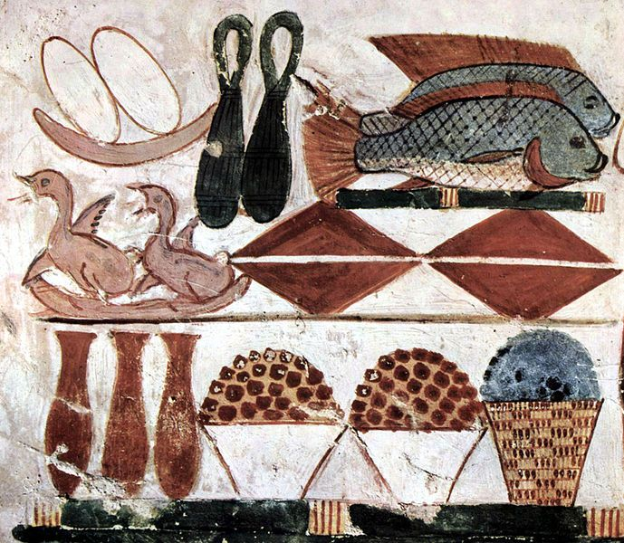
Ancient Egyptian Food:
Most common food eaten was bread.
They grew their own fruit & vegetables.
Most important thing grown was wheat.
Also raised goats & sheep on farms.
Used clay ovens to cook their food.
Most dishes used to eat from were made from clay.
Main drink was beer made from barley.
Fresh water hard to find.
Made wine from grapes, pomegranates & plums.

Slide 5
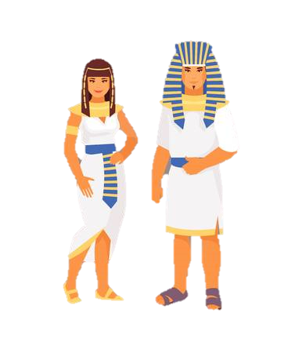
Ancient Egyptian Clothes:
Egyptians wore light clothes made from linen.
Richer people had nicer material.
Men wore a wrap around skirt tied with a belt.
Length changed depending on the time period.
Women wore a long, wrap-around dress.
Dresses were sometimes decorated with feathers or beads.
Children didn't wear clothes until 6 years old.
People often went barefoot.
Sometimes wore sandals made from leather or woven grass.

Slide 6
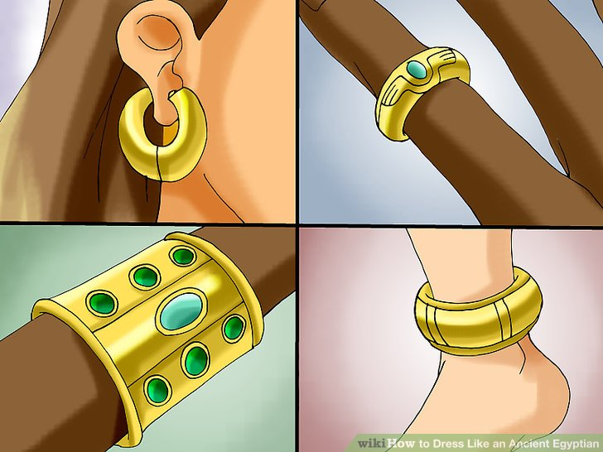
Ancient Egyptian Jewellery & Makeup:
Men & women wore jewellery.
Showed their wealth since only the rich could afford gold.
Also made them more attractive to the Gods.
Wore rings, earrings, bracelets, neck collars & pendants.
Men & women also wore makeup.
The main type was black or green eye shadow.
They used henna to dye their lips, nails & skin.

Slide 7
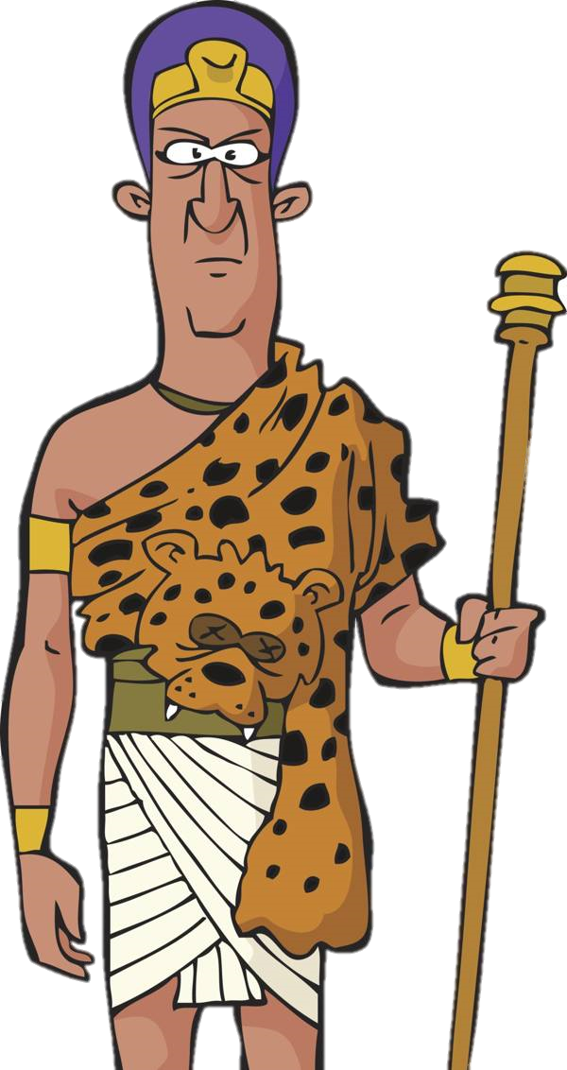
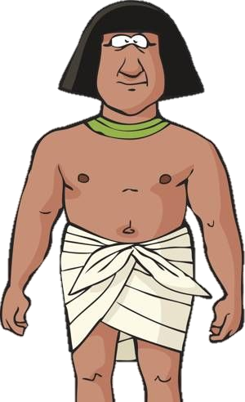
Ancient Egyptian Men:
Rich men worked all day.
Many spent their days trading along the Nile.
Many of the wealthiest men were priests.
Rich boys were taught to read & write.
Had lots of time to play.
Poor men mostly worked as farmers.
Worked long hours.
Boys often learned the job of their fathers.
Most poor boys didn’t go to school.

Slide 8
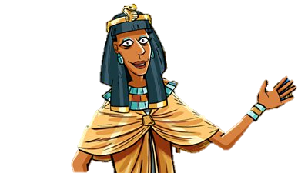
Ancient Egyptian Women:
Rich women could own land, run businesses & even bring charges on men to court.
Equal to men but not as powerful.
Oversaw the running of the homes.
Girls could get married at 12.
Girls & women played lots of music.
Also practiced singing & dancing.
Poor women stayed at home.
Took care of the home & children.
Taught girls to take care of the home.

Slide 9
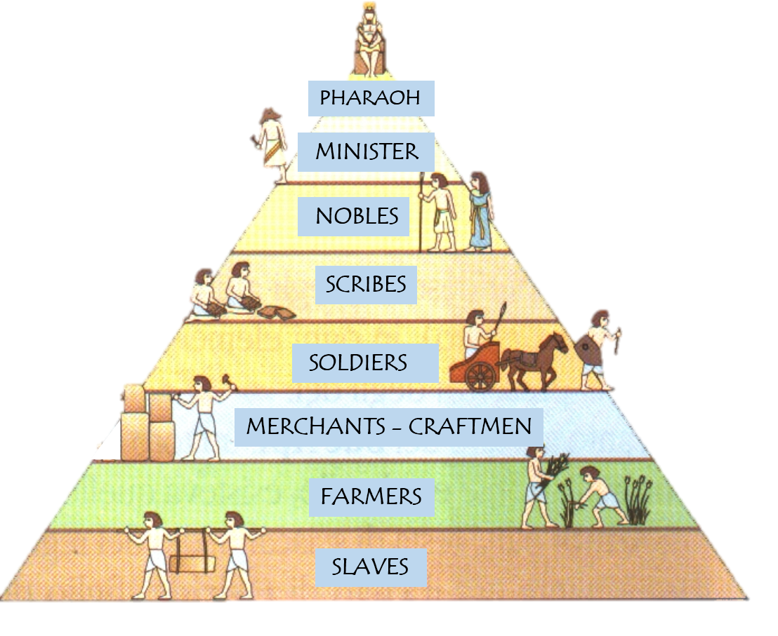
Ancient Egyptian Jobs:
Farmer - most people were farmers.
Grew barley, wheat & vegetables.
Grew crops on banks of River Nile.
Craftsmen - wide variety of jobs.
Included carpenters, weavers, potters & jewellers.
Scribes - only people who could read & write.
Came from rich families.
Took years to learn hieroglyphics.
Soldiers - some of the hardest work.
Trained a lot.
Helped with farming & construction.
Priests - responsible for temples & religion.

Slide 10
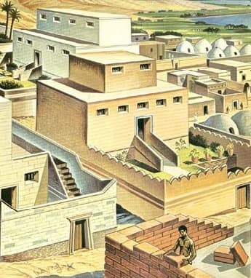
Ancient Egyptian Homes:
Average family lived in sun baked mud homes.
Usually one-floor & small.
Had a basement & four rooms.
Had little furniture & few windows.
Had flat roofs - could be slept on when it was too hot inside.
Rich homes were made from brick & wood.
Had many rooms including walled garden.
Often had a room that was a shrine to their favourite God.

Slide 11
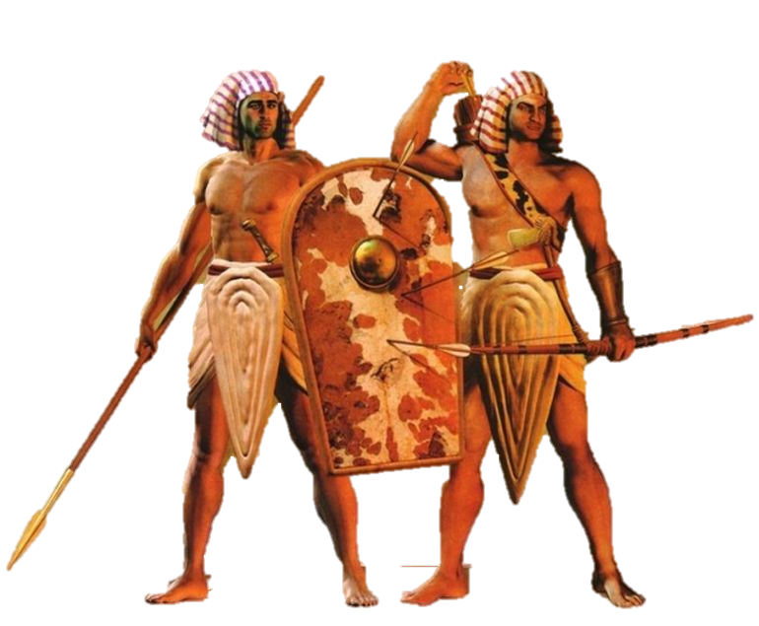
Ancient Egyptian
Sports/Pastimes:
Archery - competitions recorded in temples.
Show of strength & accuracy.
Usually kings & princes took part.
Javelin - linked to hunting.
Involved hitting a moving target.
Tug of Hoop - similar to tug of war.
Tried to get the hoop away from the other player.
Was a test of strength.
Hockey - played using palm tree branches.
Ball made from papyrus & leather.
Referee kept score.
Senet - primitive from of chess.

Slide 12
Let’s Recap:
So…Now we have looked a little bit at daily life in Ancient Egypt! Now you can see how many things you have today are different to Ancient Egypt!
Over the last few weeks, we have looked at different aspects of Ancient Egypt. Try to answer the following questions – if you don’t know the answer, you’ll need to research it on the internet.

Slide 13
Please answer in complete sentences
What were the Egyptian clothes made from?
What provided Egypt with fertile land?
What was the main food of the Egyptians?
Which fruits did the Egyptians eat?
Did Egyptian children go to school?
What type of makeup did men and women use?
Why did the Egyptian men and women wear jewellery?
What did the Egyptians wear on their feet?
What is Senet?
Why did the Egyptian houses have flat roofs?
What were the three periods of Ancient Egypt?
How was food cooked?
Why was fresh water hard to find for the Ancient Egyptians?
What age could Egyptian girls get married?
Which job role would write hieroglyphics?
What was a hockey ball made from?
What was a shaduf?
Can you name 4 pharaohs?
Why were there only a few windows in their homes?
What was Ba and Ka?

