Slide 1
Friday 26th March
Mrs Horsley

Slide 2
Maths
Please see the Easter worksheets
Worksheet 1 focuses on timetables
Worksheet 2 focuses on word problems – please write down how you have worked out each answer.

Slide 3
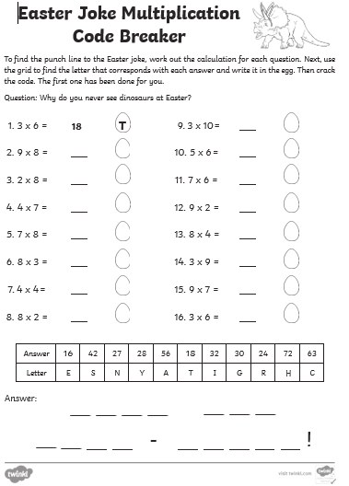
Worksheet 1

Slide 4
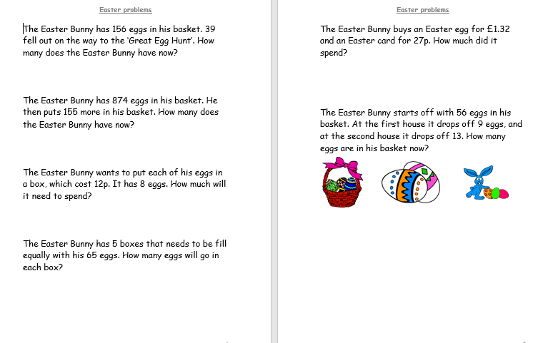
Worksheet 2

Slide 5
English

Slide 6
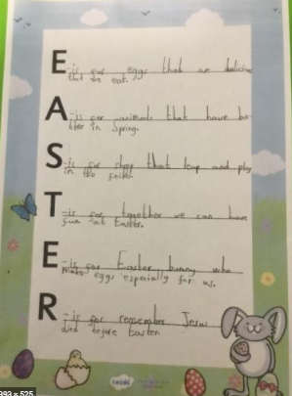
Create your own Easter Acrostic Poem

Slide 7
Aim
To recognise the features of acrostic poems.
Success Criteria
I know that acrostics have a topic word hidden in the first letter of each line.
I can look for the poem’s theme by reading the first letters vertically.
I understand that acrostics don’t have to rhyme.

Slide 8
Acrostic Examples
What is each poem about?
R
O
A
L
D
D
A
H
L
Revolting rhymes
Oompa-Loompas
Angry farmers
Lazy aunts
Dangerous witches
Dream blower
Adventurous animals
Horrible headteacher
Lickable wallpaper
I
C
E
C
R
E
A
M
It’s my favourite food
Cold as the inside of a fridge
Every sunny day
Can’t wait
Running to the van
Empty out the money
‘Any sauce on that, love?’
Mmmmmm, yummy!

Slide 9
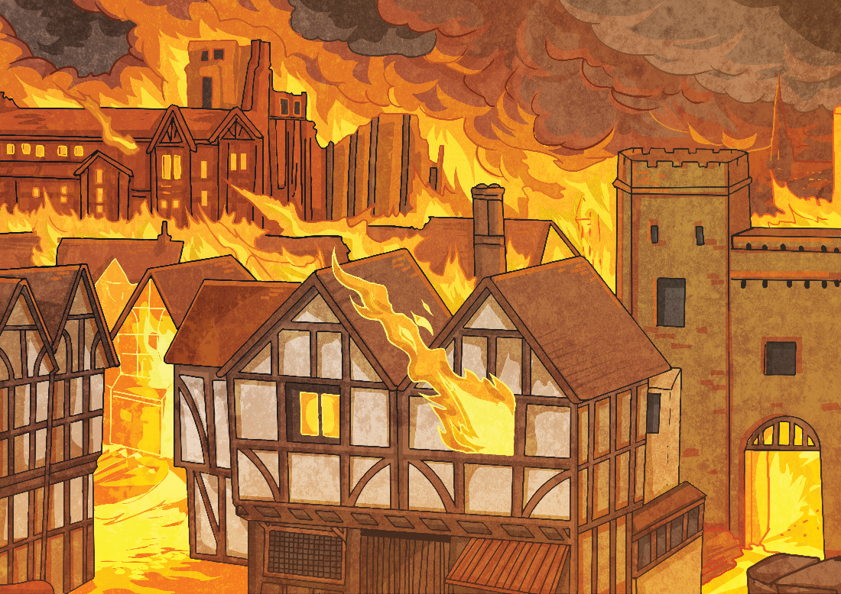
Acrostic Examples
What is the poem about?
Gigantic flames
Remember 1666
Every child knows
Ash floated everywhere
Thousands of homes destroyed
Flames all around
Inside the bakery
Red sky
Everything covered in soot
Over the city
From house to house
Lots of people escaped
On foot, by boat and carriage
Nearly every house
Demolished
On Pudding Lane – Help! Help! But
Not many people died.
G
R
E
A
T
F
I
R
E
O
F
L
O
N
D
O
N

Slide 10
Acrostic Features
What did you notice?
Poetic devices may be used.
The first letter of each line spells out the poem’s theme vertically – what’s this one about?
alliteration
simile
I
C
E
C
R
E
A
M
It’s my favourite food
Cold as the inside of a fridge
Every sunny day
Can’t wait
Running to the van
Empty out the money
‘Any sauce on that, love?’
Mmmmmm, yummy!
Lines can be different lengths

Slide 11
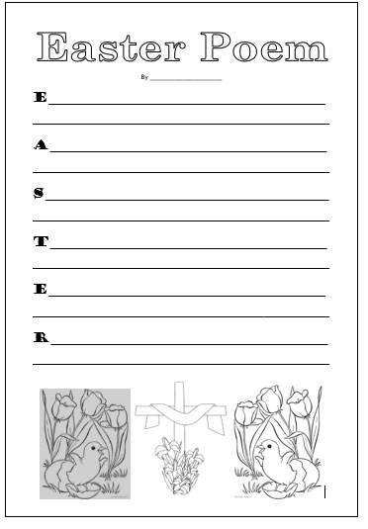
Remember to illustrate your Easter Poems

Slide 12
ART
Competition

Slide 13
Who can draw the best Spring/Easter picture?
Things to think about:
Detail
Colour
Shading
Filling the page
Please send all entries to year3.ellington@school360.co.uk
Winner to be announced when we are all back in class

