Slide 1
Monday
English
Notes:
1
1
1
1

Slide 2
Learning Objective
: to be able to write in a range of poetry styles
Notes:
2

Slide 3
CINQUAIN POEMS

Slide 4
Cinquain
Line 1: 1 word title (noun)
Line 2: 2 adjectives
Line 3: 3 words that express action (-ing)
Line 4: a phrase about the noun
Line 5: 1 synonym for the title

Slide 5
penguin
black, white
waddling, swimming, leaping
a tuxedo in the cold water
emperor
rodeo
loud, busy
roping, riding, exciting
dozens of horses in the arena
stampede
party
happy, cheerful
singing, eating, playing
my tenth birthday party
perfect
dessert
cold, creamy
eating, giggling, licking
cone with three scoops
ice cream

Slide 6
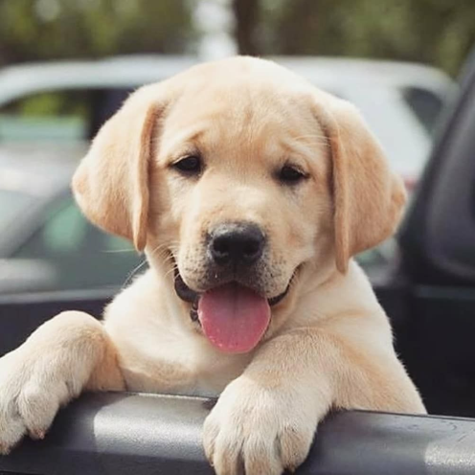
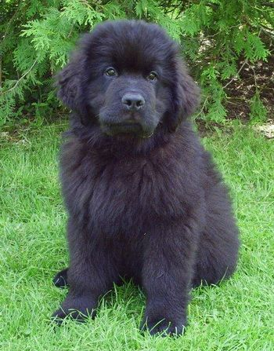
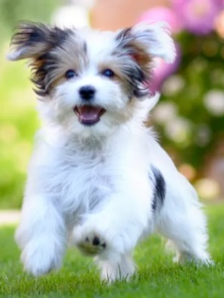
Puppy,
Lively, naughty,
Growling, jumping, chewing,
A playful bundle of trouble,
Labrador.
Noun
Adjectives
Words expressing action
Phrase
Synonym

Slide 7
Haiku

Slide 8
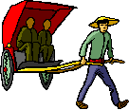
A haiku is a Japanese poem with three lines.

Slide 9
Each line of a haiku has a certain number of syllables.

Slide 10
I have yellow stripes
I fly to all the flowers
I’m making honey.

Slide 11
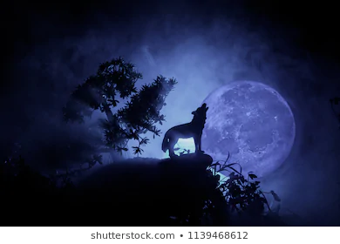
Listen to the sounds
Hear the cry of the lone wolf
Echoing at night.

Slide 12
Your Task
Write a cinquain poem Write a haiku poem
with a subject of your choice with a subject of your choice
Line 1: 1 word title (noun) 1st line - 5 syllables
Line 2: 2 adjectives 2nd line - 7 syllables
Line 3: 3 words that express action (-ing) 3rd line - 5 syllables
Line 4: a phrase about the noun
Line 5: 1 synonym for the title

Slide 13
Tuesday
English
Notes:
13
13
13
13

Slide 14
Learning Objective
: to be able to write in a range of poetry styles
Notes:
14

Slide 15
Kenning

Slide 16
The word kenning is derived from the Old Norse phrase kenna eitt við, which means "to express a thing in terms of another", and is found throughout Norse, Anglo-Saxon and Celtic literature.

Slide 17
Put this PowerPoint as a slide show so that you don’t see the answer to my questions.

Slide 18
What do you think the poem below is about?
Night prowler, Midnight howler, Meat hunter, Air sniffer, Hackle raiser, Throat ripper.

Slide 19
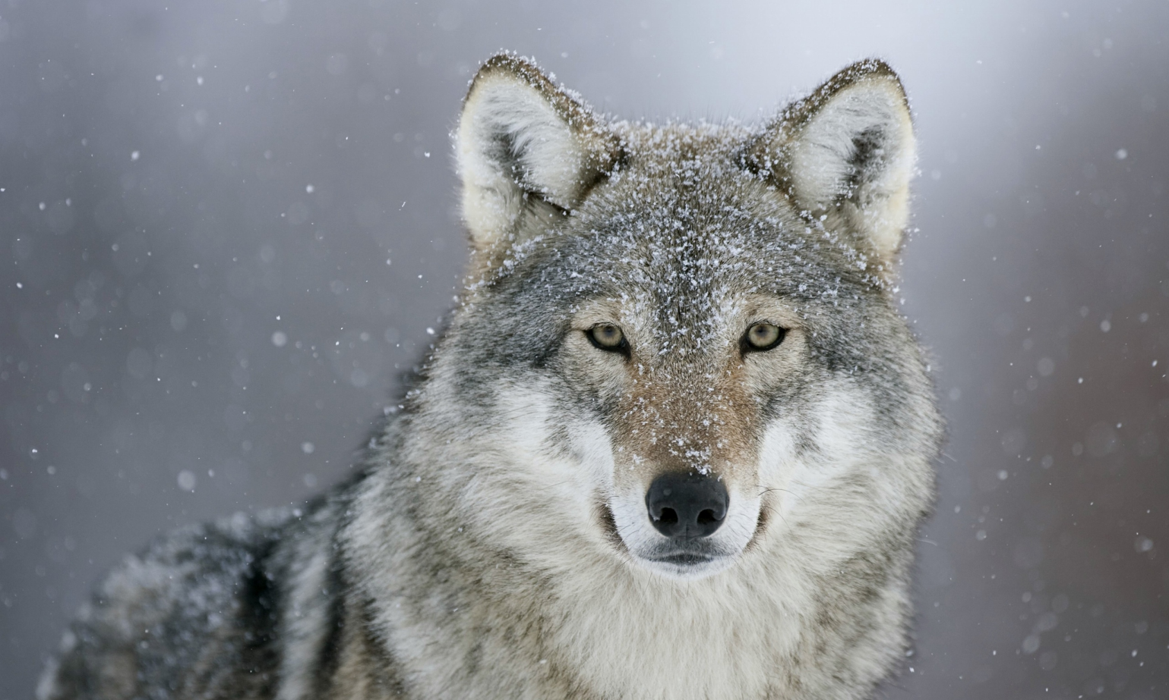
A wolf

Slide 20
What do you think the poem below is about?
Fish scarer, Body tearer, Sea hunter, Limb cruncher, Fish scoffer, Bone crusher, Sharp gnasher, Skull smasher.

Slide 21
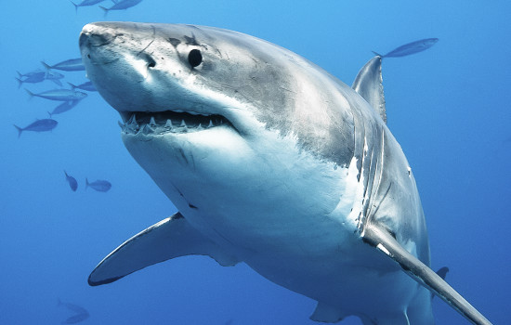
A shark

Slide 22
What do you think the poem below is about?
Boat sinker, Wave bringer, People swallower, Sand holder.

Slide 23
The sea

Slide 24
What do you think the poem below is about?
Tree stomper, Plant eater, Trunk washer, Tusk owner.

Slide 25
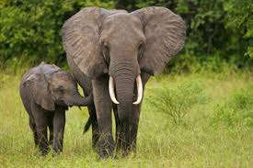
An elephant

Slide 26
Do you notice something about the structure of the poems?
Tree stomper,
Plant eater,
Trunk washer,
Tusk carrier.
noun
verb ending in ‘er’
noun
verb ending in ‘er’
verb ending in ‘er’
noun
verb ending in ‘er’
noun

Slide 27
How do I write one ?
It is not as hard as it seems.
First think of something you want to be the subject of your Kenning.
Such as….
A bus driver

Slide 28
Next...
Think about what the subject does….
Gives tickets
Takes money
Steers the bus
Follows a route
Drives carefully
Watches the road

Slide 29
Finally...
Compose your poem….
Ticket giver
Money taker
Wheel turner
Route follower
Careful driver
Road watcher

Slide 30
Your Task
Think of a subject
Think of the things that subject does
Remember to put the noun first and then
the verb (which must end in er)

Slide 31
Wednesday
English
Notes:
31
31
31
31

Slide 32
Learning Objective
: to be able to write in a range of poetry styles
Notes:
32

Slide 33
Diamanté

Slide 34
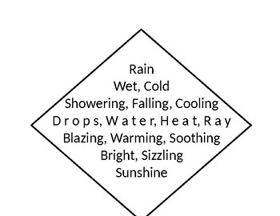
What can you tell me about the structure of a diamanté poem?

Slide 35
The second noun is the opposite of the first noun

Slide 36
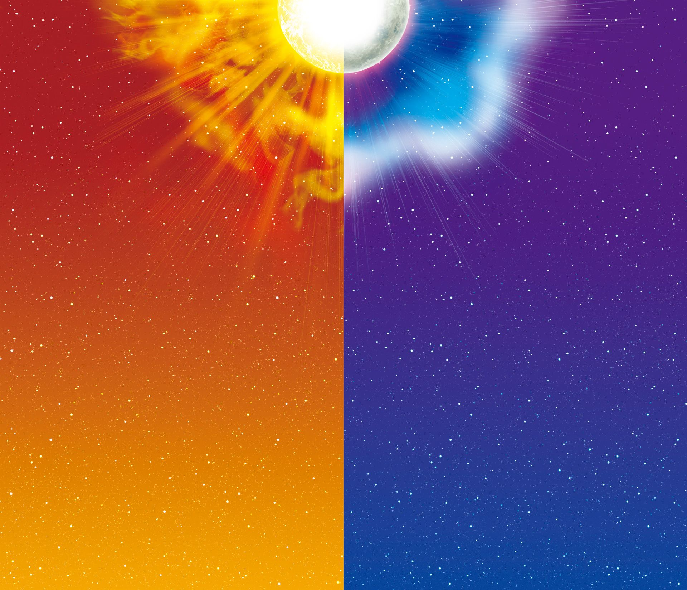
Sun
Golden, Glorious
Glowing, Warming, Burning
Fire, Sphere, Reflector, Orbiter
Waning, Waxing, Changing
Silvery, Serene
Moon

Slide 37
Your Task;
Write a diamanté poem with two subjects of your choice.

Slide 38
Thursday
English
Notes:
38
38
38
38

Slide 39
Learning Objective
: to be able to write in a range of poetry styles
Notes:
39

Slide 40
Limerick

Slide 41
The structure of a limerick is:
1st, 2nd and 5th lines have the same rhythm and rhyme
3rd and 4th rhyme with each other

Slide 42
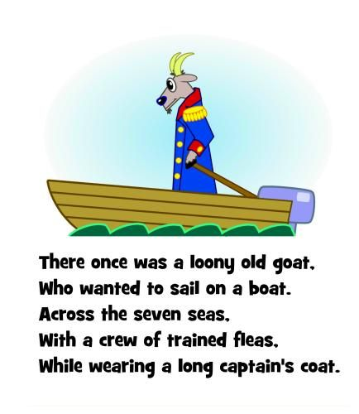
Limerick

Slide 43
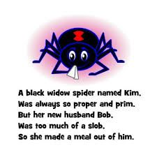
Limerick

Slide 44
Limerick
There was an old man called Greg,
Who tried to break open an egg,
He kicked it around,
But fell on the ground,
And found that he’s broken his leg.

Slide 45
Your task: To write a limerick
1st, 2nd and 5th lines rhyme with each other
3rd and 4th rhyme with each other

Slide 46
Friday
English
Notes:
46
46
46
46

Slide 47
Learning Objective
: to be able to write in a range of poetry styles
Notes:
47

Slide 48
Palindrome

Slide 49
Palindrome Poem can be read forwards and backwards – in some cases this changes the message that the writer wants to give to the reader.
Let’s look at an example

Slide 50
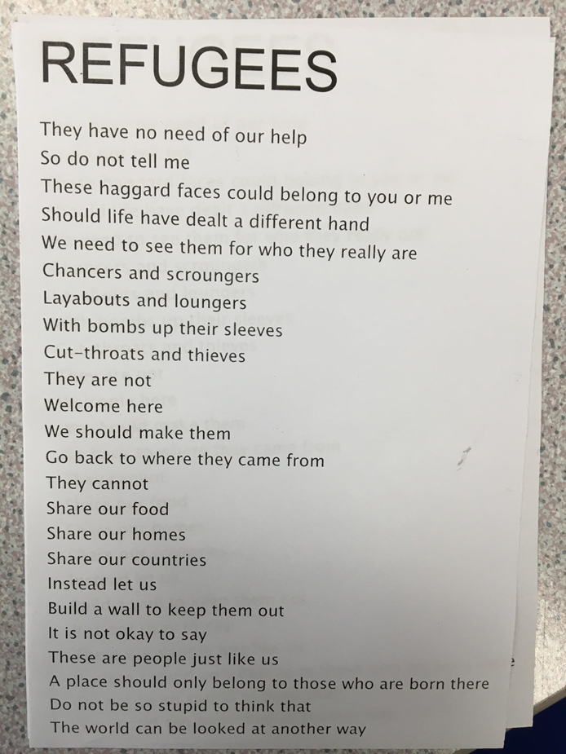
When we first read
this poem it is very
upsetting to think
that we would think
of others in this
way but…
read from the last
line and read up
the poem; now
what do you
notice?

Slide 51
Your Task
On slide 53, I have put an example of
a palindrome poem;
write out the poem in your neatest
handwriting ☺ and then tell me what
your thoughts are on your first reading
from top to bottom and then your
thoughts reading from bottom to top.
Example on the slide 52

Slide 52
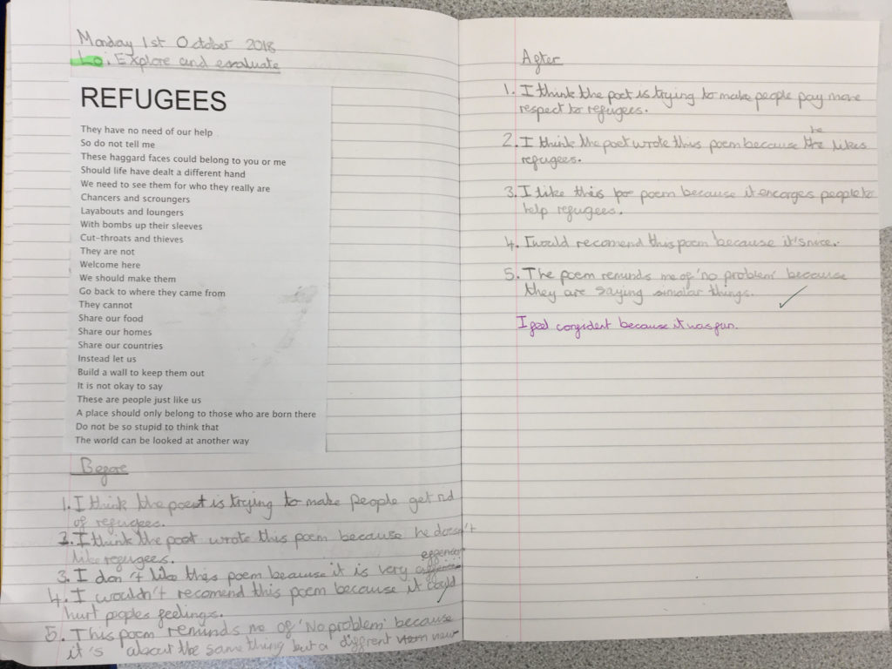

Slide 53
