Slide 1
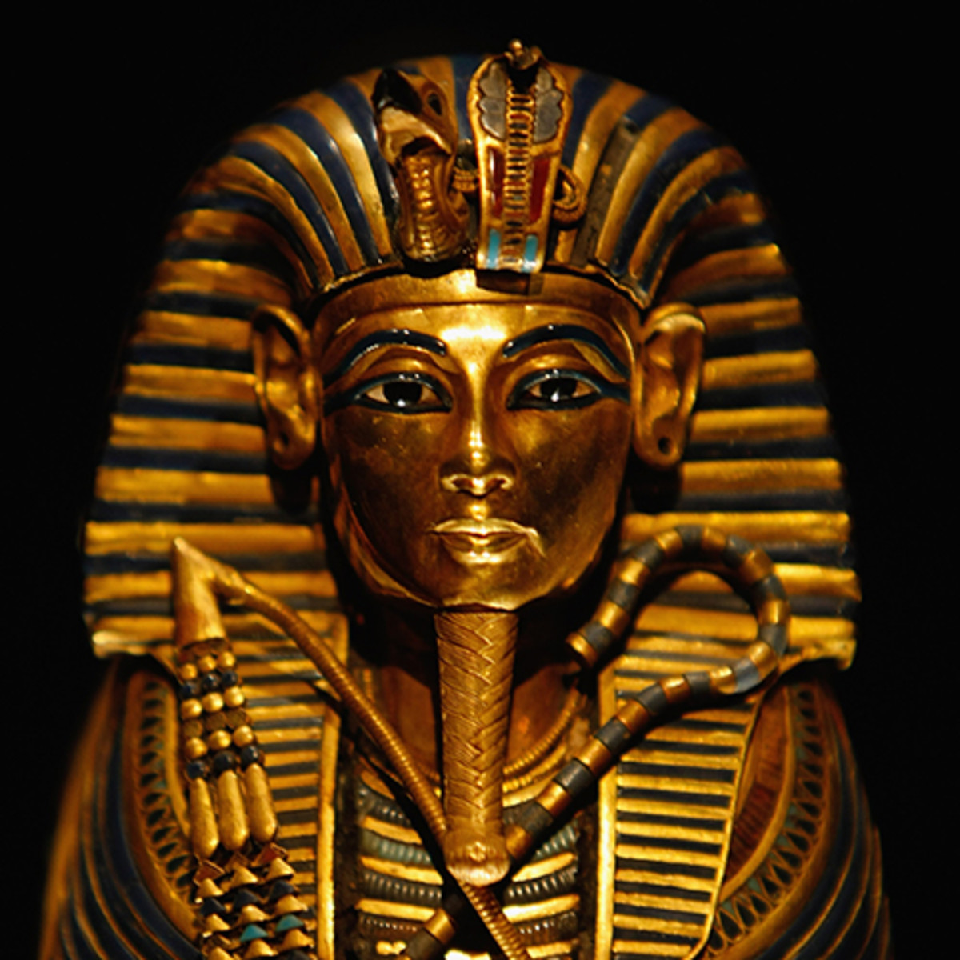
HISTORY

Slide 2
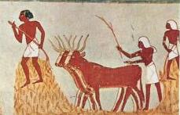
Farming in Ancient Egypt

Slide 3
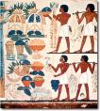
What crops did the Egyptian Farmers grow?
Egyptians grew crops such as wheat, barley, vegetables, figs, melons, pomegranates and vines (grapes).

Slide 4
What else did they grow?
They also grew flax which was made into linen.

Slide 5
Where did the farmers grow their crops?
The Egyptians grew their crops along the banks of the River Nile on the rich black soil which was left behind after the yearly floods.

Slide 6
How many seasons were there in Ancient Egypt?
Egyptian farmers divided their year into three seasons, based on the cycles of the River Nile

Slide 7
Akhet The Flooding Season.
June - September.
No farming was done at this time, as all the fields were flooded. Many farmers worked for the pharaoh instead, building pyramids or temples.

Slide 8
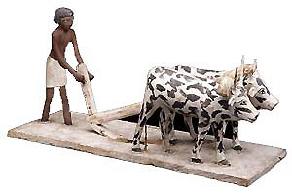
Peret The growing season
October-February:
In October the floodwaters receded, leaving behind a layer of rich, black soil. This soil was then ploughed and seeded.

Slide 9
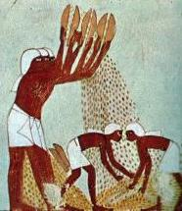
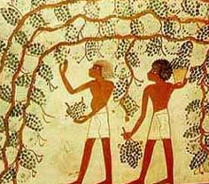
Shemu The Harvesting Season
March-May.
The harvest season was the time when crops were cut and gathered. It was also the time to repair the canals ready for the next flood.

Slide 10
How was the corn harvested?
Reapers cut the ripe corn with wooden sickles, edged with sharp flints.
Women and children followed behind the reapers to collect any fallen ears of corn.

Slide 11
What happens next?
Cattle were used to trample over the cut corn to remove the grain from the ears.
Then the grain was tossed into the air so the breeze blew the light useless chaff away.

Slide 12
Your Task:
Think of a creative way to tell people how the Ancient Egyptians used to farm. You will need to include the technical vocabulary and pictures would be helpful to the reader.

