Slide 1
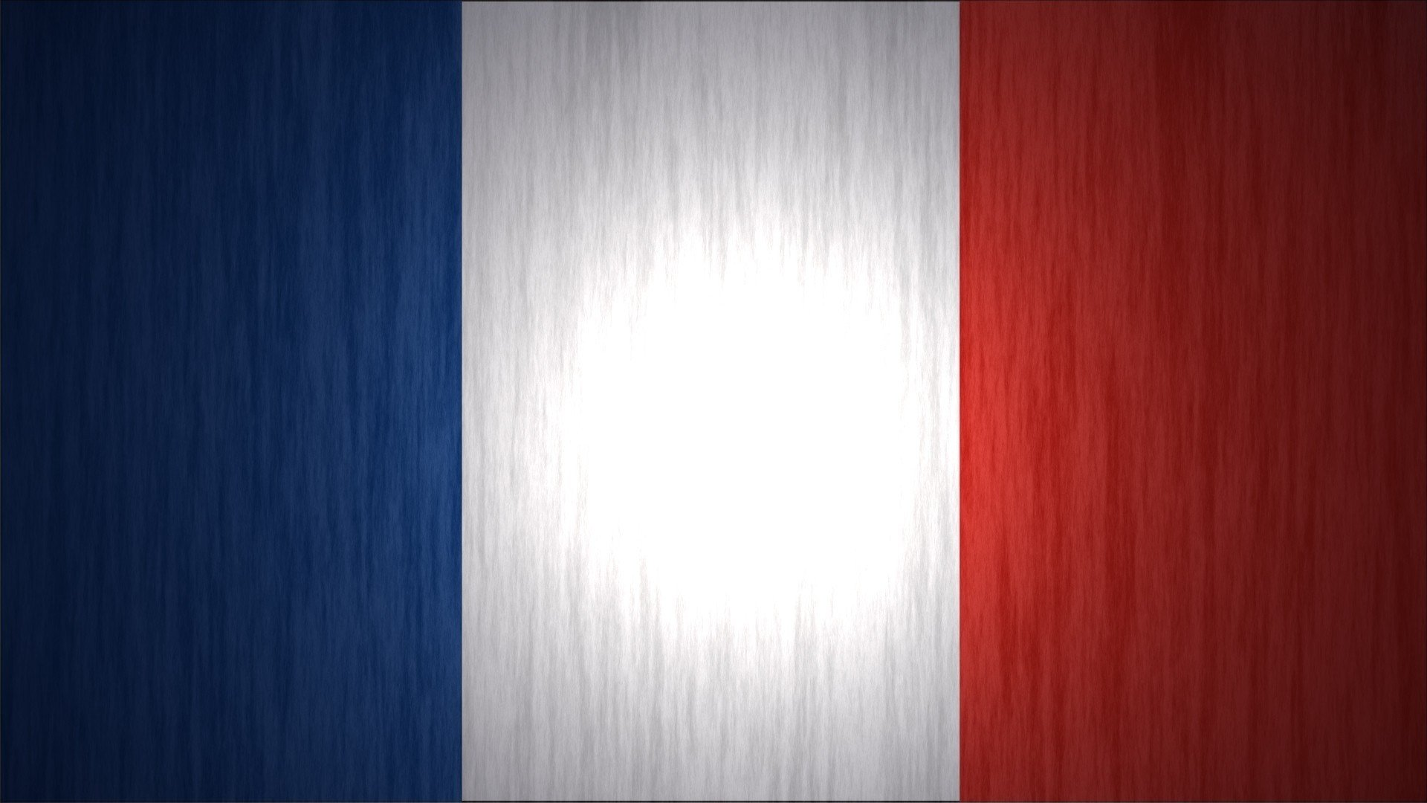

Slide 2
Learning Objective WALT
To know the word for colours in French
Success Criteria WILF
That you can name some of the colours
That you use the word bank to find out the word for the animal in French
Notes:
2

Slide 3
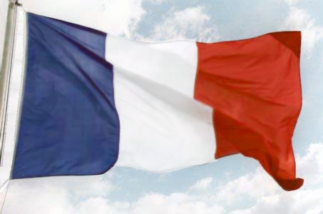
Couleurs

Slide 4
violet

Slide 5
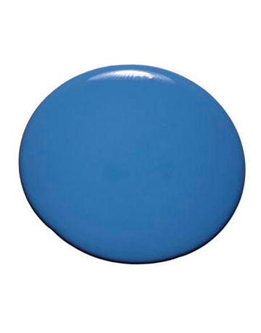
bleu

Slide 6
vert

Slide 7
jaune

Slide 8
orange

Slide 9
rouge

Slide 10
noir

Slide 11
blanc

Slide 12
gris

Slide 13
marron

Slide 14
rose

Slide 15
Please colour the animals in the following colours.
To find out the French words for the animals, see the word bank below the picture.
chameau - marron tigresse – jaune et noir serpent- vert
manchote – noir et blanc rhinocéros – rose girafe - rouge
ours - bleu guenon – vert et orange autruche – gris
zébresse – rouge et jaune hippopotame - violet phoque – gris et rose
kangourou – bleu et orange l’éléphant – rose et noir renard – marron
lion – rose et violet crocodile – bleu et noir oiseau – multicolore
REMEMBER TO STAY IN THE LINES! ☺

