Slide 1
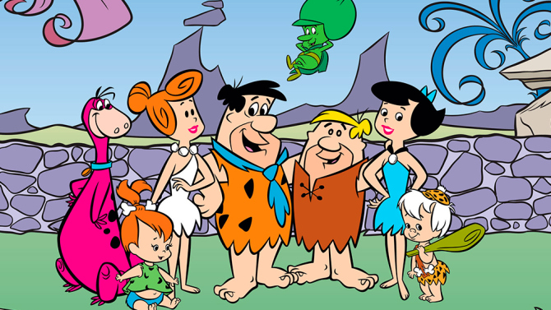
Stone Age to Iron Age:
1. Stone Age
Learning Objectives:
Demonstrate an understanding of what and when the Stone Age was.
To select relevant information about Skara Brae.
Success Criteria
I can explain how people used to live in Skara Brae and relate it to the Stone Age.

Slide 2
What was the Stone Age???
Watch the following clip…
Do you think this is what the Stone Age was like?
Watch the clip 1 more time. This time write down everything you think is wrong.
https://www.youtube.com/watch?v=3s-MnvKIqb8
Demonstrate an understanding of what and when the Stone Age was.

Slide 3
Who found the most ANACHRONISMS????
An anachronism is an item that is in the wrong time period.
Look at the picture on the next slide. What do you think are the anachronisms in it?

Slide 4
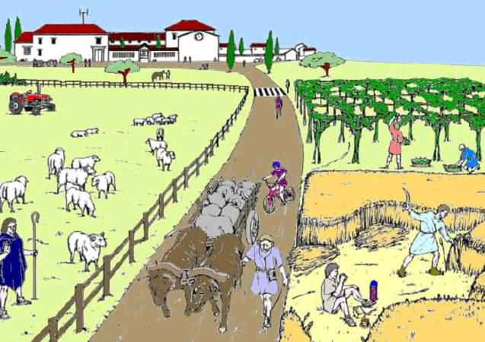

Slide 5
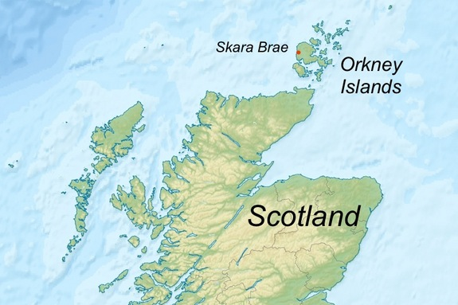
Life in the Stone Age
Today you will examine a Stone Age community called Skara Brae.
To select relevant information about Skara Brae.

Slide 6
Stone Age
Stone Age: Lasted about 2.5million years. Creation and use of stone tools.
3 periods of the Stone Age…
Demonstrate an understanding of what
and when the Stone Age was.

Slide 7
Task 1
Look at the following slides carefully. These pictures are of Skara Brae. In your exercise books or on a piece of paper, write down anything you think might be important to how people lived in Skara Brae.
CHALLENGE:
Can you compare the homes in Skara Brae to your home.
i.e. The houses in Skara Brae are made from stone, while my house is made from …...
To select relevant
information about Skara Brae.

Slide 8
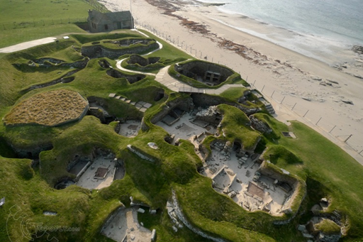
To select relevant information about Skara Brae.

Slide 9
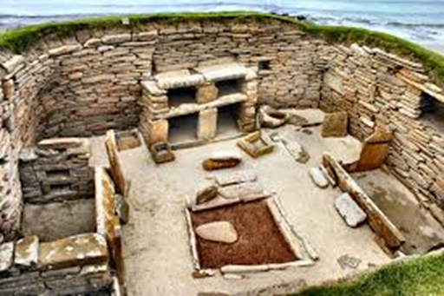
To select relevant information about Skara Brae.

Slide 10
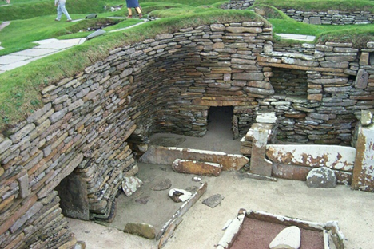
To select relevant information about Skara Brae.

Slide 11
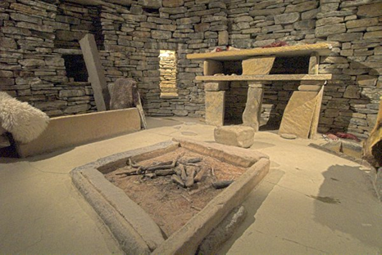
To select relevant information about Skara Brae.

Slide 12
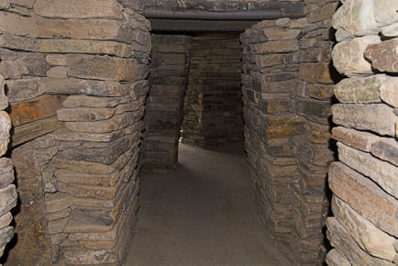
To select relevant information about Skara Brae.

Slide 13
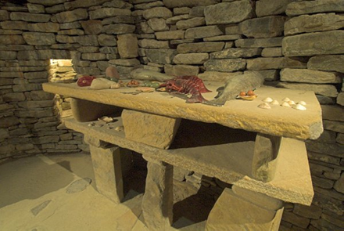
To select relevant information about Skara Brae.

Slide 14
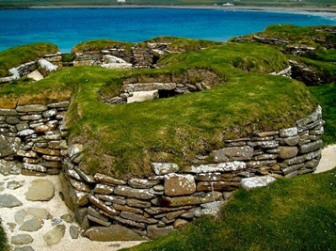
To select relevant information about Skara Brae.

Slide 15
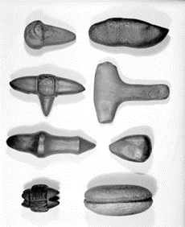
To select relevant information about Skara Brae.

Slide 16
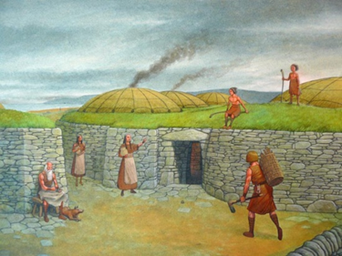
To select relevant information about Skara Brae.

Slide 17
Task 2
The next slide shows you a room in Skara Brea. On your Skara Brea Activity worksheet can you label what things are.
To select relevant information about Skara Brae.

Slide 18
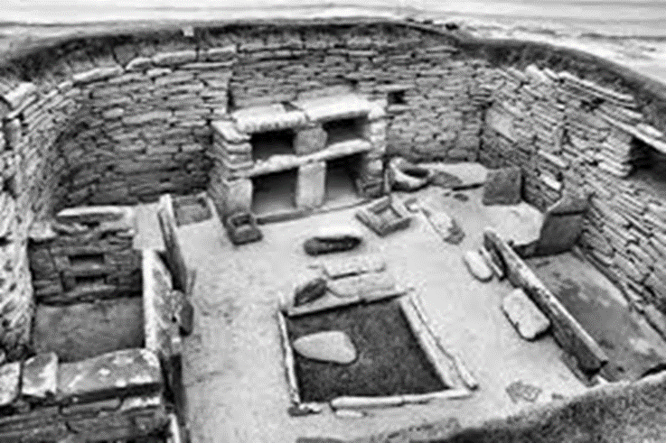
Dresser
Storage Boxes
Fire
Bed

Slide 19
Skara Brae Facts
Located in Orkney, an island to the North of Scotland
Late Neolithic Settlement
People lived there between 3200 and 2200BCE.
8 houses have been found at Skara Brae.
The 1st of the houses were found because of a storm in 1850 which destroyed ‘sand dunes’ and revealed houses.
7 of the 8 houses all have the same layout.
Skara Brae is now a World Heritage Site.
To select relevant information about Skara Brae.

Slide 20
Task 3
Complete the worksheet.
Find out additional facts on the websites that you find interesting.
www.bbc.co.uk/scotland/learning/primary/skarabrae/
www.educationscotland.gov.uk/scotlandshistory/earlypeople/skarabrae/
http://primaryfacts.com/2424/skara-brae-facts-and-information-about-the-neolithic-settlement/

