Slide 1
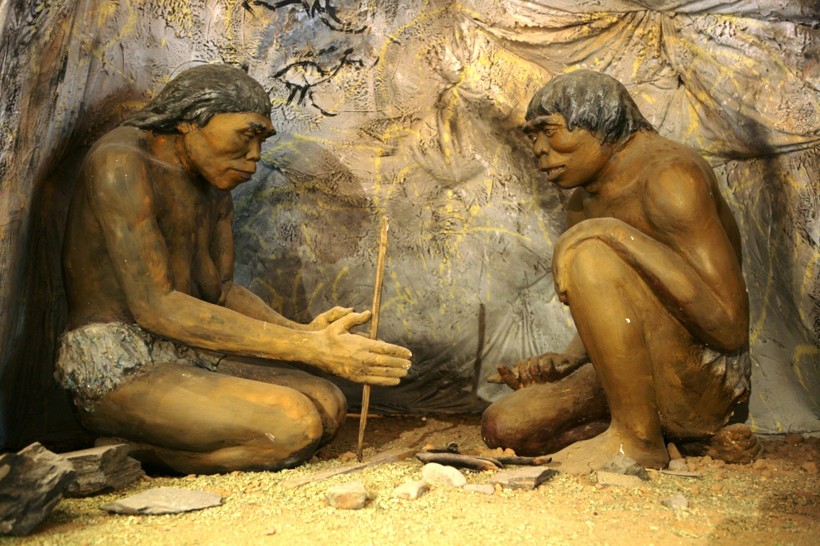
Step into...
The Stone Age

Slide 2
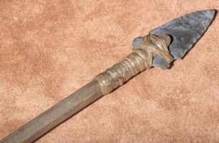
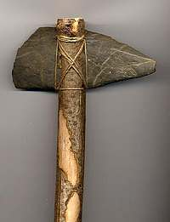
Why is it called the stone age?
The stone age is the first period of human history. It is called the stone age because stone was used to make tools and other objects during this time period. The first humans existed 2 million years ago.
Harpoon
Axe

Slide 3
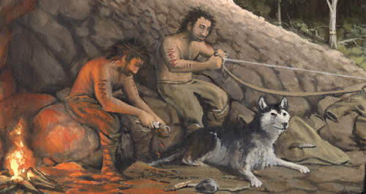
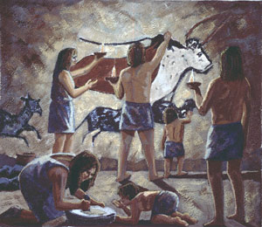
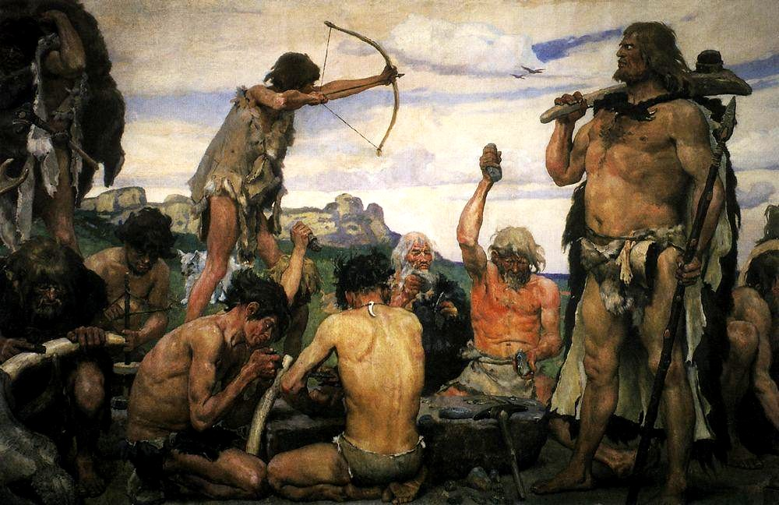
What was it like in the stone age?

Slide 4
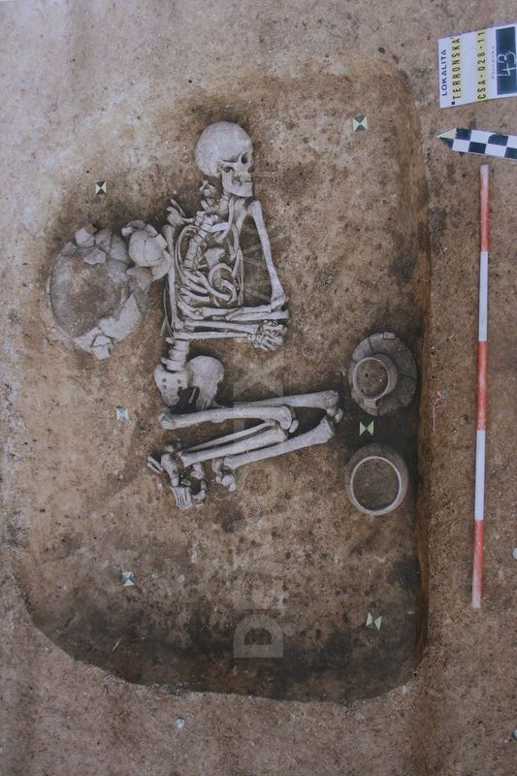
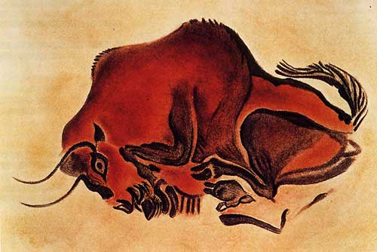
How do we know about the stone age?
Archaeologists are like detectives, they have discovered what the first hunter-gathers lived like by digging up skeletons and weapons. They have used these as clues to try to understand the how these Neanderthals lived in 120,000BC.
Archaeologists have discovered cave
Paintings which show how the Neanderthals might have lived and communicated in the Stone Age. The painting of a Bison was found in the caves at Altamira in Spain.

Slide 5
Periods in the stone age
The stone age is the longest period of human history (it can be split into three stages).
Palaeolithic period (2 million years ago)
First stone tools invented
Mesolithic period (10,000BC)
Tools, bow and arrows to hunt deer.
Neolithic period (8000BC)
The start of farming

Slide 6
What was the stone age like?
Because the stone age happened all over the world, our ancestors had to survive through harsh weather, changing climate and even wild animals such as mammoths and wild boar.
Stone Age weather report:
http://www.youtube.com/watch?v=QdTk5OvtvM4

Slide 7
Hunters & Farmers
http://www.youtube.com/watch?v=gGkmPqdjAeI
http://www.youtube.com/watch?v=fu9-7ZJ1h1g

Slide 8
Facts about the stone age
There were no dinosaurs in the Stone Age. Dinosaurs died around 65 million years ago.
Mammoths and Sabre-toothed Cats did live at the same time as Stone Age people. And Cave Bears.
We often talk about The Ice Age meaning the last ice age which took place towards the end of the Stone Age.
At the beginning of the Stone Age people didn't know how to make fire but made use of naturally occurring fires after lightning strikes.
It wasn't just adults who created cave art, children made cave paintings too.

Slide 9
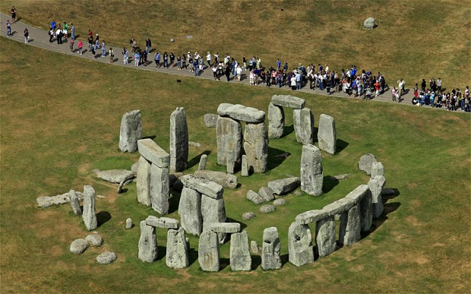
Stonehenge
Stonehenge was built in phases from about 3100 B.C. to 1600 B.C. Yes, more than 5,000 years ago—during the Stone Age, long before the wheel was invented! We know this because scientists have used carbon dating to analyze the age of animal bones buried at the site.
Nobody knows where it came from, how the stones got there or why its there. It is one of the biggest mysteries.

