Slide 1
Wednesday

Slide 2
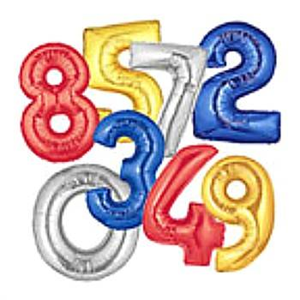
Maths
Notes:
2
2
2
2

Slide 3
Get an adult at home to give you quick fire questions on
Times Tables

Slide 4
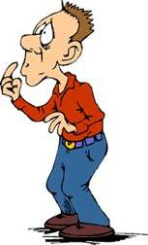
Calculating percentages
Do you remember how to calculate percentages?

Slide 5
Calculating percentages
Easiest
£3.50
10% of £35.00
If you’ve cracked it have a go at this one
£11.88
20% of £59.40
Real challenge!
35% of £153.80
£53.83

Slide 6
Calculating percentages
If you are still a little unsure have a go at this one
£8.80
10% of £88.00
If you’ve cracked it have a go at this one
£13.72
20% of £68.60
Real challenge!
45% of £243.56
£109.60

Slide 7
Calculating percentages
If you are still a little unsure have a go at this one
£27.30
10% of £273.00
If you’ve cracked it have a go at this one
£25.70
20% of £128.50
Real challenge!
35% of £468.00
£163.80

Slide 8
Calculating percentages
If you are still a little unsure have a go at this one
£18.60
10% of £186.00
If you’ve cracked it have a go at this one
£113.20
20% of £566.00
Real challenge!
75% of £653.80
£490.35

Slide 9
Calculating percentages
If you are still a little unsure have a go at this one
£21.10
10% of £211.00
If you’ve cracked it have a go at this one
£25.92
20% of £129.62
Real challenge!
65% of £145.40
£94.51

Slide 10
Calculating percentages
If you are still a little unsure have a go at this one
£24.40
10% of £244.00
If you’ve cracked it have a go at this one
£77.30
20% of £386.50
Real challenge!
35% of £8436.00
2952.60

Slide 11
Learning Objective
: to be able to solve Roman numeral problems
WALT
Notes:
11

Slide 12
Roman Numerals
I
V
X
L
1
5
10
50
C
D
M
100
500
1000

Slide 13
I
V
X
L
C
D
M
1
5
10
50
100
500
1000
Just a reminder
When a numeral is written after a larger numeral: it is added.
When a numeral is written before a larger numeral: it is subtracted.

Slide 14
I
V
X
L
C
D
M
1
5
10
50
100
500
1000
Can you remember how you worked these out?
III
= 3
These are all the same numeral or the largest numeral comes first so we add these ones
XX
= 20
CCC
= 300
MC
= 1100
LXV
= 65

Slide 15
I
V
X
L
C
D
M
1
5
10
50
100
500
1000
Can you remember how you worked these out?
IV
= 4
These have a smaller value numeral in front of the larger value numeral so we subtract
XCIX
= 99
CD
= 400
XXXIX
= 39
DMLIV
= 554

Slide 16
I
V
X
L
C
D
M
1
5
10
50
100
500
1000
Let’s have a try of working these Roman Numerals out ☺
Put it as a slideshow so that you don’t see the answers first please

Slide 17
I
V
X
L
C
D
M
1
5
10
50
100
500
1000
Let’s have a try of working these Roman Numerals out ☺
IV
CCV
CDVII
MDCLXI
CCCXLIV
DCCLXXVII
DXII
CDXCII
CMXLVIII
= 4
= 205
= 407
= 1661
= 344
= 777
= 512
= 492
= 948

Slide 18
Thursday
English
Notes:
18
18
18
18

Slide 19
Pronouns
When you want sentences to flow smoothly, avoiding repetition, you will need to use pronouns in place of nouns.

Slide 20
There are three main groups of pronouns.
Personal
I you
he she
it we
they me
you him
her us them
Compound
myself
yourself
himself
herself
itself
ourselves
yourselves
themselves
Possessive
theirs
ours
yours
hers
its
mine
his
yours
Pronouns

Slide 21
Pronoun – Quiz
I…..you…. she…. it…..they……he….
Mary could not find______ anywhere.
Jack said that _____ thought Joe was ill.
______ had a dream.
“______ are my best friends,” ____ said.

Slide 22
Pronoun – Quiz
me….you ….it ….them ….us….her….him
Jack saw the ball and picked ____ up.
Susan looked at _____ and he cried.
The girls said that the books belonged to ________.
Paul spoke to ______ about the problem.

Slide 23
Pronoun – Quiz
herself...himself…itself…yourself…myself…
themselves…ourselves…yourselves
The man could fly the plane by ____________.
They like to walk to school ___________.
She solved the problem ___________.
They managed to complete the tasks by ___________.

Slide 24
Pronoun – Quiz
Which pronouns would you use for these sentences?
Is this book __________?
That bag is_________ not hers.
Those sweets are _________.
Are you going to the shop with __________?

Slide 25
Learning Objective WALT
To be able to complete a comprehension exercise
Success Criteria WILF
That you read and understand the text
That you write your answers in complete sentences
Notes:
25

Slide 26
Please see attached comprehension exercise 1

Slide 27
Religious Education

Slide 28
Wudu
Islamic bathing ritual before prayer

Slide 29
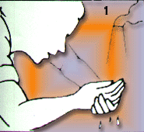
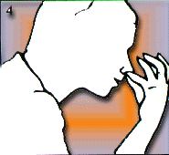
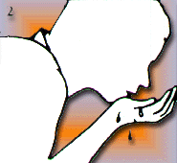
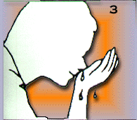
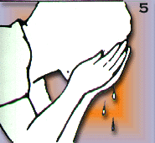
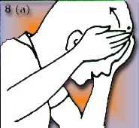
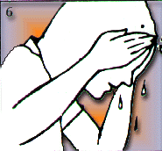
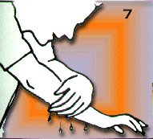
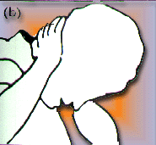
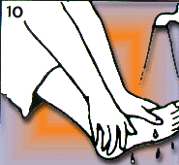
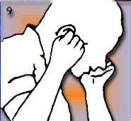
Wudu

Slide 30
Wudu
Wudu, the ritual washing in preparation for prayer, can be performed anywhere, but very often is performed in a bathroom. Mosques have a special area, separate from the toilets, where wudu is performed.

Slide 31
Wudu
Before performing Wudu Muslims will need to make their intention to wudu by clearing their minds and saying “Bismillah”
Translated this means
"In the name of Allah”

Slide 32
Step 1
Wash your hands to your wrists three times, right hand then left hand making sure you wash between your fingers.

Slide 33
Step 2
Put a hand full of water in your mouth and rinse it thoroughly three times.

Slide 34
Step 3
Step 4
Sniff water into your nose three times and then wash the tip of your nose.

Slide 35
Step 5
Step 6
Wash your face three times from right ear to left ear and from the forehead to the throat.

Slide 36
Step 7
Wash your right arm then your left arm thoroughly from the wrist up to the elbow three times.

Slide 37
Steps 8 a & b
Move wet palms over the head from the top of the forehead to the back of the head.

Slide 38
Step 9
Steps 8 a & b
Clean the inside and outside of both ears including behind the ears.

Slide 39
Step 10
Steps 8 a & b
Finally, wash both feet up to the ankles making sure that you wash between the toes and all parts of the feet.

Slide 40
At the end of the steps recite:
“ash-hadu an la ilaha illal lehu wa ash-hadu anna Muammadan ‘abduhu was rasuluah”
Translated this means:
I testify that there is no God but Allah and he is One and has no partner that Muhammad is His servant and messenger.

Slide 41
Wudu - Golden Rules
Every bit of skin on the face, forearms and feet need to have touched water for Wudu to have been performed properly.
Make sure all steps are performed in the right order.
Do not interrupt the Wudu. If you stop the wudu you will have to start the steps again.

Slide 42
LO: to know about Wudu and what it means in practice.
Task:
Design an information leaflet explaining and illustrating the practice of Wudu. Include an explanation of what Wudu is and the three golden rules.

