Slide 1
Stone Age Painting
Mrs Horsley

Slide 2
Watch the video.
https://www.youtube.com/watch?v=kMs4FpFko_o
This video explains how Stone Age men and women used natural sources to make the paints so that they could decorate caves, tents etc.
The Living in the Stone Age team created a piece of artwork on deerskin using natural pigments made from charcoal, chalk and ochre.

Slide 3
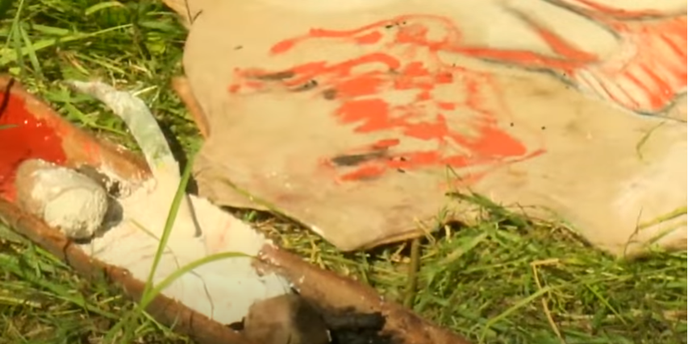

Slide 4
Can you make some of your own paints?
The main colours which were used for Stone Age paintings are, White, Black, Brown and Red.
Could you make some of your own colours using natural materials?
Perhaps you could use mud and water, or chalk which was mentioned in the video.
I would love to see your finished painting using your natural paints.

Slide 5
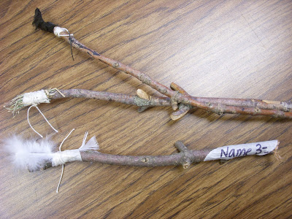
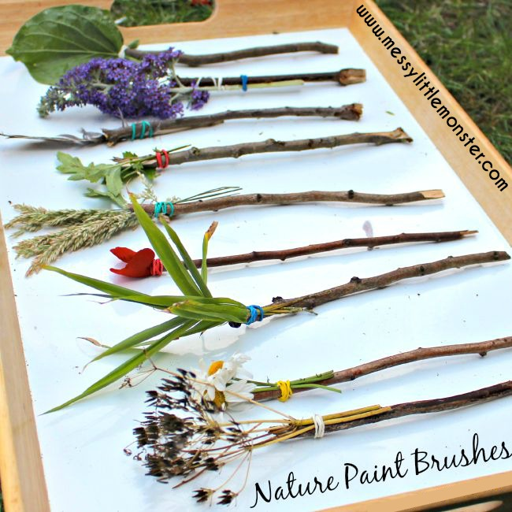
Make your own paintbrush
During the Stone Age period, they did not have ready made paintbrushes so used their hands to paint with.
They started making their own paintbrushes out of sticks, horse hair and feathers.
Could you try and make your own paint brushes using sticks, grass, leaves etc?
I would love to see your end results so please take some pictures and send them to me on
year3.ellington@school360.co.uk

