Slide 1
In a previous lesson we learnt about
Food Chains

Slide 2
Can you tell someone at home what these KEY WORDS mean?
food chain
consumer producer
predator prey

Slide 3
Can you remember what the arrows meant in a food chain?
eaten by
direction of energy flow

Slide 4
Food chains
A food chain shows where the energy goes in a
food chain (in other words, “what gets eaten by what”):
Primary consumer
Secondary consumer
Tertiary consumer
Producer
eaten by
eaten by
eaten by
Cabbage
Rabbit
Stoat
Fox
Plants convert the sun’s energy into food
The arrows indicate where the energy is going

Slide 5
Your Task
I would like you to create 4 food chains which have a producer, primary consumer, secondary consumer and tertiary consumer. I am going to give you one animal for each food chain; you have to find the rest and complete a food chain which is labelled with type of consumer and prey/predator.

Slide 6
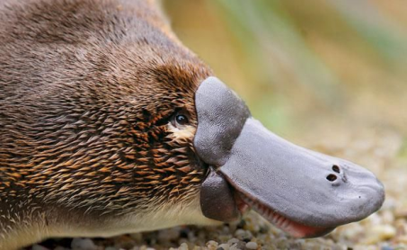
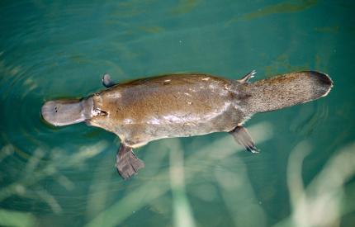
For your first food chain the animal that I have chosen is… duck-billed platypus Unless you have a wealth of information about food chains in that brain of yours, you’ll need to research on the internet.

Slide 7
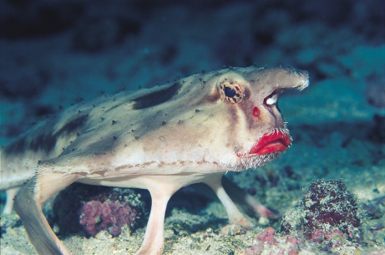
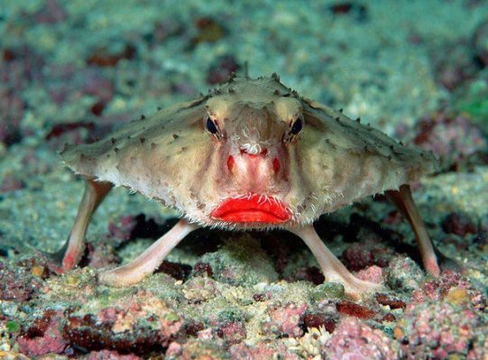
For your second food chain the animal that I have chosen is… red-lipped batfish

Slide 8
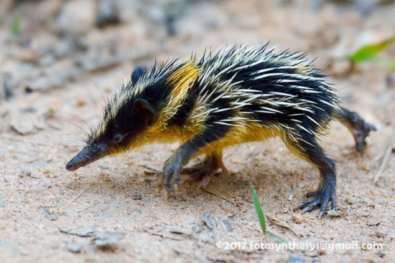
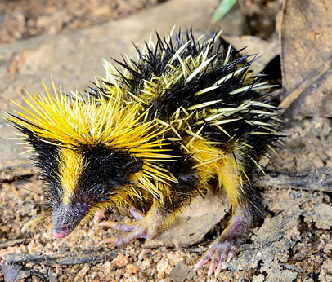
For your third food chain the animal that I have chosen is… lowland streaked tenrec

Slide 9
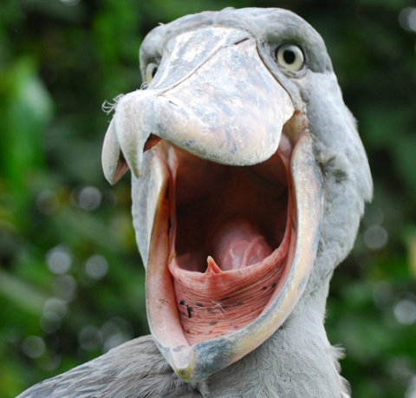
For your final food chain the animal that I have chosen is… shoebill

