Slide 1
Please cut the timeline statements and pictures out and then place on a timeline in the correct order.
You may want to research some of these for your computing work.

Slide 2
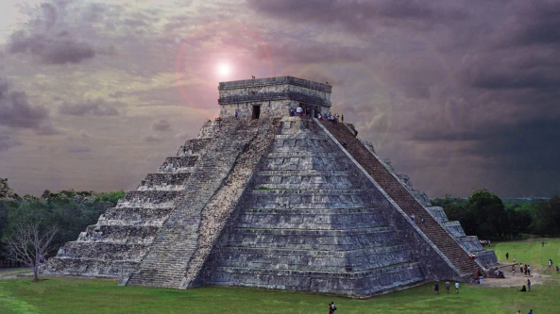
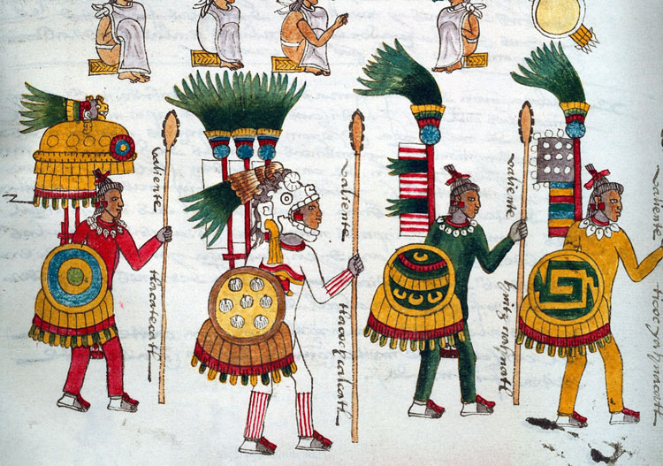
Just a brief overview of some aspects of the Aztec Life

Slide 3
Who were the Aztecs?
The Aztecs lived in the country we now call Mexico, Central America. It is a hot place full of deserts, volcanoes and mountains.
The Aztecs didn’t settle in the valley of Mexico until the 1320s and their empire was destroyed by the Spanish in the 1520s. – around 500 years ago.
Mexico city, the capital of Mexico is the biggest city in the Americas and more than 8 million people live and work there. Beneath the traffic that rushes through these streets, lie the ruins of an older, lost city. It was called Tenochtitlan. From the 1320s until the 1520s it was the home to the Aztecs.

Slide 4
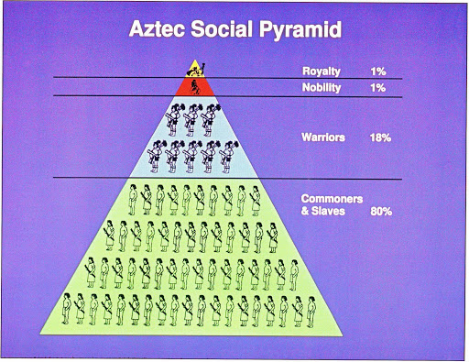
Warfare and Religion
Warfare was absolutely vital to Aztec Society and culture. Constant wars supplied prisoners for the human sacrifices that were demanded by the Aztec religion. The empire’s powerful army crushed any resistance to Aztec rule and professional soldiers formed a privileged upper class.
There was a four tier system of society with slaves at the bottom and warriors in the next tier. All boys trained in warfare at school. Those who rose to high rank won the right to dine at the royal palace, wear fine clothes and drink alcohol.

Slide 5
Religion
The Aztecs had about 1600 gods, one for every aspect of their lives. They worshipped them at home shrines and also in elaborate public rituals, led by priests. The ceremonies involved dance and drama in fantastic costume, as well as human sacrifices.
The Aztecs believed very strongly that the gods had decided what would happen to every person before he or she was born. They also believed that the priests could foretell events in the future.
Huitzilopochtli was the patron god of the Aztecs. His name means blue hummingbird. He was the god of war. The Aztecs fought a special war every year called the war of the flowers in order to capture victims to sacrifice to him.
Aztec video

Slide 6
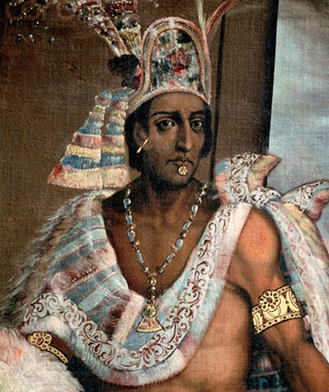
Moctezuma
In 1502 Moctenzuma became ruler of the mighty Aztec empire. As Emporer, he strengthened his power and conquered more lands and the Aztec people become even richer.

Slide 7
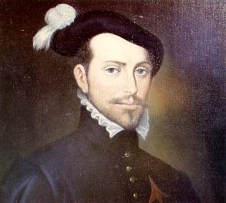
Hernan Cortes
In 1504, however, a Spanish merchant ship sailed to the Americas. On board was an 18 year old Spaniard named Hernan Cortes who was eager to find adventure and gold. In 1511 he set sail again to Cuba where the Cubans were defeated and Cortes became secretary to the new Spanish Governor.

Slide 8
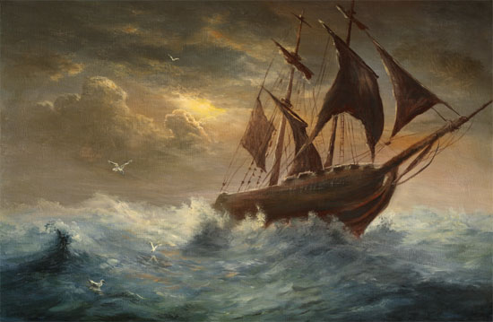
What happened next?
However, Cortes wanted new adventures and in 1519 he set sail for Yucatan in Mexico where there were reports of great riches. He travelled with 550 soldiers called Conquisitadors. Here, Cortes found out about the powerful Aztec civilisation and he sailed further along the coast. He made friends with local people and exchanged gifts. He also sent messages to Moctezuma at Tenochtitlan saying he would like to meet him.
.

Slide 9
What happened next?
When Cortes finally reached the capital of the Aztec empire, Cortes was stunned. He had hoped to be able to conquer the land easily but what he found was far greater and grander than anything in Spain.
The Aztecs had never met anyone like the Spanish before. They had never seen pale skinned people or body armour or horses. Many thought they must be gods. They were welcomed and invited to stay in the palace… but Moctezuma was take prisoner and forced to swear loyalty to Spain. When Cortes took Moctezuma with him to the coastal city of Vera, he left conquisitador Alvarado in charge. He was so horrified at the Aztecs human sacrifices and was scared that he would be attacked himself, that he had his men slaughter 12,000 Aztecs at a religious ceremony. The Aztecs rose up against the Spanish and swore to kill all the intruders, they felt so betrayed by Moctezuma that they stoned him to death. Without an Emporer, Cortes forces took hold of Tenochtitlan and the Aztec empire ended.

