Slide 1
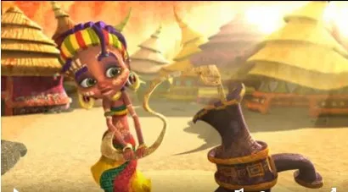
Zahra

Slide 2
Task One
Please write a diary entry as if you are Zahra
Remember to add some fabulous adjectives and try to talk about feelings.
Add an exquisite picture to enhance your
diary writing

Slide 3
Task Two
Please write a short story as if you were
Zahra’s brother.
You could include the jobs that he might have to do around the village
Or
the fact that he feels sorry for Zahra trying to keep the tree alive
Or
How he witnessed the tree coming alive and how it moved to shade Zahra.

Slide 4
Task Three
A huge problem in Africa is shortage of water.
You have been given the task of designing a poster to get people to do some kind of sponsored activity to raise money for Water Aid.
Have a little look on Google images to see examples (type in water Aid Posters); think about what sponsored activity you want people to do then create an eye-catching poster!

Slide 5
Task Four
Please write a formal letter to the government asking them to support Water Aid.
You need to give them reasons why Water Aid need their funding – it must be more than
‘They don’t have any water’
Remember to use the key features of
formal letter writing

Slide 6
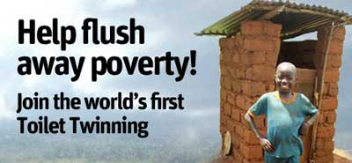
Task Five
Do you take your toilet for granted?
You are very lucky because thousands of African people don’t have access to a toilet.
There is a scheme where you can twin your toilet, which means you raise £60 and a company called Toilet Twinning will build a toilet for a community in Africa. They will send you a picture of the toilet that your money helped build.
Could you write a persuasive letter to Mr Vardy asking if we could have a non-uniform day to raise money to buy a toilet?

