Slide 1
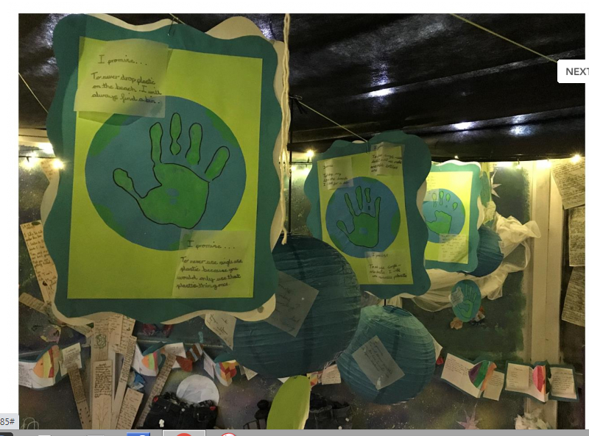
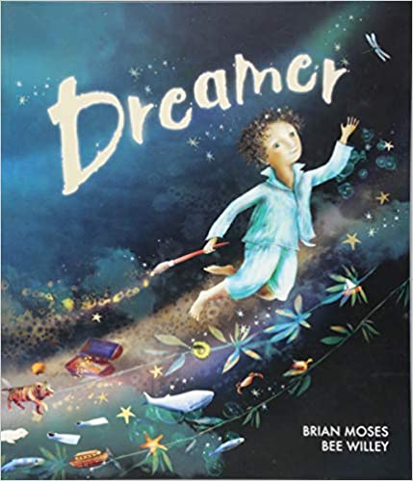
Task 1 Dreamer by Brian Moses and Bee Willey. Watch the video for today with the link on the weekly plan. See the part about putting a smile on our planet. Remember how proud we were when we told Beegu and their family all about Earth when they came to visit our class. See if you can make a Promise Poster to tell everybody that you are going to help to look after our world. (Resources in pack to cut out a blue earth and handprint to add to it) Remember to send photos and keep your poster safe until we return to school next week)

Slide 2
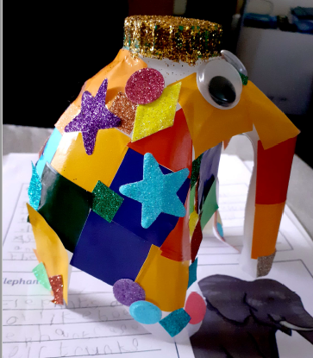
Task 2 After listening to the video for Wednesday see if you can think about making an elephant from a plastic milk bottle. Look at the one that George has kindly made already. You have the instructions in your pack and some bits to stick onto your recycled elephant. You can use your own materials if you would want.

