Slide 1
Changing Improper Fractions to Mixed Number Fractions

Slide 2
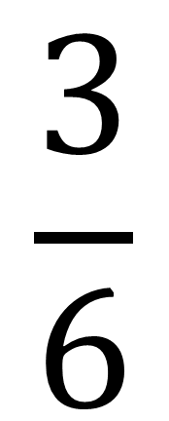
What is a fraction?
$$\frac{3}{6}$$
Number of shaded parts
Shape is divided into 6 parts

Slide 3
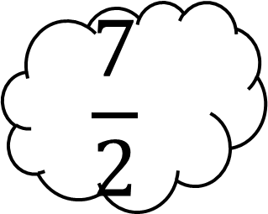
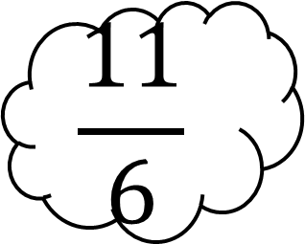
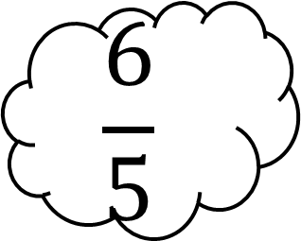
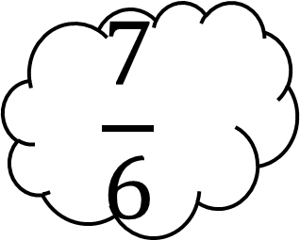
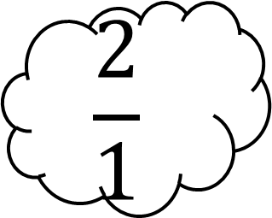
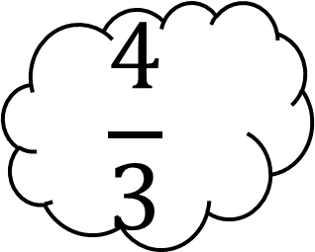
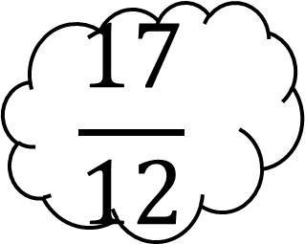
Improper Fraction
An improper fraction is where the numerator (top number) is bigger than the denominator (bottom number)
$$\frac{7}{6}$$
$$\frac{11}{6}$$
$$\frac{17}{12}$$
$$\frac{7}{2}$$
$$\frac{4}{3}$$
$$\frac{2}{1}$$
$$\frac{6}{5}$$

Slide 4
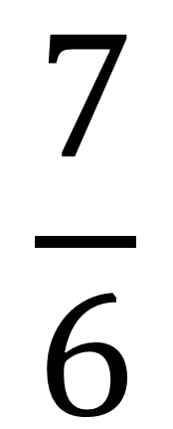
7 parts shaded in!
$$\frac{7}{6}$$
Shape is divided into 6 parts

Slide 5
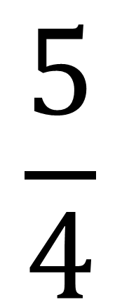
5 parts shaded in!
$$\frac{5}{4}$$
Shape is divided into 4 parts

Slide 6



What improper fractions are shown in these pictures?
$$\frac{9}{6}$$
$$\frac{9}{4}$$
$$\frac{12}{8}$$

Slide 7
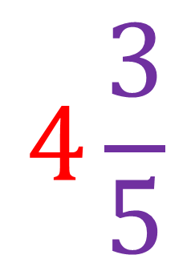
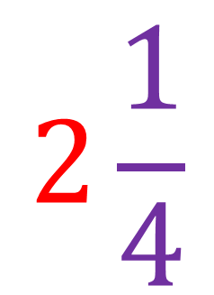
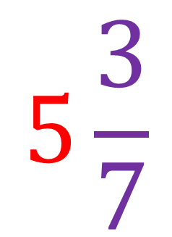
Mixed Numbers
A mixed number is made of a whole number and a fraction.
$$2\frac{1}{4}$$
$$4\frac{3}{5}$$
$$5\frac{3}{7}$$
$$5\frac{3}{7}$$

Slide 8
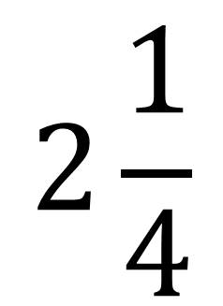
2 full shapes coloured in!
…with 1 more part shaded in
$$2\frac{1}{4}$$
Shape is divided into 4 parts

Slide 9



What mixed numbers are shown in these pictures?
$$1\frac{3}{6}$$
$$2\frac{1}{4}$$
$$1\frac{4}{8}$$

Slide 10
$$1\frac{3}{6} is equivalent \left(the same as\right)to \frac{9}{4}$$

Slide 11


Mixed number to improper fraction
The shape is always divided into 6 parts. So our denominator (bottom number) doesn’t change.
$$1\frac{3}{6}$$
$$\frac{9}{6}$$
3 + 6 =
6x1 = 6

Slide 12

Mixed number to improper fraction
The shape is always divided into 5 parts. So our denominator (bottom number) doesn’t change.
$$1\frac{2}{5}$$
$$\frac{7}{5}$$
2 + 5 =
5x1 = 5

Slide 13


Mixed number to improper fraction
The shape is always divided into 3 parts. So our denominator (bottom number) doesn’t change.
$$2\frac{1}{3}$$
$$\frac{7}{3}$$
1 + 6 =
3x2 = 6

Slide 14


Mixed number to improper fraction
$$5\frac{3}{4}$$
The shape is always divided into 4 parts. So our denominator (bottom number) doesn’t change.
$$\frac{23}{4}$$
3 + 20 =
4x5 = 20

Slide 15
The denominator always stays the same
To change an improper fraction to a mixed number fraction you must divide.
3
1
5
16
5
This number becomes the numerator
16 ÷ 5 = 3 remainder 1

Slide 16
Can you solve this one?
2
2
5
12
5
This number becomes the numerator
12 ÷ 5 = 2 r 2

Slide 17
And another
6
1
3
17
3
This number becomes the numerator
17 ÷ 3 = 6 r 1

Slide 18
Another one
11
3
3
2
3
11 ÷ 3 = 3 r 2

Slide 19
Last one
23
5
4
3
5
23 ÷ 5 = 4 r 3

Slide 20
Please have a go at the worksheets which are on home learning.

