Slide 1
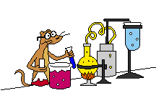
Science
Notes:
1
1

Slide 2
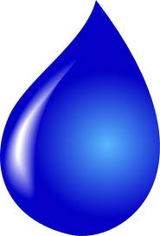
The Water
Cycle

Slide 3
Let’s talk a bit about water.
_________________________________________________________________________________________________________________________________________________________

Slide 4
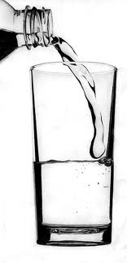
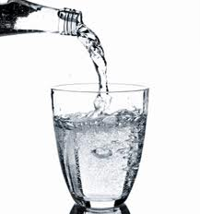
When did you last have a glass of water?
?

Slide 5
When did you last wash you hands?
?

Slide 6
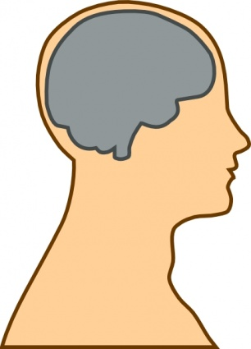
Think of all the other times you have used water.

Slide 7
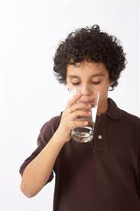
Did you know that water makes up 70% of your body?

Slide 8
We’re going to explore the water cycle. But first, do you know what ‘cycle’ means?

Slide 9
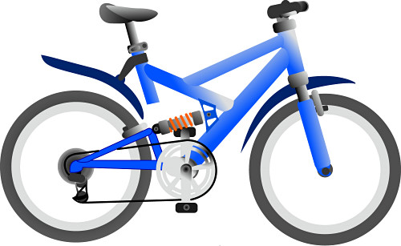
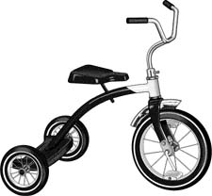
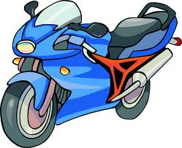
‘Cycle’ means to keep going around and around and around, like the wheels on your bike, for example.

Slide 10
Now let’s get back to the Water Cycle journey.

Slide 11
This is H2O. He’s our guide for the water cycle trip. He’s going to quickly show us his water cycle journey.

Slide 13
Now we’re going to go through each of the steps!

Slide 14
1
We’re going to start at the beach!

Slide 15
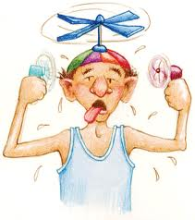
When the sun heats up the sea water, some of the water droplets moves into the air.

Slide 16
H2O
H2O

Slide 17
H2O has moved from the sea into the air. H2O has changed from a liquid to a gas. H2O has evaporated. This is him now →

Slide 18
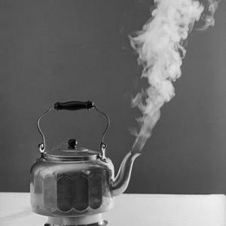
Seeing it in your home.
When you heat up water in kettle, what do you see? You can see steam. This is because the water droplets in the kettle get very hot so they move out from the
water in the kettle,
and into the air
instead where it
is cooler.

Slide 19
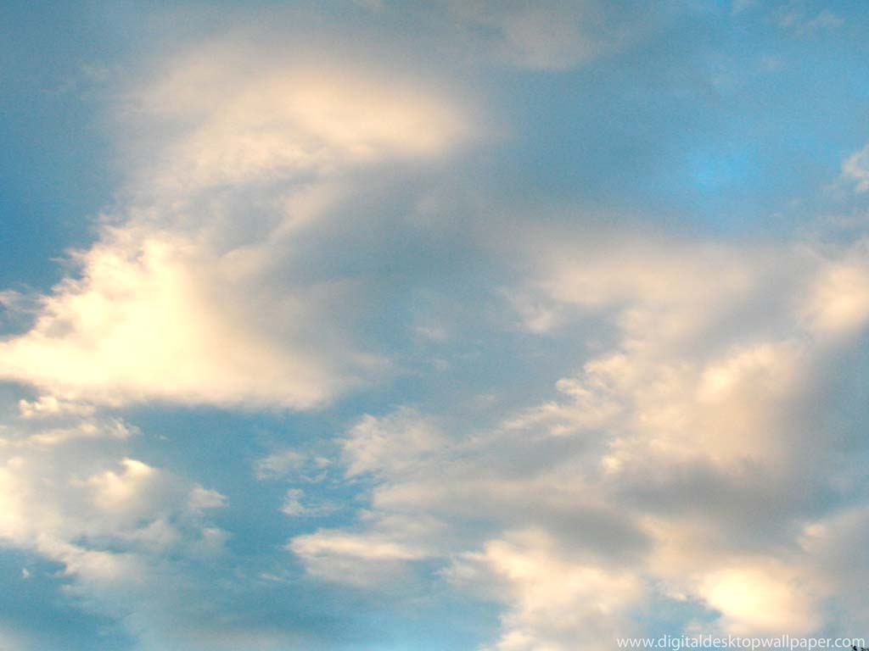
2
H2O is now in the sky and is cooling down. H20 is now cold and turns back into
a liquid again which turns him and the other droplets into a cloud!

Slide 20
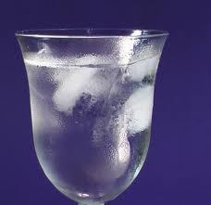
Seeing it in your home.
When you pour yourself a cold drink, have you ever noticed the water that forms on the cup? Where did the water come from? When the water droplets in the air touches the glass, it cools down and turns into a liquid.

Slide 21
3
When H2O and the other water droplets turned into a cloud, and when water formed on your cup of cold drink, this is called condensation.

Slide 22
?
What do you think happens when the clouds get very big and full of water?

Slide 24
The water droplets will fall from the sky. The water droplets may be rain, or if the weather is very cold, then snow, hail or sleet!

Slide 25
When things fall to the earth from the clouds, we call this process precipitation.

Slide 26
?
Where do you think the rain and snow lands when it falls from the sky?

Slide 27
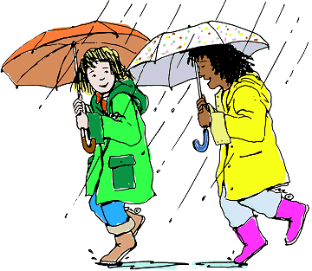
It may land in the sea or in rivers. It may land on the
roof of your
house or
even on
your head!

Slide 28
Precipitation can fall anywhere!
Some will soak into the ground and be used by plants and trees.
Some will fall into the rivers and flow back into the sea.

Slide 29
And the water cycle continues.
Remember though, that the water cycle is ALWAYS happening. So, water is always evaporating from the sea, clouds are always forming, and there is always precipitation somewhere in the world.

Slide 30
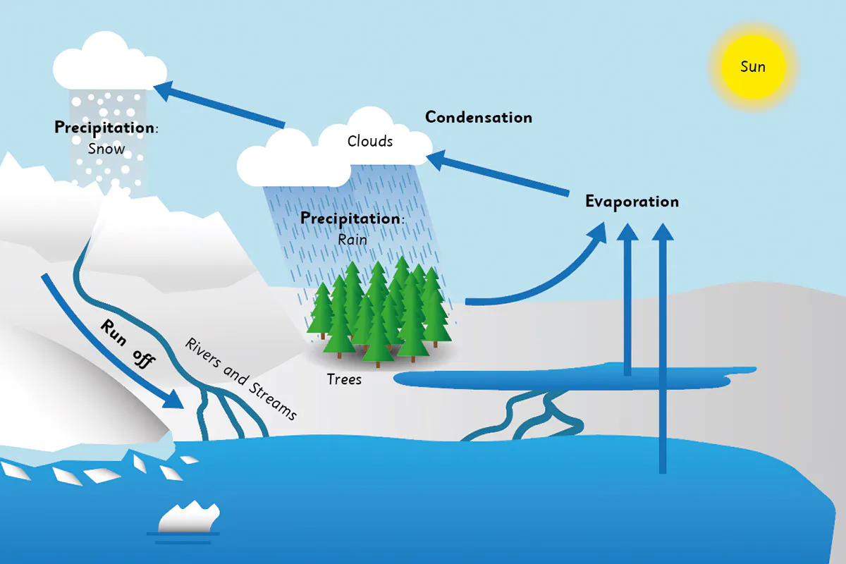
If you drew it scientifically, it would look like this. You have a go at drawing the water cycle.
Water Cycle

