Slide 1
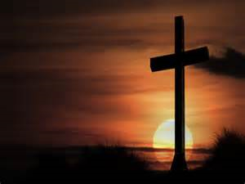
Religious education

Slide 2
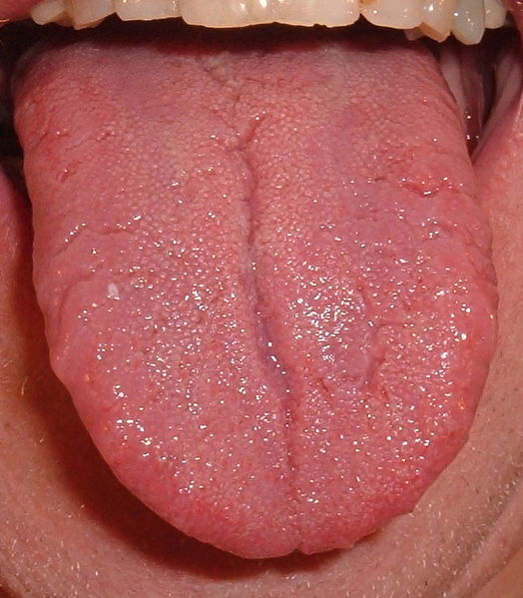
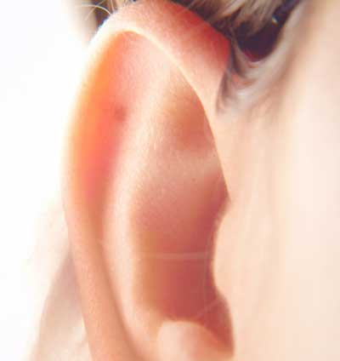
The five senses What has this got to do with this week’s lesson?
Sight
Sound
Taste
Smell
Touch

Slide 3
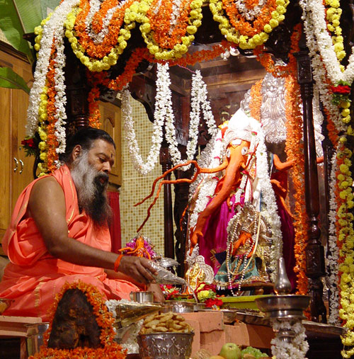
Hindu Worship
LO: To be able to explain what happens during Puja and why it is important to a Hindu.

Slide 4
What is a shrine? A sacred or special place that is dedicated to a deity (deity is a god) that has meaning to someone.
Can you think of any examples of shrines?

Slide 5
6 steps of Hindu Worship
Puja
Hindu worship will involve a shrine and is a multi sensory experience.
When engaging in Hindu worship, all five senses are used and reference is made to the five elements.
A Puja tray will have six key features:
A bell
A dish containing sandal wood
Food offerings
A pot containing holy water
An incense stick
An arti lamp
Puja = Hindu word for ‘worship.’
Notes:
http://www.bbc.co.uk/learningzone/clips/puja/4799.html Hyperlink on Puja.

Slide 6
1) Bell
Bell: this is rung at the beginning of Puja to let the deity know worship is about to begin.

Slide 7
2) Dish
A dish containing sandalwood paste or ashes, this is used to mark the worshipper’s forehead; it is a symbol of his or her devotion and the blessing and protection of God.

Slide 8
3) Food offerings
Offerings of food such as nuts, fruit, rice and sweets are placed on the shrine.
These are symbolic exchanges of love between the worshippers and the deity.

Slide 9
4) Holy water
A pot containing holy water is used for cleansing and purification.
Some shrines have a jar containing water from the river Ganges.

Slide 10
5) Incense
An incense stick and holder: incense sticks are lit to purify and cleanse the air where prayers are being said and to create a holy atmosphere.

Slide 11
6) Arti lamp
An arti lamp with five wicks, each one represents one of the five elements, earth, air, fire, water and ether. Hindus believe that fire can be used to communicate with God and transfer his blessings.

Slide 12
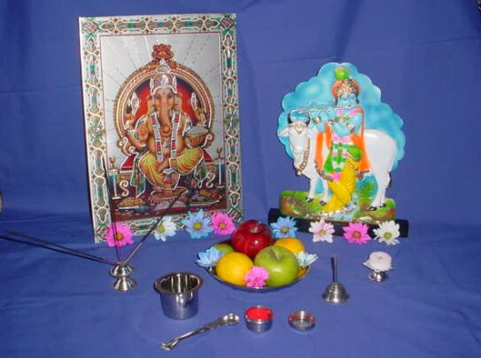
The Puja Tray
Draw and label the Puja tray.
Try and explain what the different aspects mean to a Hindu.

