Slide 1
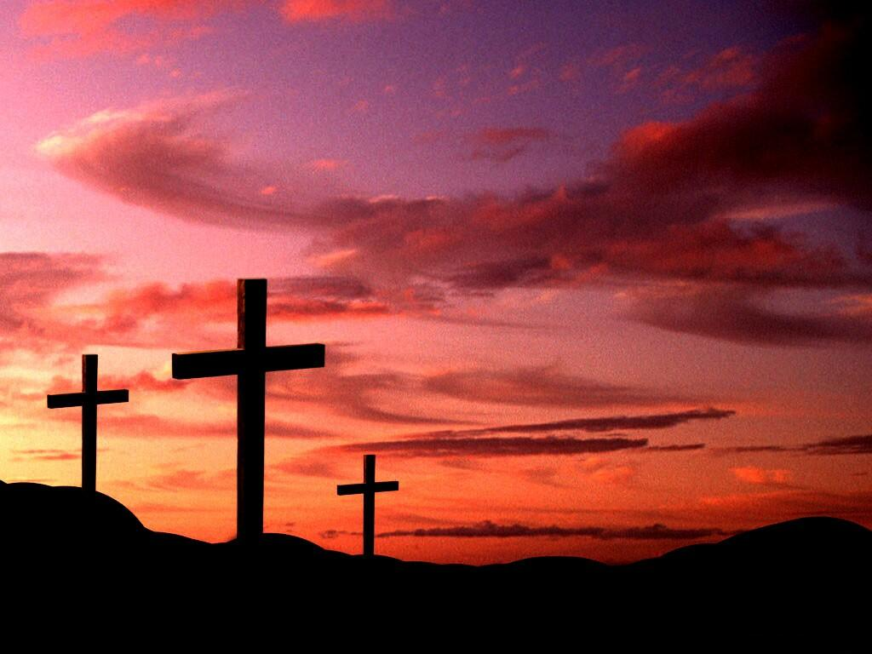
Religious Education

Slide 2
Holy Week
Betrayal of Jesus
Monday to Thursday

Slide 3
Palm Sunday
Jesus came to Jerusalem to celebrate the festival of Pesach.
He rode into the city on a donkey
The people welcomed him waving palm leaves and shouting Hosanna, which meant ‘save (us) now’
This marks the beginning of Holy Week which remind us of the events which led up to the death of Jesus.
Today, some Christians make crosses out of Palm Leaves.
If you would like to read about this, please read (Mark 11:7-10).

Slide 4
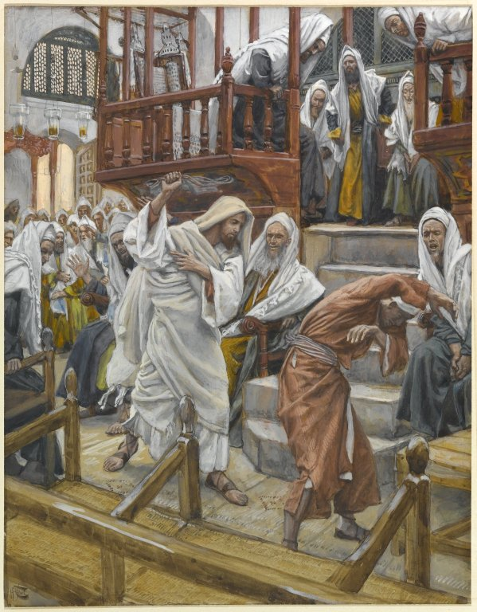
Holy Monday
Jesus went to preach in the Synagogue (church).
When he got there, he was disgusted to see traders and money-changers.
He overturned their tables and forced them out of the Synagogue.
This angered the Jewish leaders the Sadducees and the Pharisees.
If you would like to read about this, please read (Matthew 21:12-17).

Slide 5
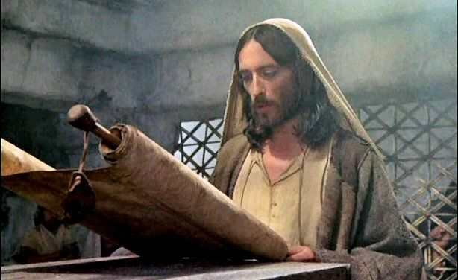
Holy Tuesday
Jesus spent the day praying and preaching in the Synagogue.
In the meantime the Jewish Leaders were plotting a way to get rid of Jesus because they saw him as a threat.
If you would like to read about this, please read (Luke 22:1-3).

Slide 6
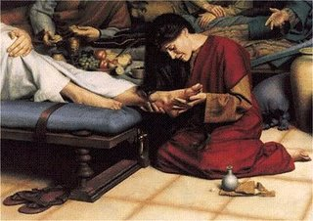
Holy Wednesday
Jesus was in Bethany at a house that belonged to Simon.
Simon suffered from a terrible skin disease called leprosy.
Whilst Jesus was eating, a woman came in with a jar of expensive perfume and poured it on his feet.
The disciples thought this was a waste.
Jesus questioned them saying the woman had anointed him and prepared him for burial.
Holy Wednesday is also known as Spy Wednesday as it is this day that Judas Iscariot betrayed Jesus.
If you would like to read about his betrayal please read (Matthew 14:1-12)

Slide 7
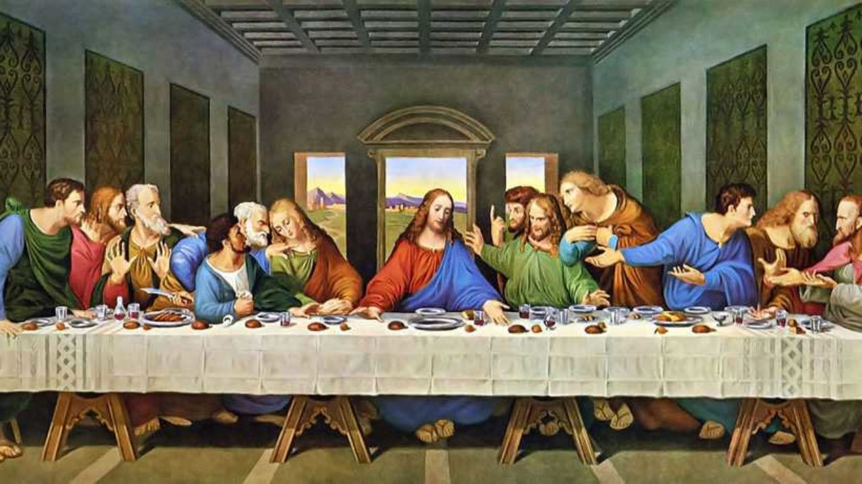
Maundy Thursday
The word Maundy comes from a Latin word which means ‘command’ which refers to Jesus telling his disciples to love one another.
It was the Jewish festival of Pesach (Passover) and Jesus celebrated with his disciples in Jerusalem.
Jesus changed the original celebration, firstly he washed the feet of his friends.

Slide 8
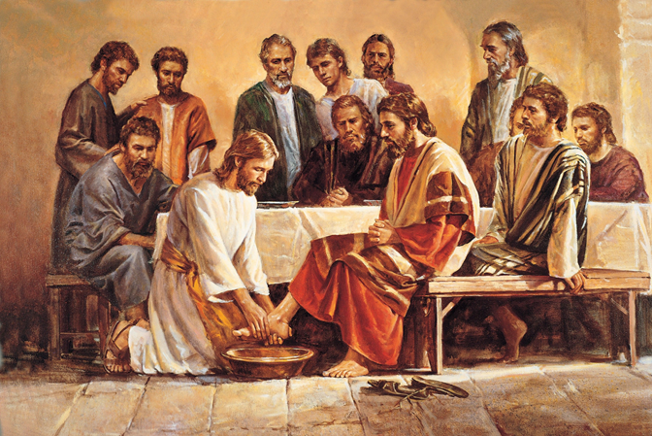
Maundy Thursday continued
The job of washing feet was usually a servant’s job, Jesus did this as a symbolic act to show he had come to serve.
During the Last Supper, Jesus compared the bread and wine to his body and blood.
Judas slipped out during the meal to betray Jesus.
Read (John 13:1-20)

Slide 9
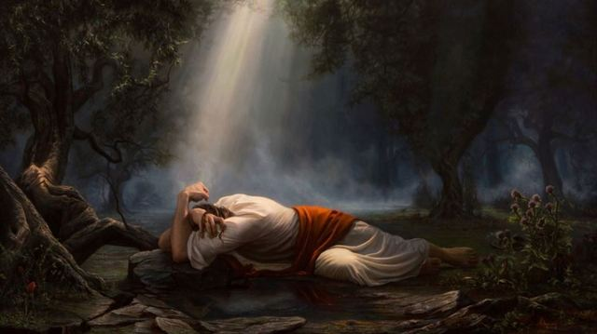
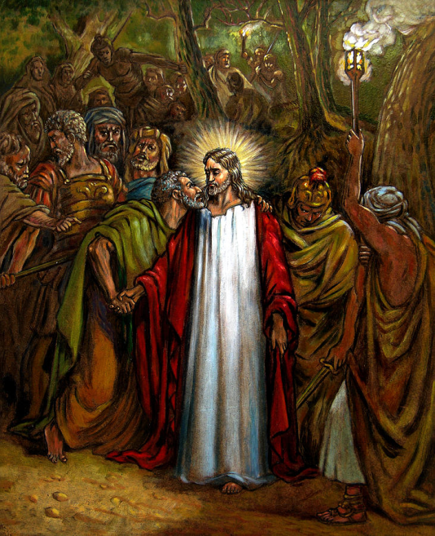
Maundy Thursday continued
After the meal, Jesus and the disciples went to the Garden of Gethsemane to pray.
The disciples fell asleep, whilst Jesus called out to God for help. This is often referred to as the agony in the garden, because Jesus knew he was going to die.
Shortly afterwards, Judas arrived with soldiers to arrest Jesus, he betrayed Jesus with a kiss.
Read (Mark 14:32-52)

Slide 10
Maundy Thursday continued
Jesus was taken to the High Priest’s house in the middle of the night.
He was accused of the crime of blasphemy which means speaking against religion.
Many lies were told about Jesus but the evidence against him did not add up.
Peter, one of the disciples followed Jesus, but was recognized. Out of fear, he denied ever knowing Jesus just as Jesus predicted he would
If you would like to read about this please read ( Mark 14:53-72)

Slide 11
Your task – retell the story of Holy Week up to Maunday Thursday

Slide 12
Holy Week
_______________________________________
Holy Monday Holy Tuesday
___________________________________________________________________________________________________________________________________________________________________________________________________________________________________________________________________________________________________________________________
Holy Wednesday Maundy Thursday
___________________________________________________________________________________________________________________________________________________________________________________________________________________________________________________________________________________________________________________________

