Slide 1
Thursday 25th March
Mrs Horsley

Slide 2
Maths
Please see today’s video - https://vimeo.com/515805842
Please complete today's worksheet see Ellington Primary School website – home learning – Year 3

Slide 5
English and Food Technology
Make some Easter nests using the following slides as a guide and then write your own set of instructions for making Easter nests.

Slide 6
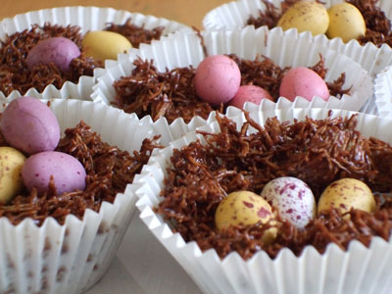
Easter Nests Recipe

Slide 7
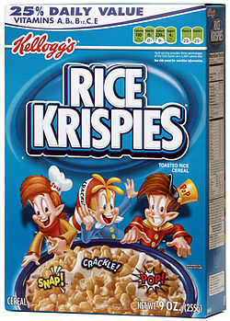
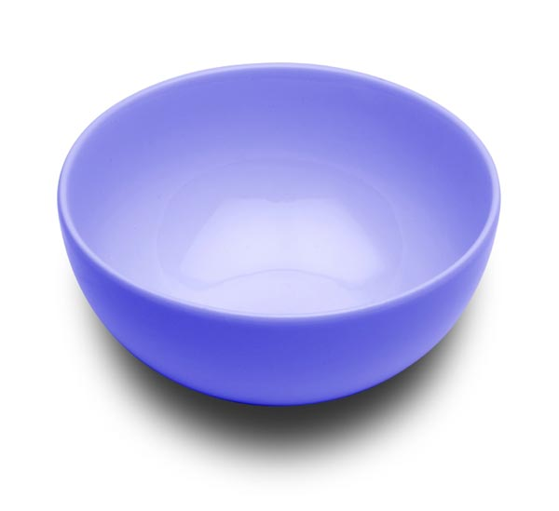
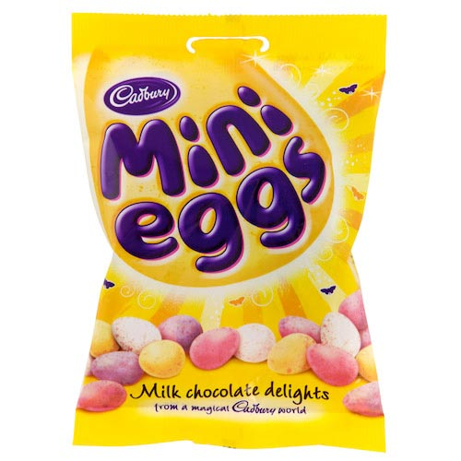
You will need:
Some chocolate
Some Rice Krispies
A bowl
Some bun cases
A spoon
A microwave
Some Mini Eggs

Slide 8
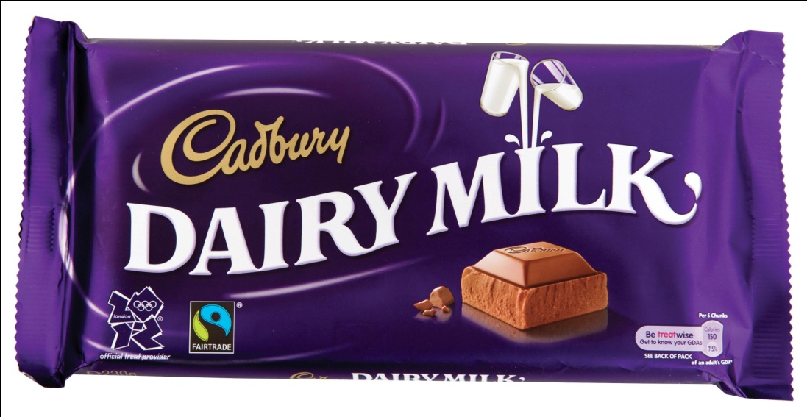
Step 1
1. Put the chocolate in the bowl.

Slide 9
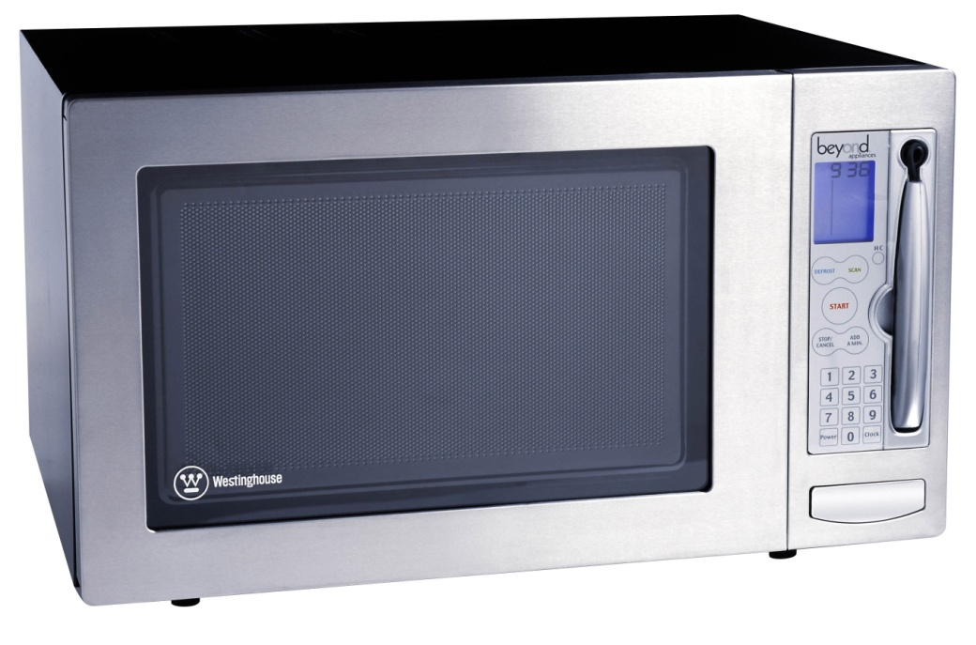
Step 2
2. Melt the chocolate in the microwave (get a grown up to help you)

Slide 10
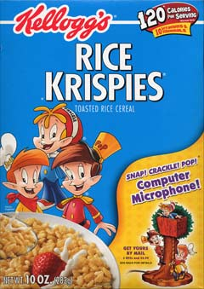
Step 3
3. Add the Rice Krispies.

Slide 11
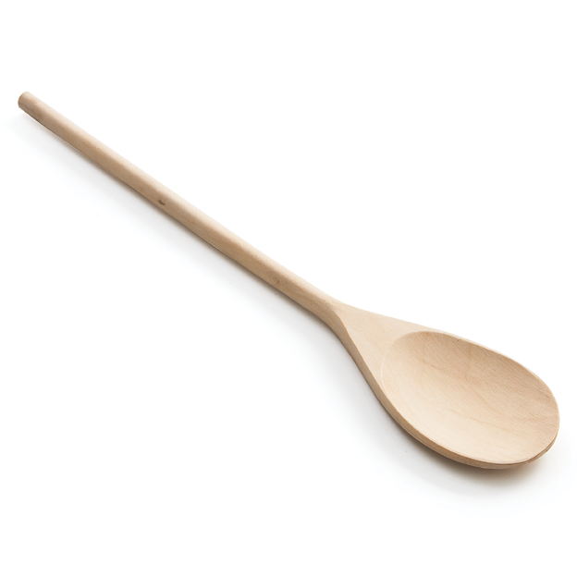
Step 4
4. Mix with the spoon.

Slide 12
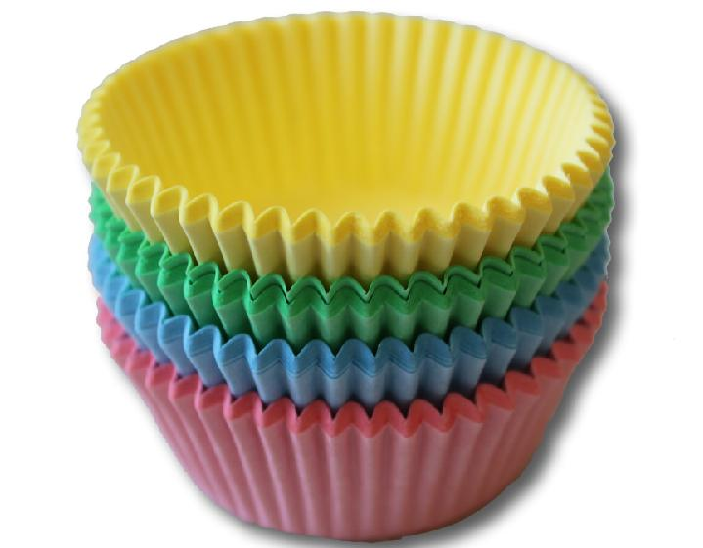
Step 5
5. Spoon into bun cases.

Slide 13
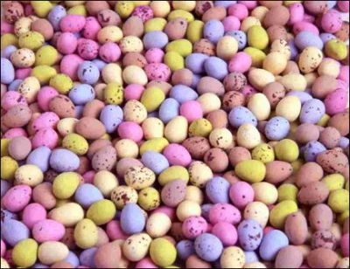
Step 6
6. Add two Mini Eggs.

Slide 14
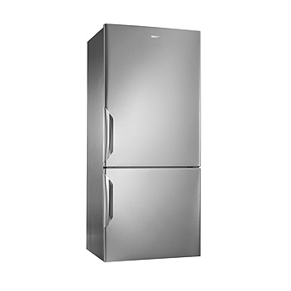
Step 7
7. Leave to cool in the fridge.

Slide 15
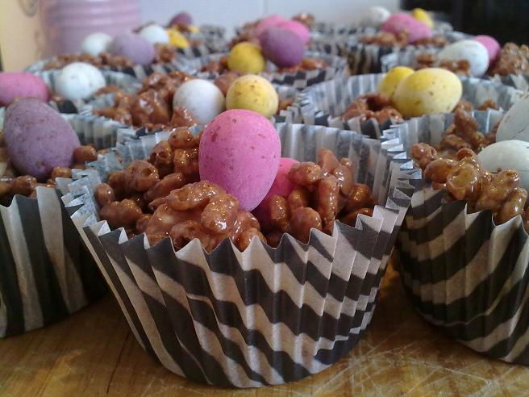
Step 8
8. Eat and enjoy your Easter nests!

Slide 16
Key features of Instructions
THEY USUALLY CONTAIN:
A title
A list of things that you will need.
Numbered steps (Each step set out on a new line)
A sequence of steps set out in the right order.
Imperative verbs which begin each instruction (put, get, spread, cut etc.)

Slide 17
D&T
Make a pop-up Easter Card

Slide 18
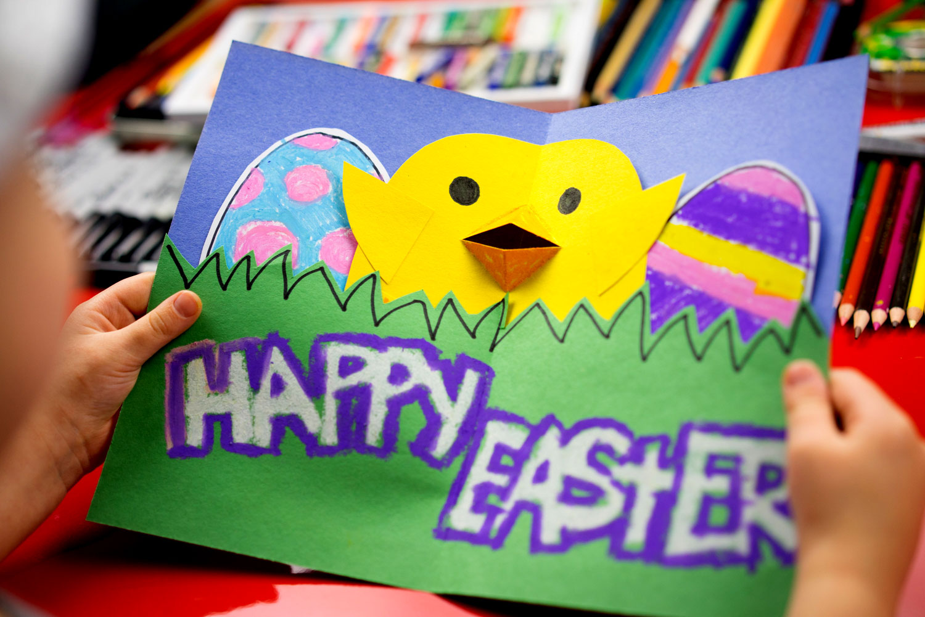
Watch this video on Youtube and try and make your own pop-up Easter card for a friend or family member
https://www.youtube.com/watch?v=AXslZbTWSHg

