Slide 1
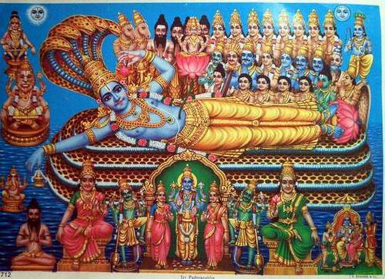
Notes:
Font from Flaming Text.com ~ Plasma with Roostheavy

Slide 2
What are the core beliefs of Hindus and who do they worship?
… explain the name of the being Hindus view as God?
… explain the idea of the Trimurti?
… give examples of the work of the three faces of God?
Notes:
Font from Flaming Text.com ~ Plasma with Roostheavy

Slide 3
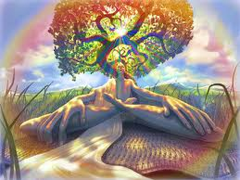
God is called BRAHMAN in the Hindu religion. He may take on the form of anything in the world, usually a god or goddess and each god or goddess has its own personality and appearance.
BRAHMAN is usually represented in the form of 3 different Gods.
Notes:
Font from Flaming Text.com ~ Plasma with Roostheavy

Slide 4
Tri = three Murti = image
The 3 main Hindu Gods are together called the TRIMURTI. They are all different aspects of BRAHMAN and work together in a never ending way.
BRAHMA (The Creator)
VISHNU (The Preserver)
SHIVA (The Destroyer)
Notes:
Font from Flaming Text.com ~ Plasma with Roostheavy

Slide 5
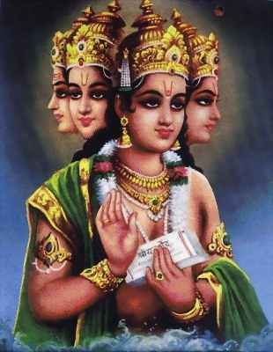
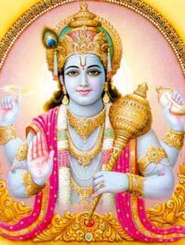
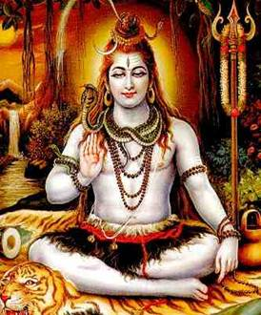
Tri = three Murti = image
BRAHMAN
BRAHMA
VISHNU
SHIVA
CREATOR
PRESERVER
DESTROYER
Notes:
Font from Flaming Text.com ~ Plasma with Roostheavy

Slide 6
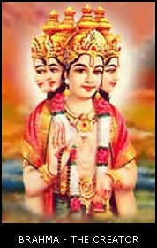
The Creator
Brahma is the least worshipped of the three main gods.
He has four heads and he recites the Vedas continually.
He is the creator.
At his own command, he can divide himself into any type of new life.
He can populate the world after Shiva has destroyed it ready for new creation.
Notes:
Font from Flaming Text.com ~ Plasma with Roostheavy

Slide 7
The Preserver
Vishnu is worshipped under several names. This is because he has different appearances.
Hindus believe that when there is a time of danger for the earth, Vishnu comes to protect it.
They believe he has come to the earth in 9 bodies. The most famous are Krishna and Rama .
Notes:
Font from Flaming Text.com ~ Plasma with Roostheavy

Slide 8
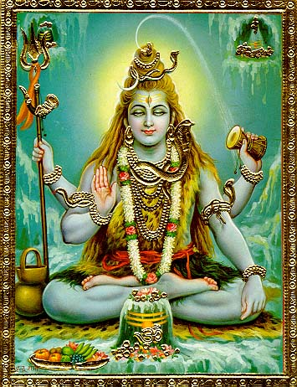
The Destroyer
Shiva is worshipped by about a quarter of all Hindus.
He is the god who destroys so he controls death (and even life).
Although he can be frightening he is also thought of being kind and easy to please.
He has at least 4 hands to show that he holds life and death and good and evil.
Notes:
Font from Flaming Text.com ~ Plasma with Roostheavy

Slide 9
The Three Hindu Gods
Brahma
(The Creator)
Vishnu
(The Preserver)
Shiva
(The Destroyer)
Write one fact you found interesting about this God.
Write one fact you found interesting about this God.
Write one fact you found interesting about this God.
Now write at least 3 examples from the world today of things being created.
Now write at least 3 examples from the world today of things being preserved.
Now write at least 3 examples from the world today of things being destroyed.
Notes:
Font from Flaming Text.com ~ Plasma with Roostheavy

