Slide 1
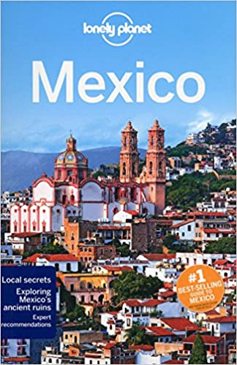
Please could you produce a Mexico Travel Guide – this is linked to your research for computing so you should be able to use one bit of information for both tasks.

Slide 2
What kind of information do you think a tourist would want in a Travel Guide?
Best time of year to visit?
Great places to eat?
Fabulous tourist attractions?
Wonderful places to stay?
How to get from place to place?

Slide 3
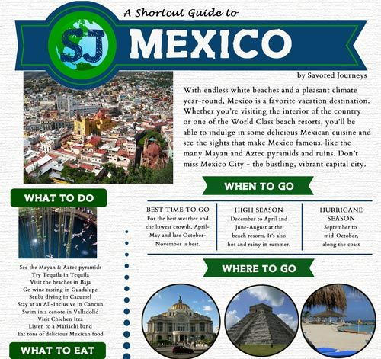
Your travel guide can be in any format but it must be informative and colourful.
I look forward to seeing what you produce.

