Slide 1
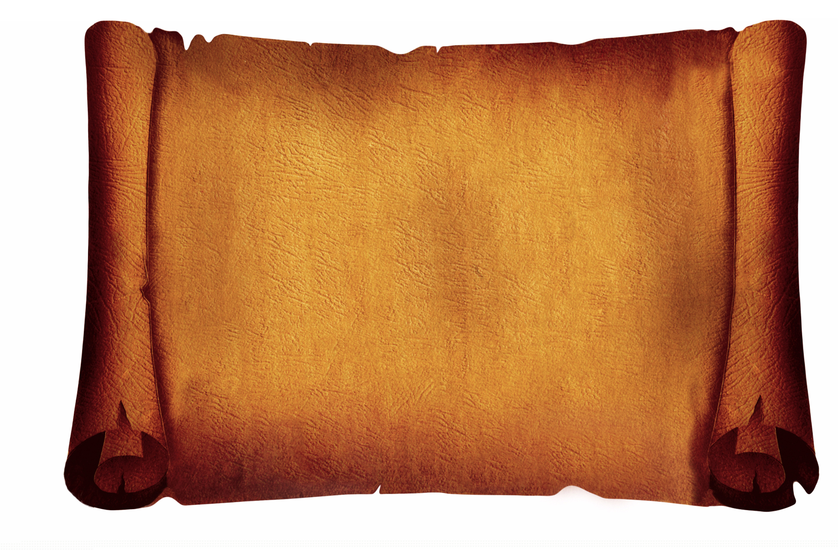
Why did sailors sing shanties?

Slide 2
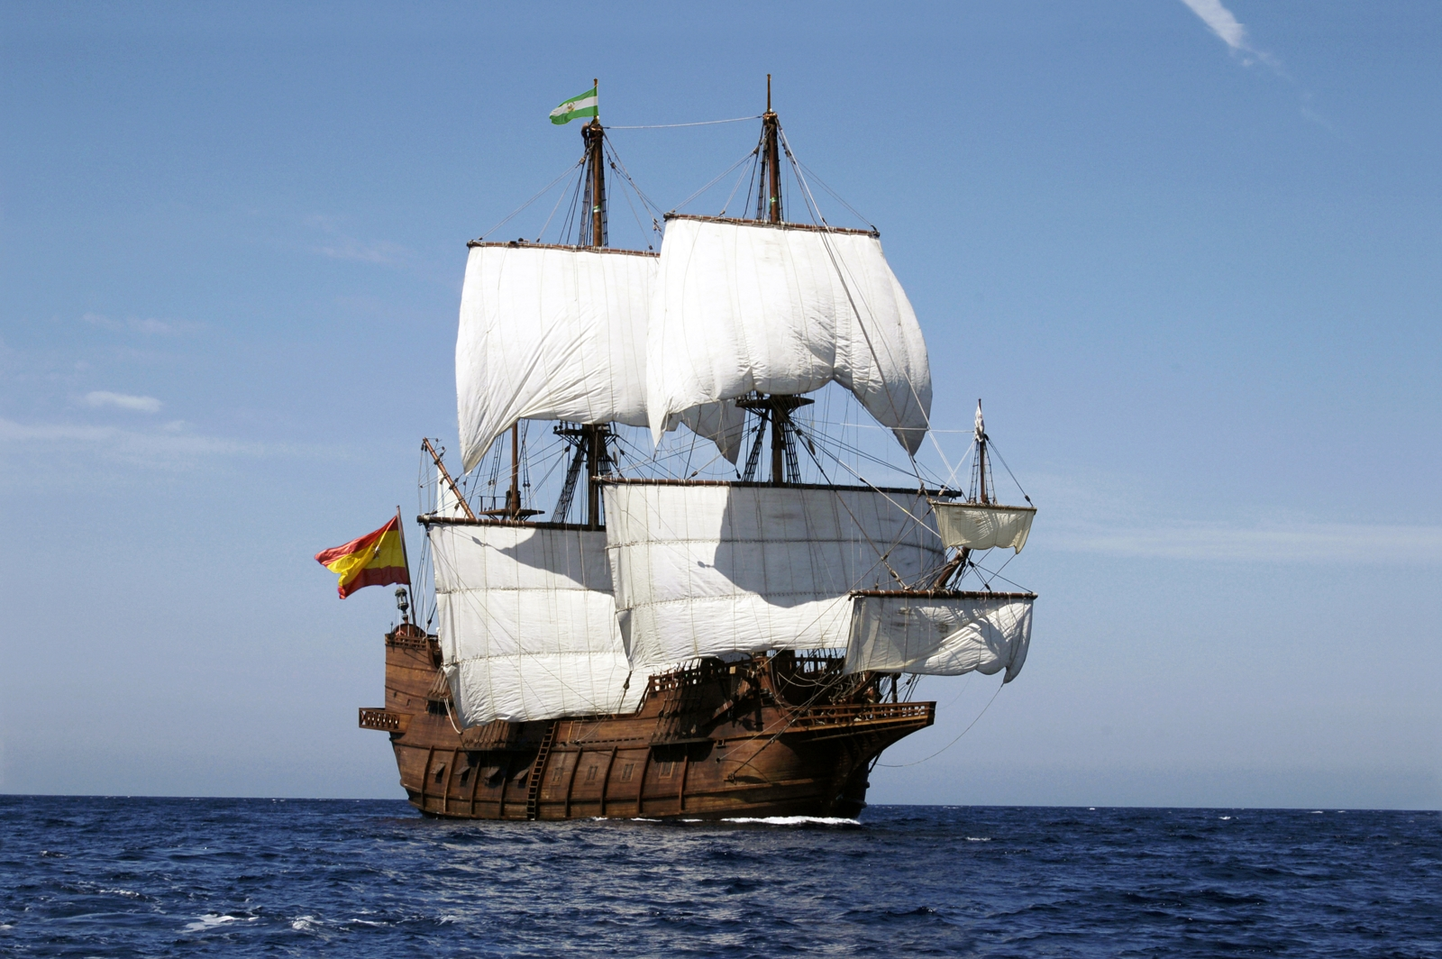
On a ship like this the sailors would have lots of jobs to do…

Slide 3
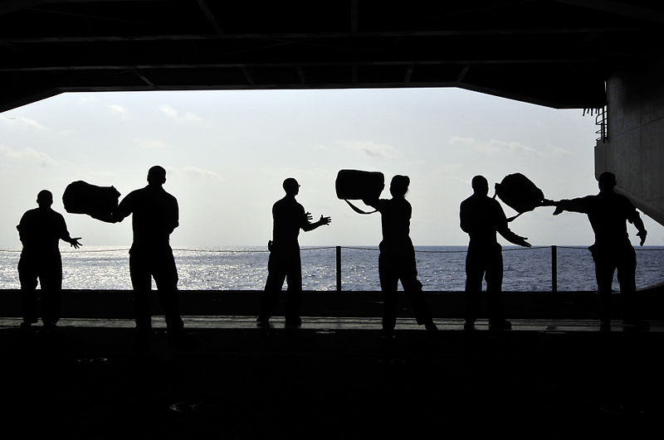
Loading up all of the luggage…

Slide 4
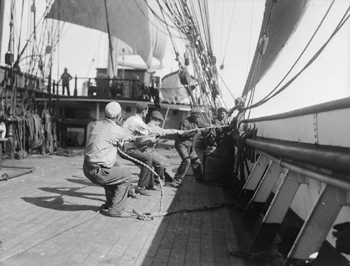
Pulling all
of the sails
up…

Slide 5
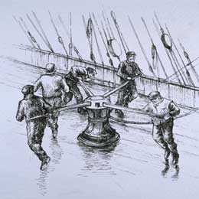
Pulling up the anchor…

Slide 6
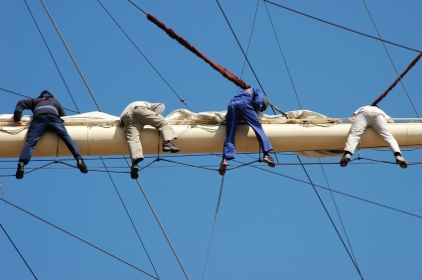
And tying the sails back up after!

Slide 7
These jobs were hard jobs. The sailors needed to work together to get the heavy work done.

Slide 8
To help the sailors work together they would sing sea shanties.

Slide 9
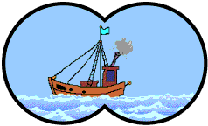
Can you listen to any of these sea shanties and have a go at singing along?
Sons of the sea Bobbing up and down like this Sailing the ocean Bobbing up and down like this
They may build the ships my lads Bobbing up and down like this But they can’t beat the boys of the old brigade Bobbing up and down like this

Slide 10
Pirates are free Bobbing up and down like this Searching the ocean Bobbing up and down like this
They care not for wind or rain Bobbing up and down like this For they rob the gold on the Spanish main Bobbing up and down like this

Slide 11
Listen to this tune and see if you can sing along with these words:
What shall we do with the grumpy pirate? What shall we do with the grumpy pirate? What shall we do with the grumpy pirate? Early in the morning.
Hooray and up she rises, Hooray and up she rises, Hooray and up she rises, Early in the morning.

Slide 12
Do a little jig and make him smile, Do a little jig and make him smile, Do a little jig and make him smile, Early in the morning.
What shall we do with the grumpy pirate? What shall we do with the grumpy pirate? What shall we do with the grumpy pirate? Early in the morning.

Slide 13
A pirate ship, oh a pirate ship
Going on an exciting trip!
Sailing the ocean, far away A different adventure every day!
Shiver me timbers, girls and boys!
Walk the plank, it’s ‘ships ahoy!’
Sail the sea and walk the land
Looking for treasure in the sand!
Another shanty to try and sing along with:

Slide 14
We are pirates, strong and free
Sailing on the open sea!
Splash the oars and hoist the sail
Did you see that big blue whale?
Silver coins and chests of gold
Pots of treasure in the hold
Sailing under an open sky
Raise your hand and say “Aye Aye!”

Slide 15
Every day on the deep, blue sea
It’s a pirate’s life for you and me!
Parrot’s squawking, singing songs
In the sunshine all day long!
Digging in the yellow sand
Captain waving hook and hand
Dig, dig, dig ‘til we catch a cold
To find a chest that’s full of gold!

Slide 16
We are pirates, strong and free
Sailing on the open sea!
Splash the oars and hoist the sail
Did you see that big blue whale?
Silver coins and chests of gold
Pots of treasure in the hold
Sailing under an open sky
Raise your hand and say “Aye Aye!”

