Slide 1

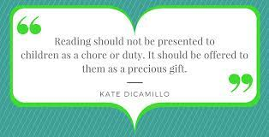
Reading at Ellington Primary School
Early Years
Monday 9th October 2023

Slide 2
What have I just seen?
Nursery - Storytime to encourage reading for pleasure and opportunities for word and sound reading in our continuous provision
Reception - An example of how your children have been formally introduced to RWI phonics using the Set 1 sounds (1 letter, 1 sound). They will soon be assessed and will start attending a more specific group that will target their needs in order to make progress.
In Early Years, we have constant opportunities to access stories, reading, sounds and words.

Slide 3

Why Read, Write, Inc Phonics?
Teach a child to read and keep that child reading and we will change everything.
And I mean everything.
Jeanette Winterson

Slide 4
Why Read, Write, Inc Phonics?
44 sounds
26 letters
Over 150+ graphemes (letter combinations)
One of the most complex alphabetic codes in the world.

Slide 5
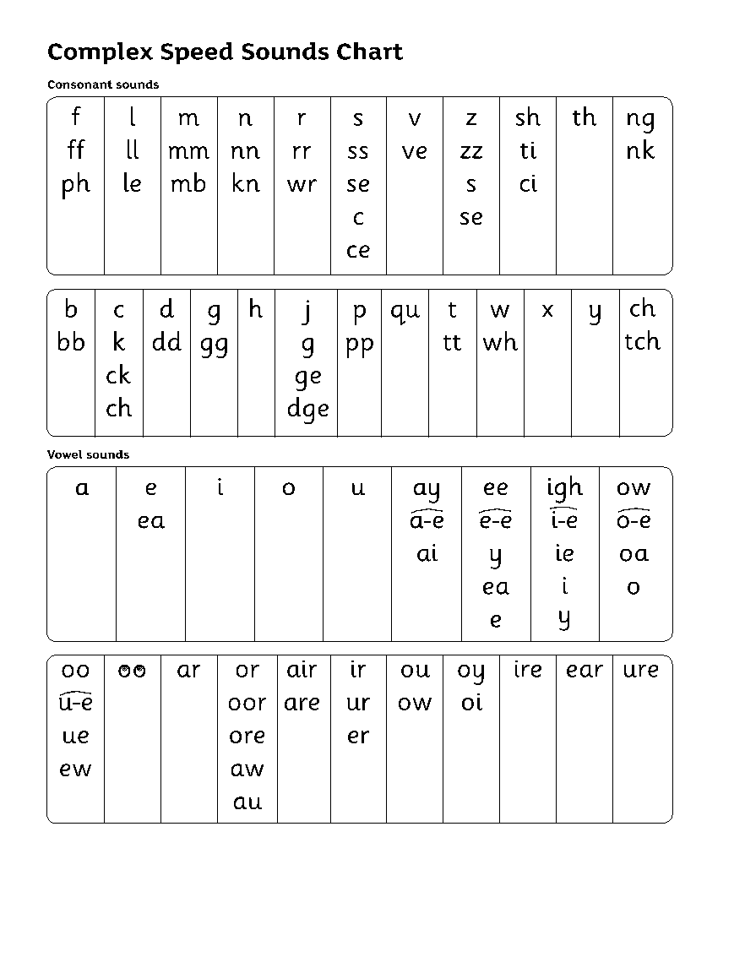
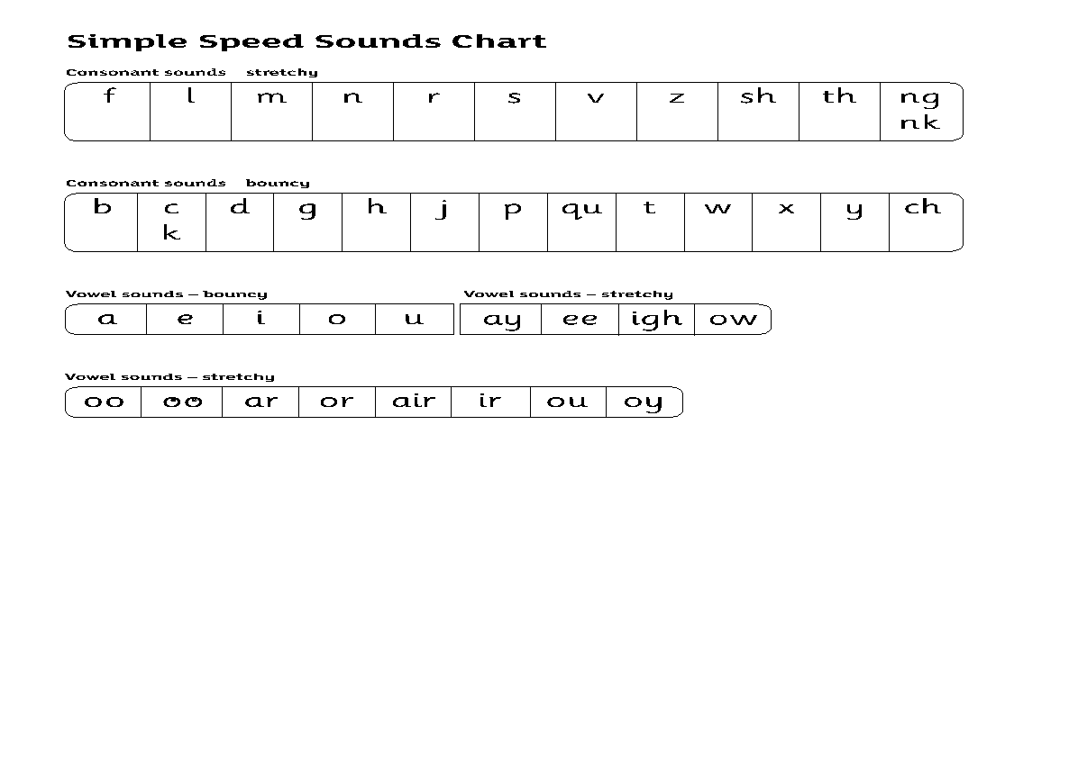
Why Read, Write, Inc Phonics?
Group children by phonic stages.
Teach to the group’s challenge level.
Re-assess all children every half term.

Slide 6
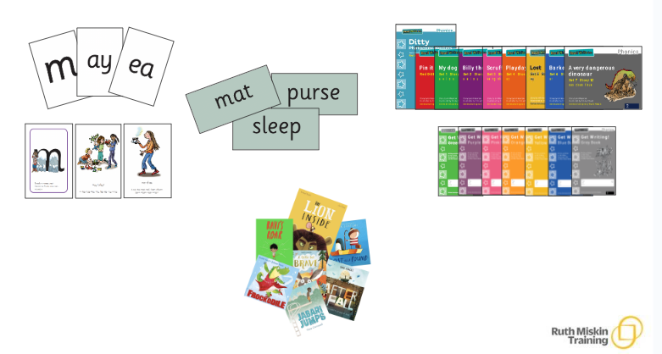
Why Read, Write, Inc Phonics?

Slide 7
Why read to your child?
A study says parents who read to their children are not only strengthening their bond but also increasing their chances at school. The study shows that kids who are read one short book a day enter their first school years hearing almost 300,000 more words than those whose parents didn’t read to them at all. Of course, when parents read more than one book, the number increases again; five books per day increases their vocabulary by 1.4 million words!
Never read to - 4,662 words
1-2 times per week - 63,570 words
3-5 times per week- 169,520 words
Daily - 296,660 words
Five books a day - 1,483,300 words.

Slide 8
Home Reading
Reading for pleasure books
Storybooks or ditty sheets
Book bag book or sound blending book
Reception take part in our school reading challenge. 3 reads a week is a must. 5 reads a week is ideal.
Children earn stamps to gain prizes throughout the year.

Slide 9
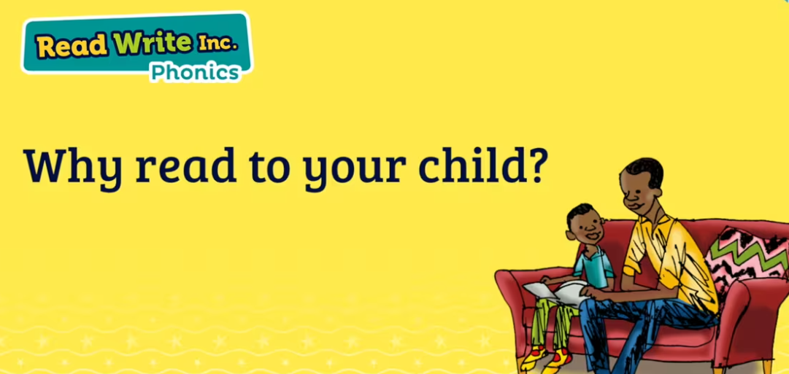

Slide 10
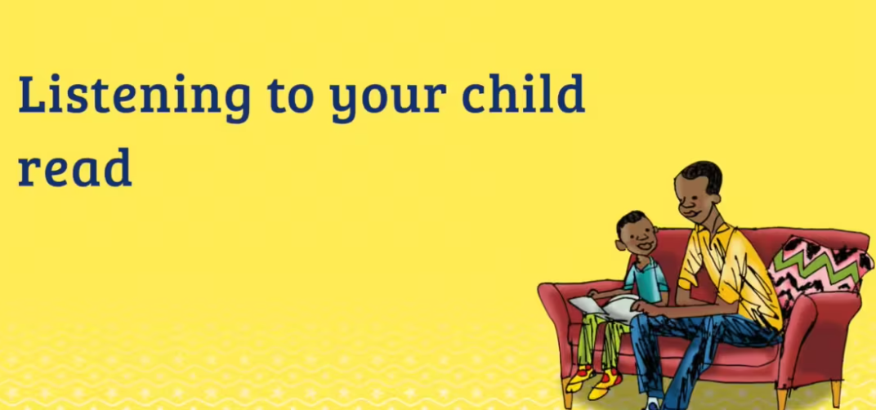

Slide 11
If books are lost, this comes at a great expense to the school. Therefore, the following charges will be applied:
Reading record - £1
Reading book - £5

Slide 12
Ruth Miskin Parents’ Page:
https://www.ruthmiskin.com/parents/
Ruth Miskin Facebook:
https://www.facebook.com/miskin.education
Free e-books for home reading:
http://www.oxfordowl.co.uk/Reading/

Slide 13


