Slide 1


Ellington Primary school
Walk to School Month 2024
Notes:
Conkers

Slide 2
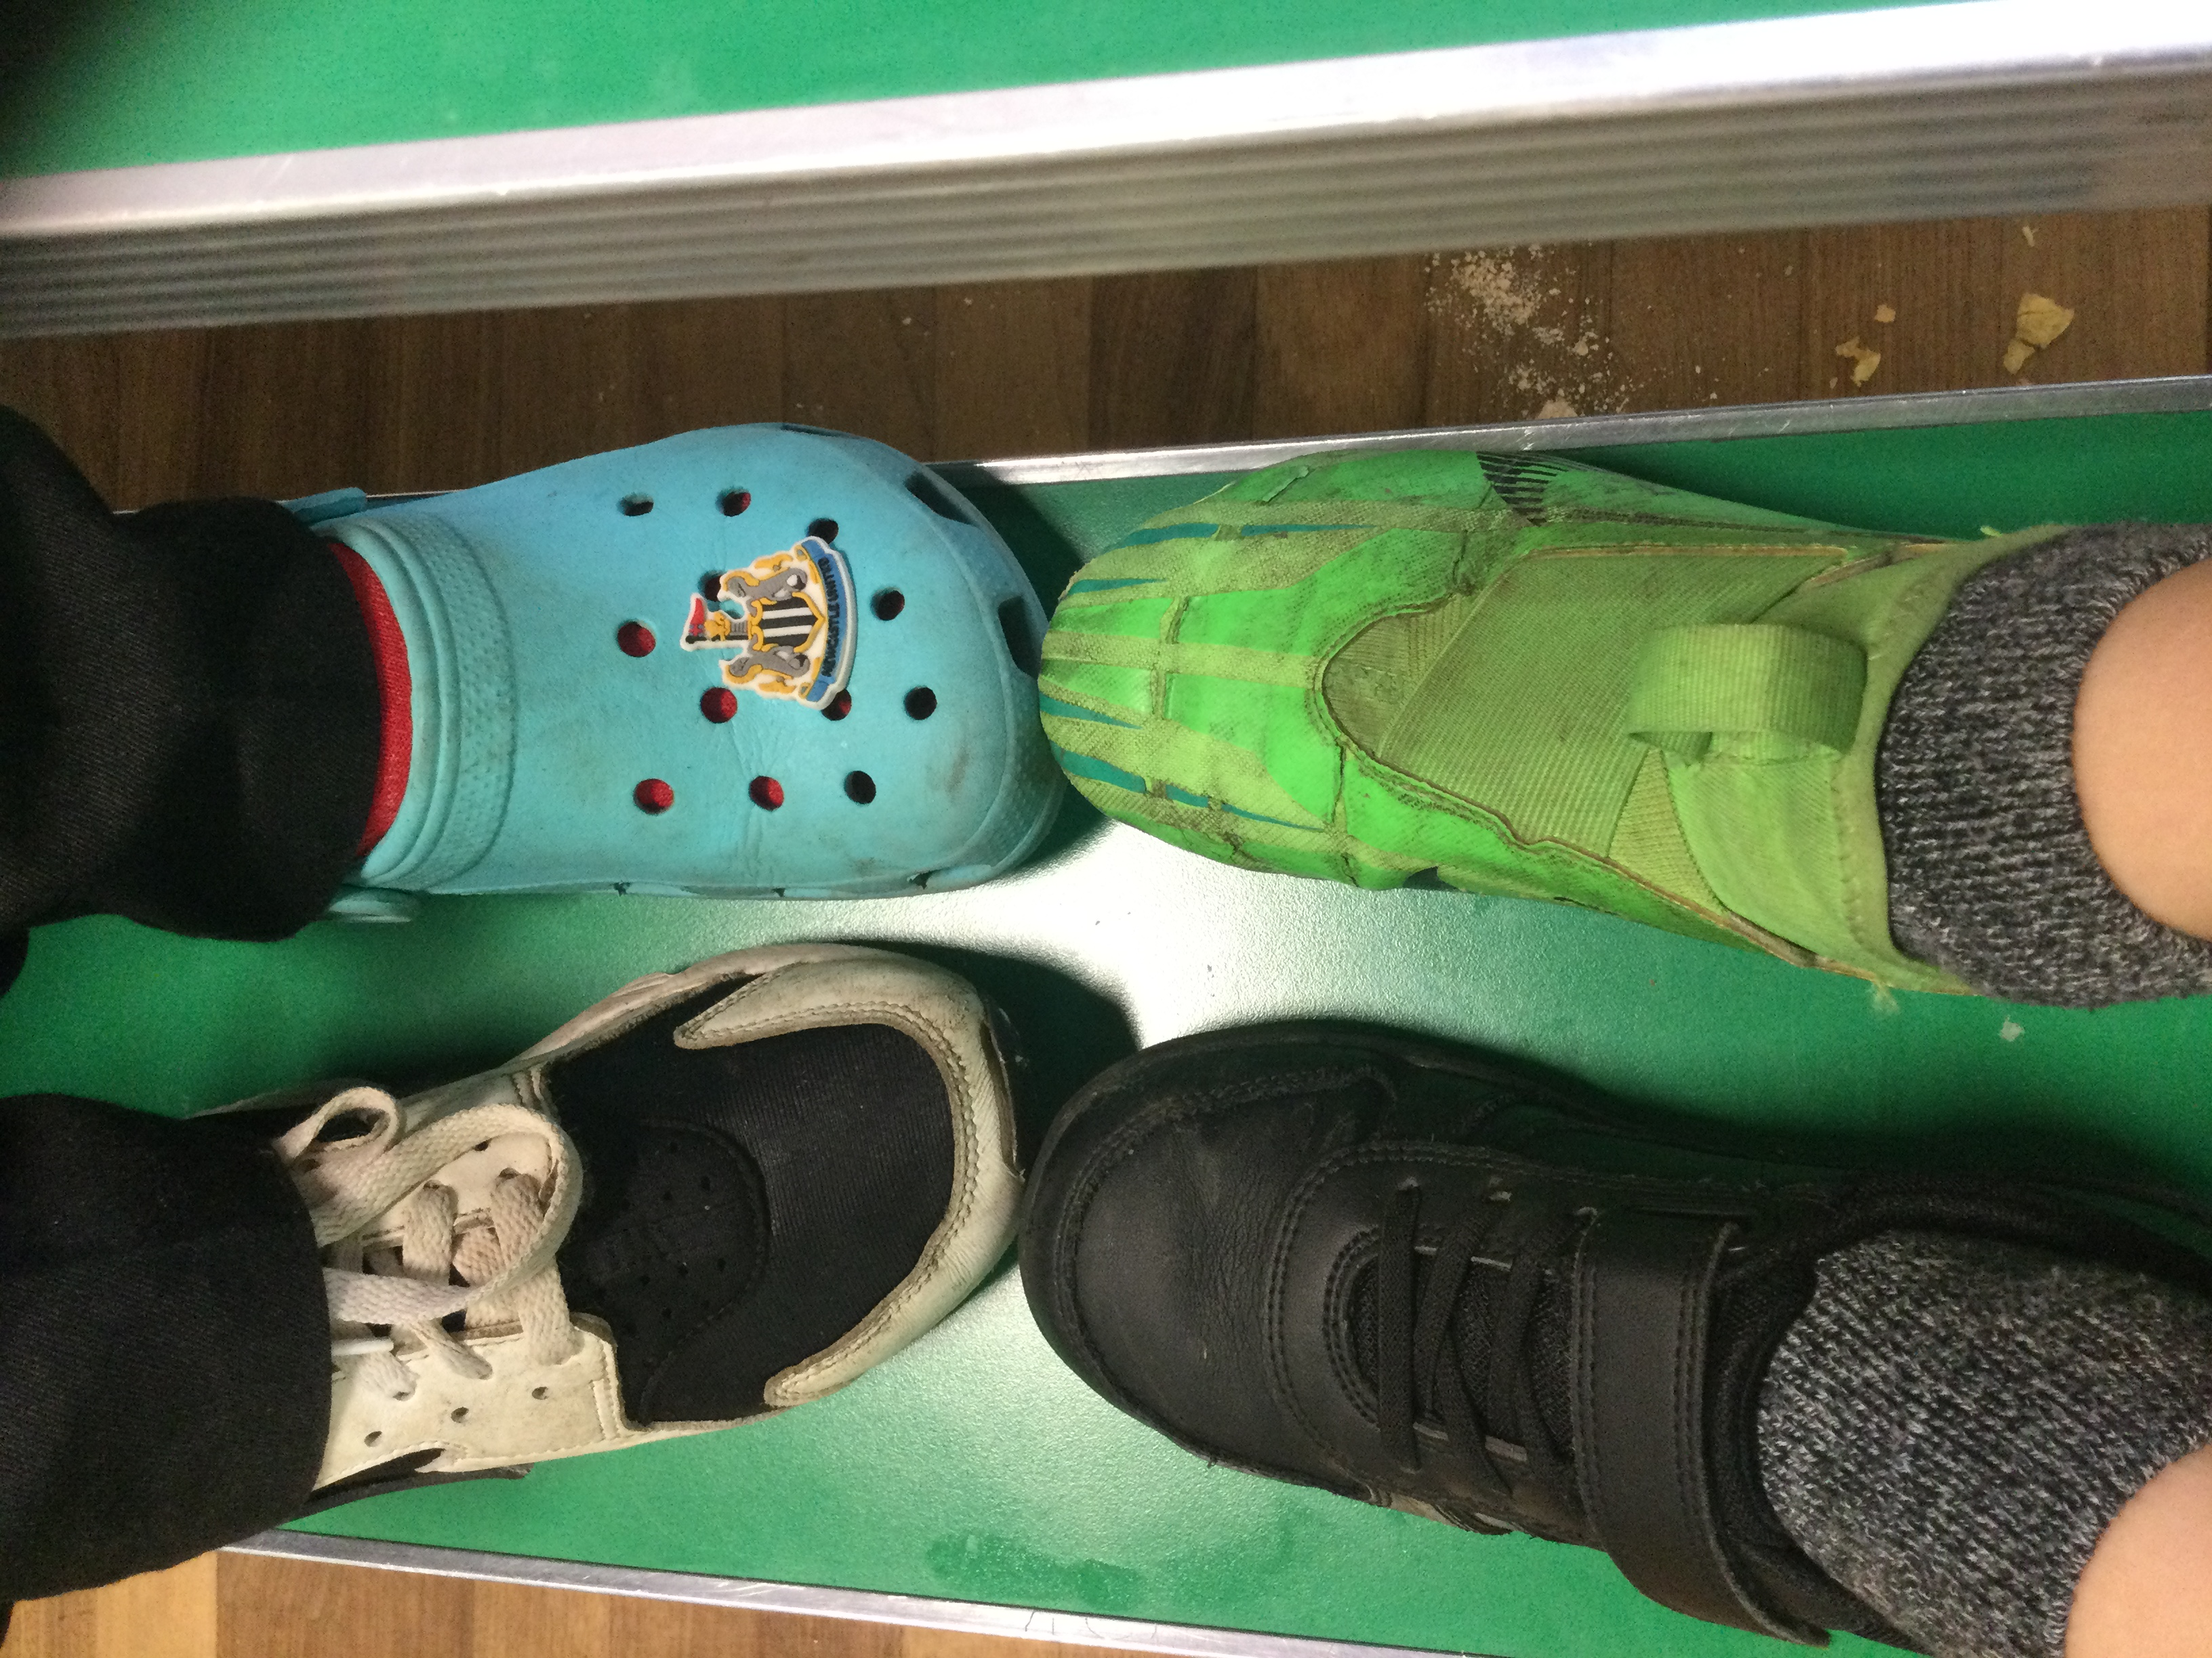
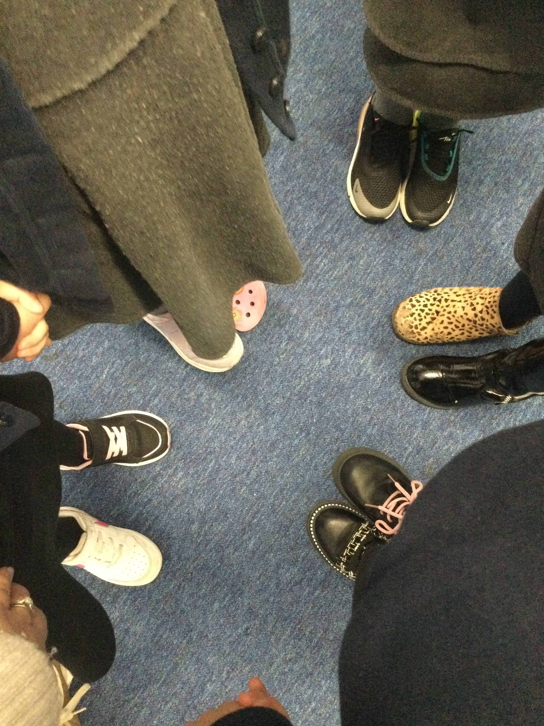
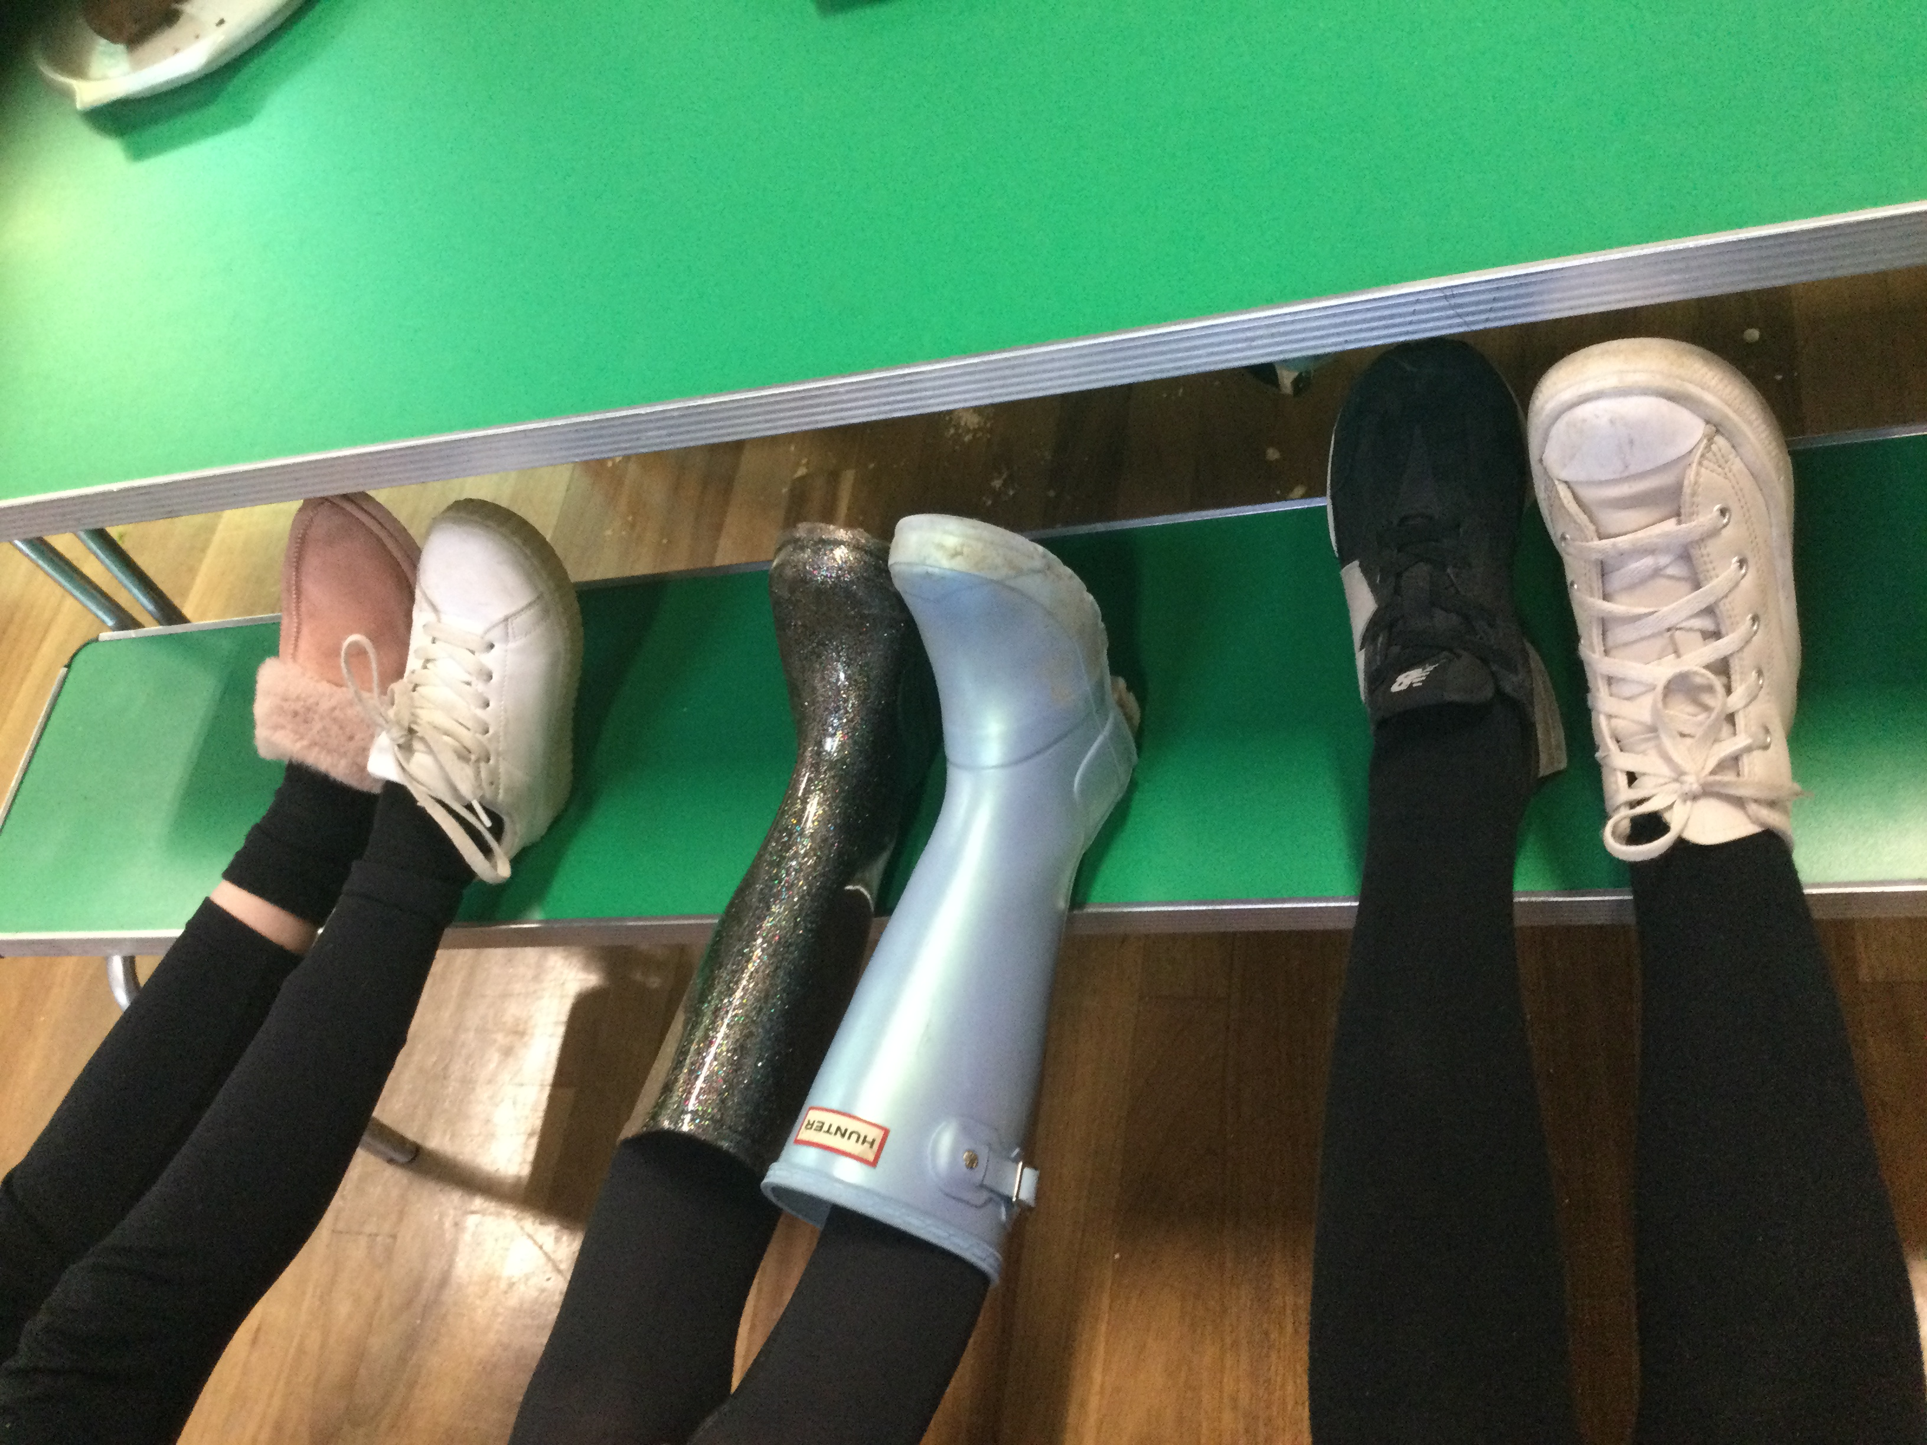
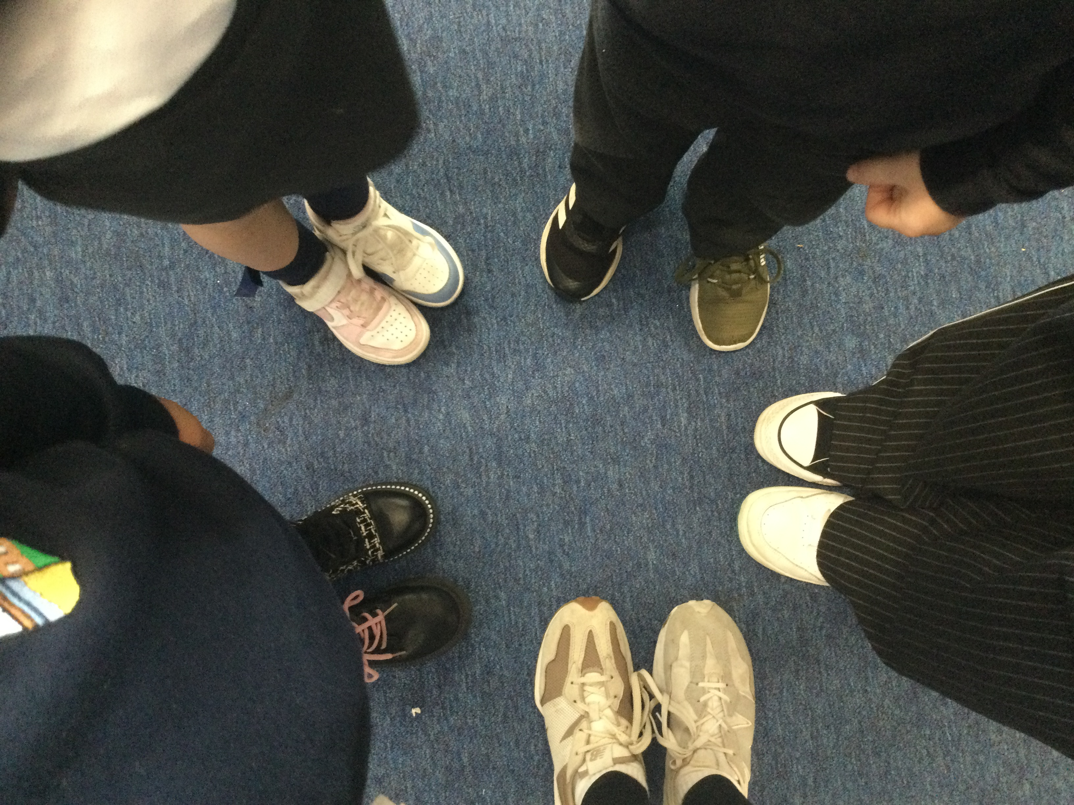
Shoesday/Odd Shoe Day!
All children and staff wore odd shoes on 10.10.24 and enjoyed ‘Shoesday’ on 8.10.24 where they could wear any shoes they liked for school!

Slide 3
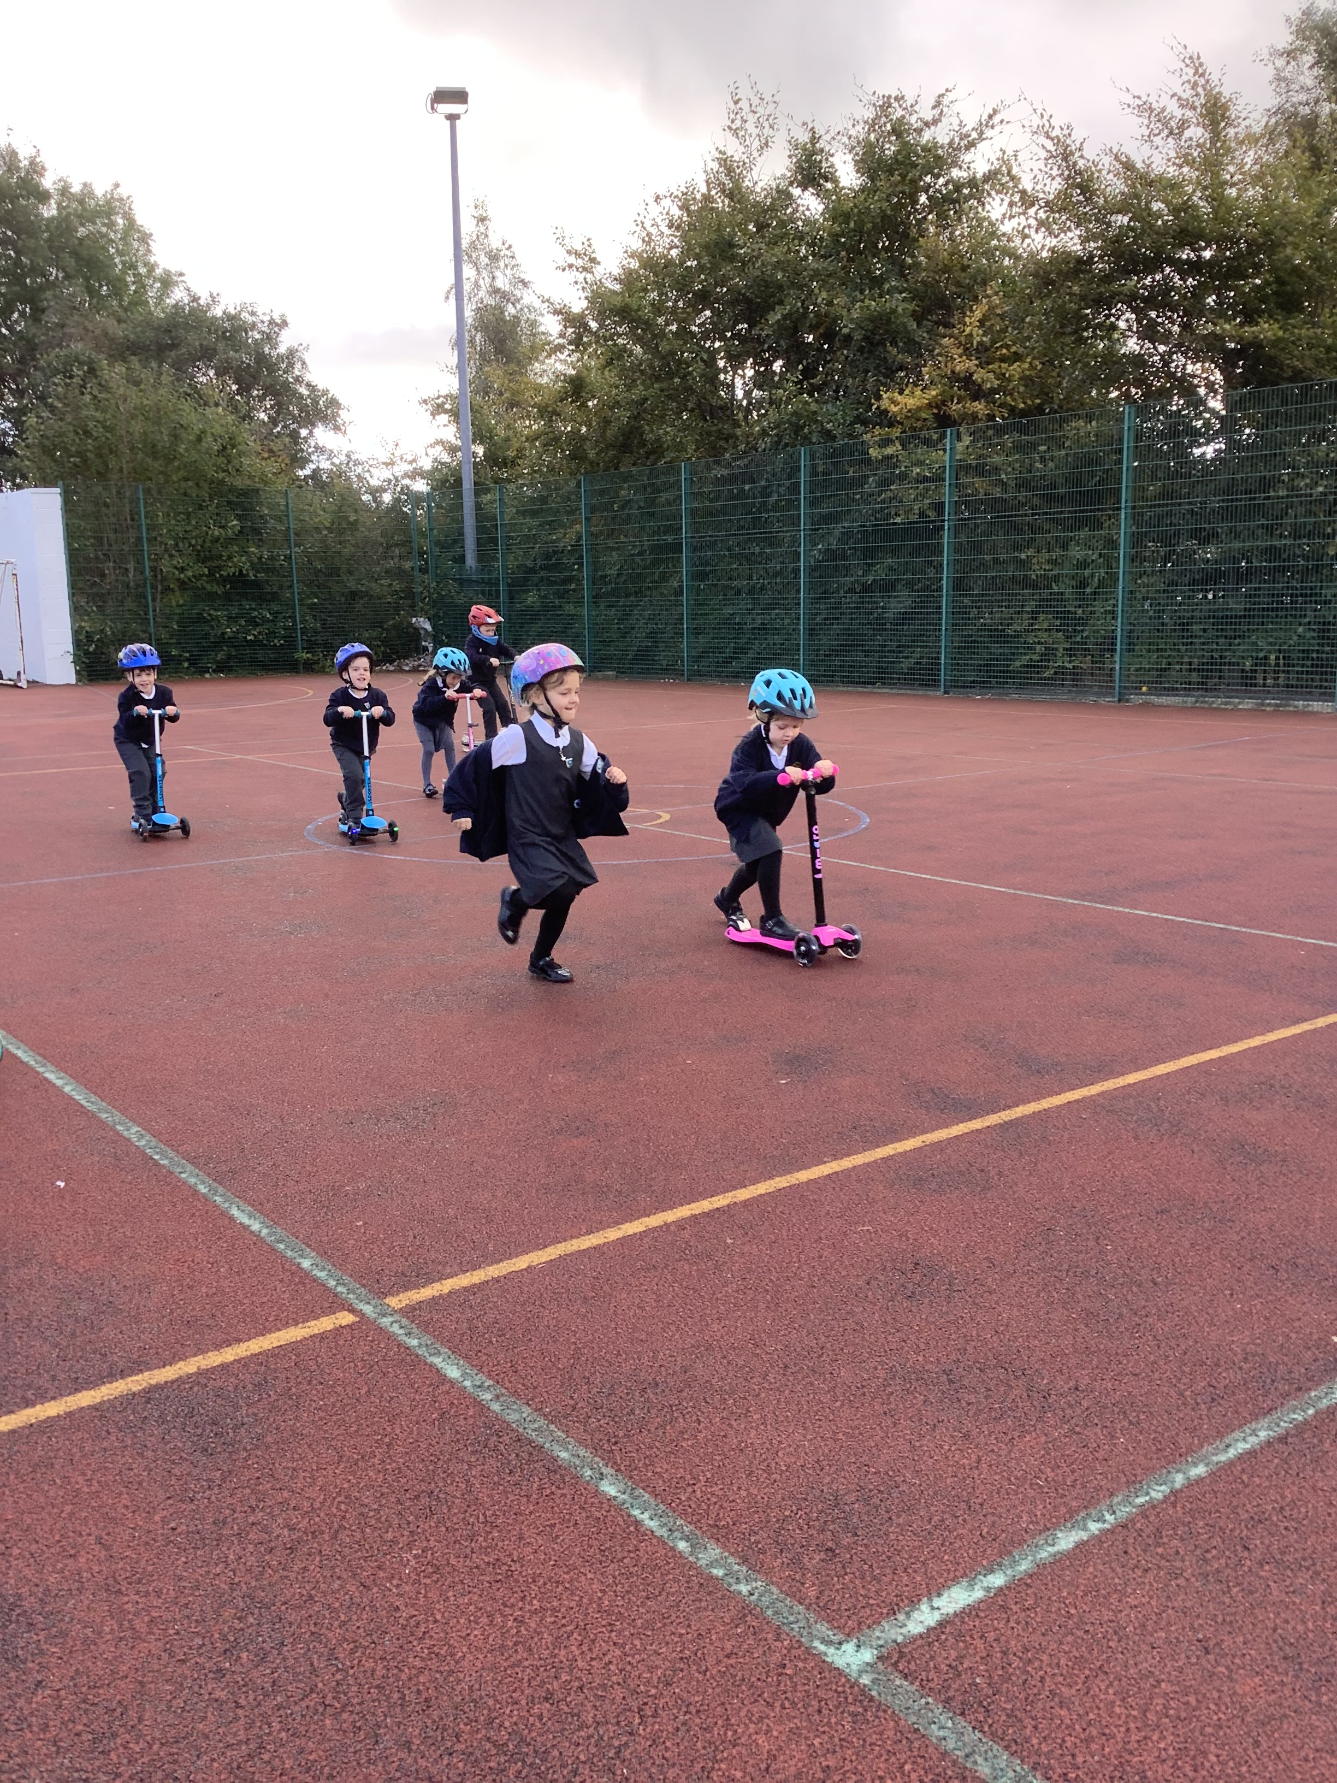
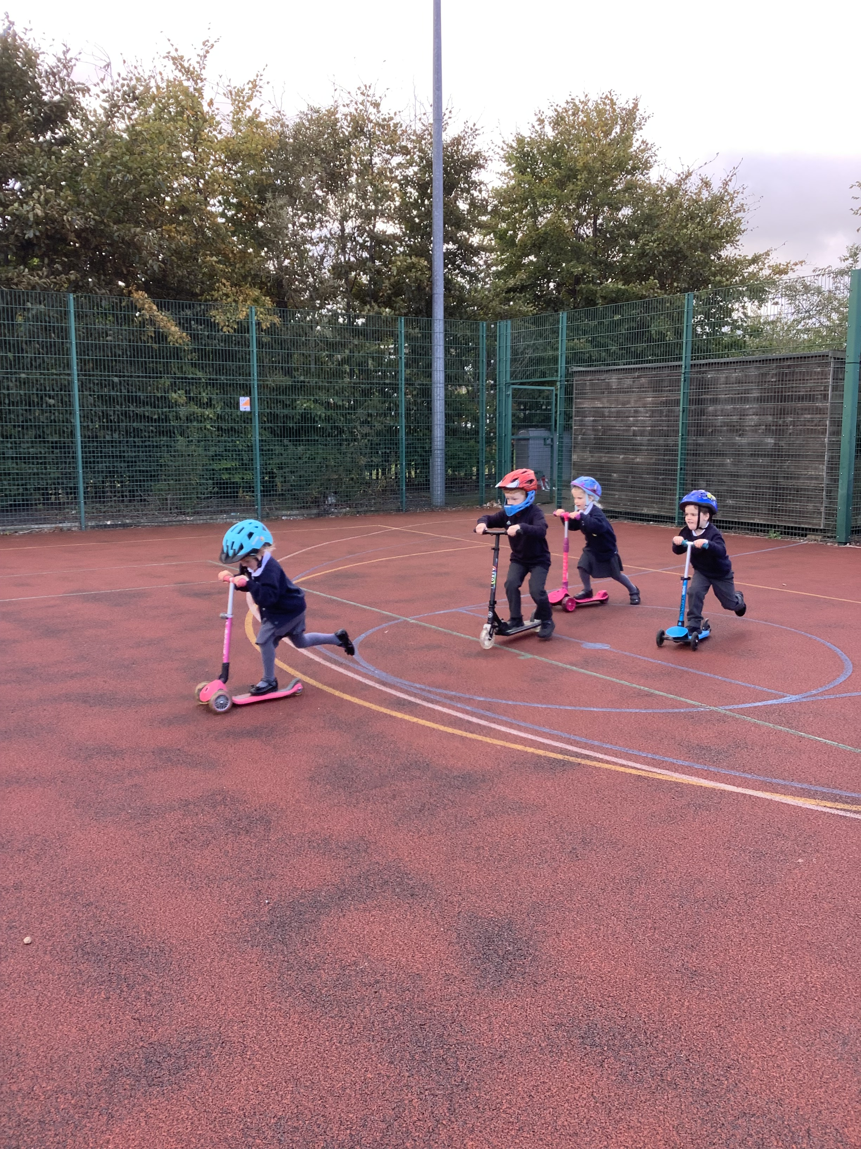
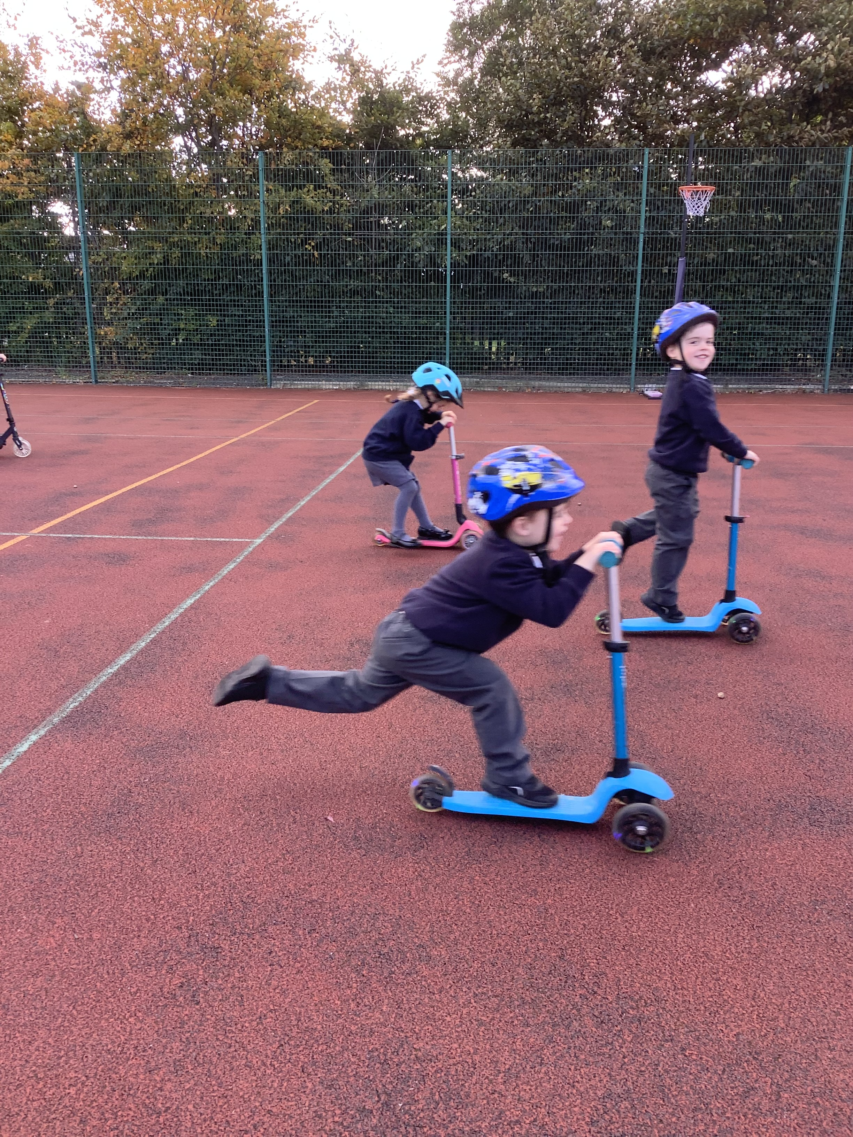
Wheels to school week!
Week beginning October 11th, we encouraged all children from Nursery to Y6 to cycle or scoot to school. They then enjoyed the MUGA at playtimes. Here are Reception having a great time racing on their scooters!

Slide 4
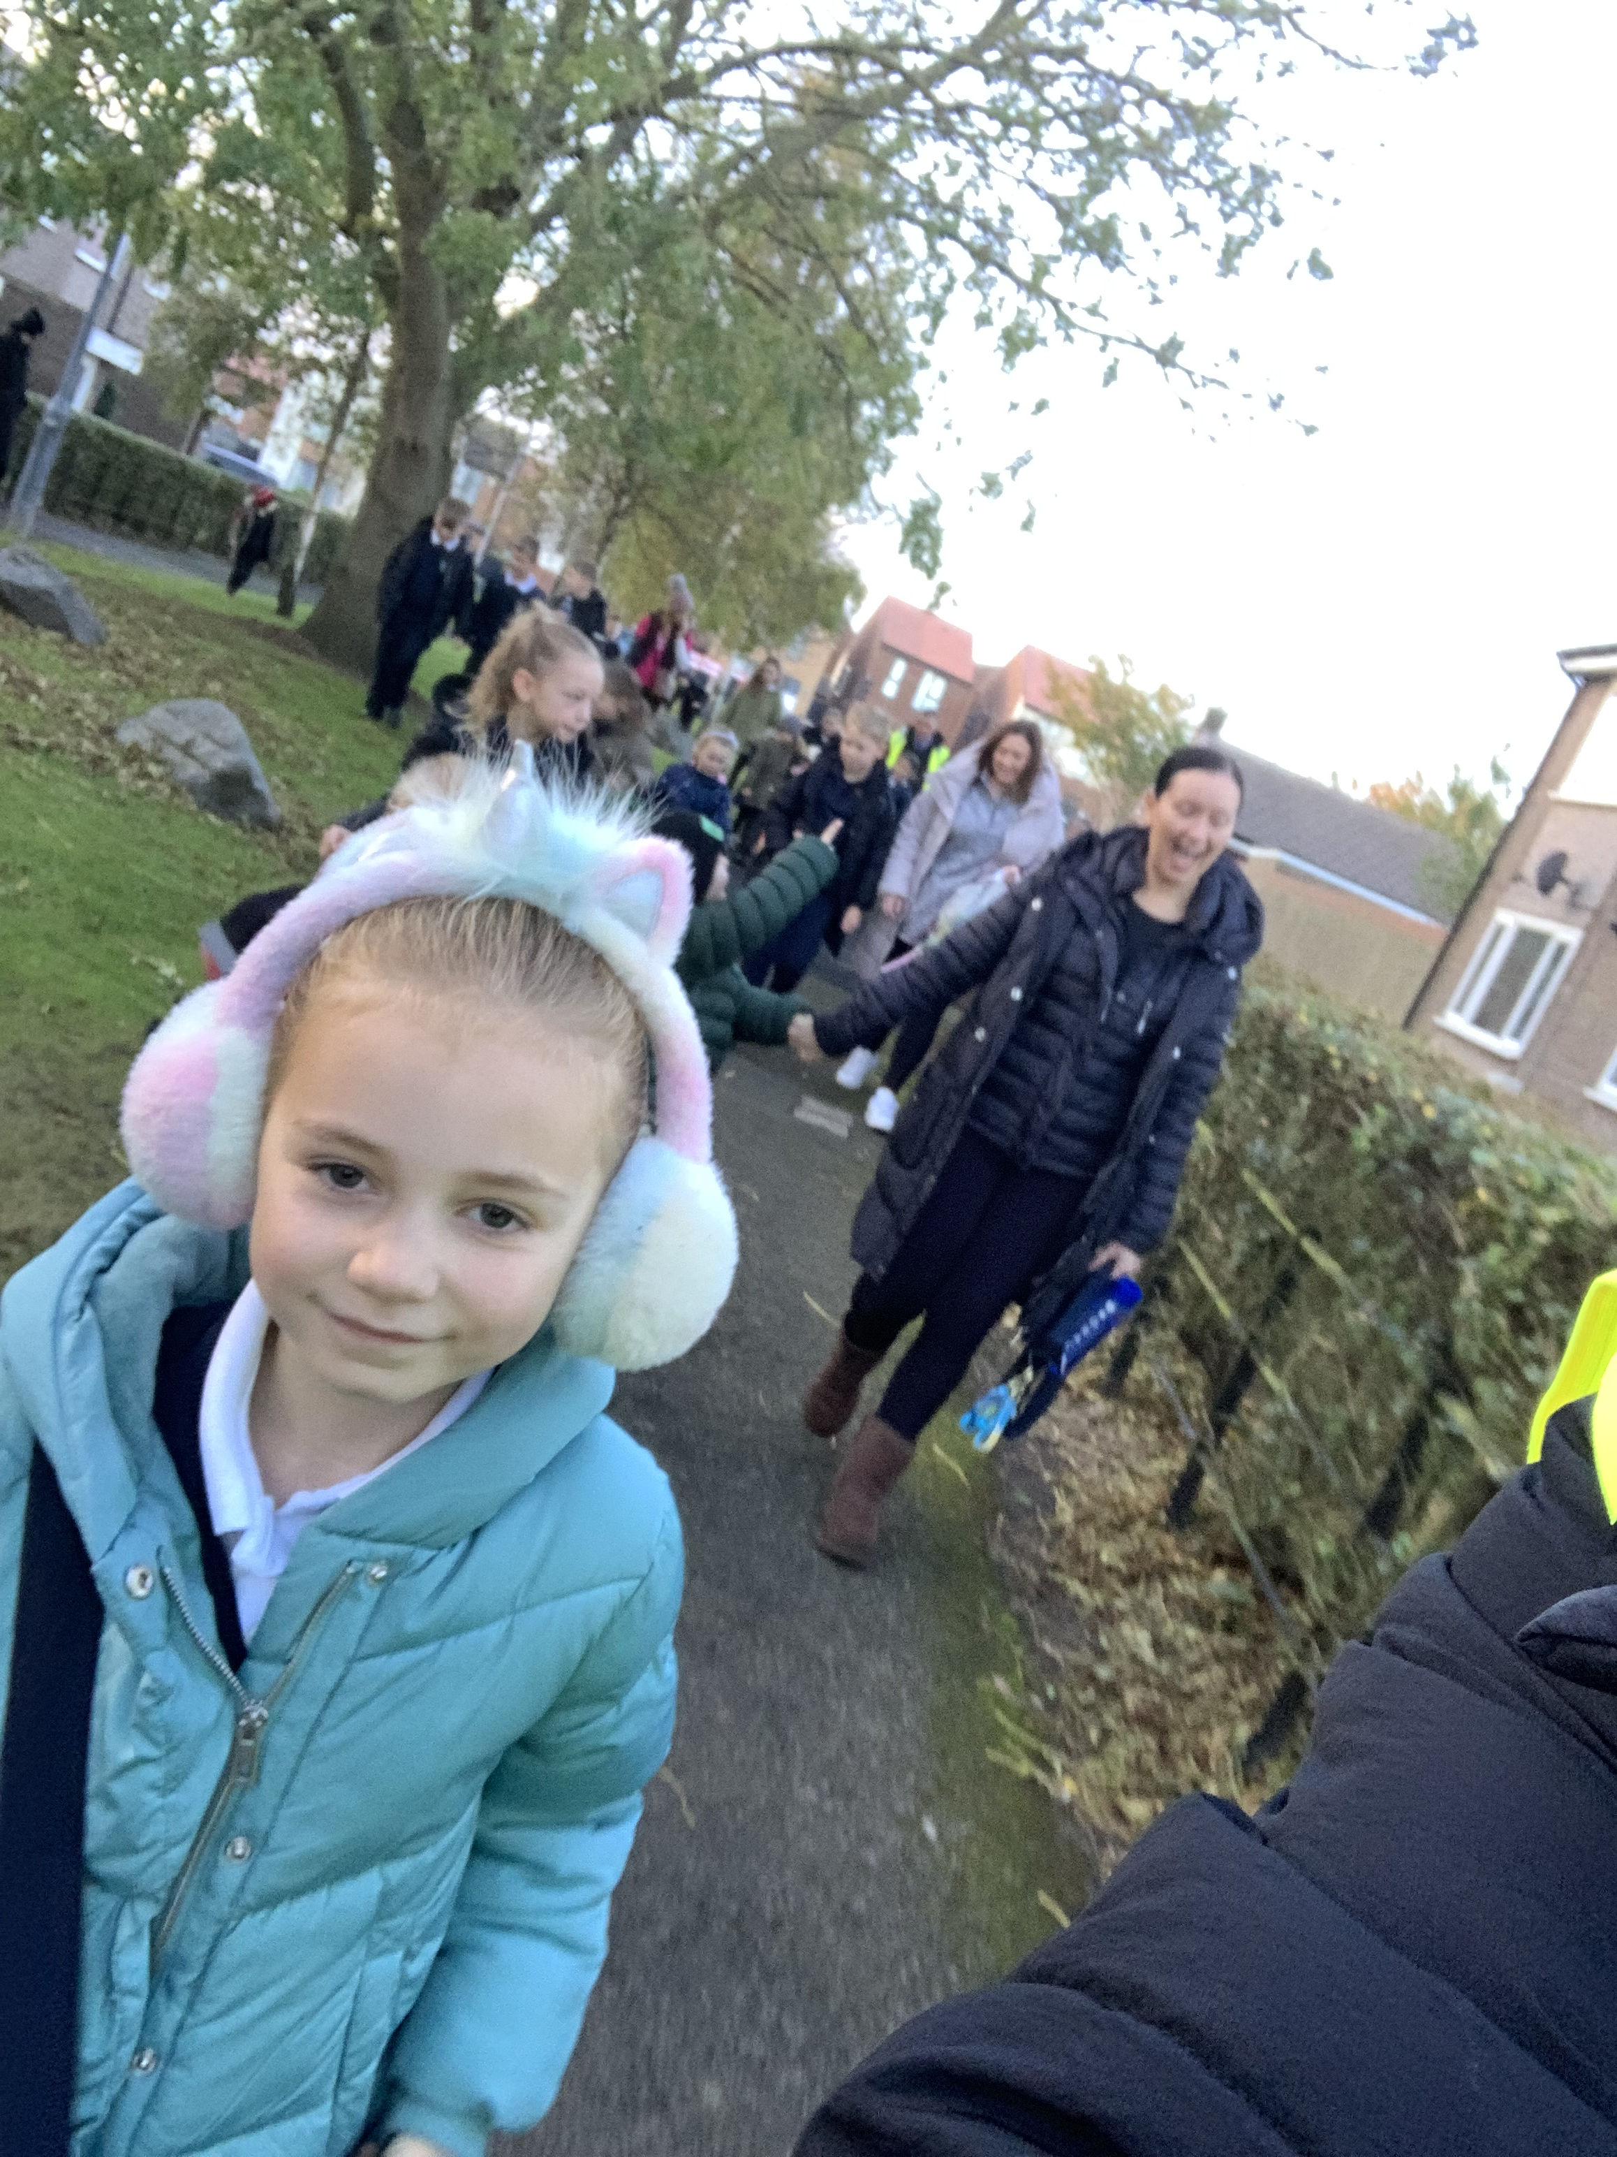
Walking Bus
We did our Waking Bus every day on the week beginning October 21st. We now have over 40 children joining us regularly!

Slide 5
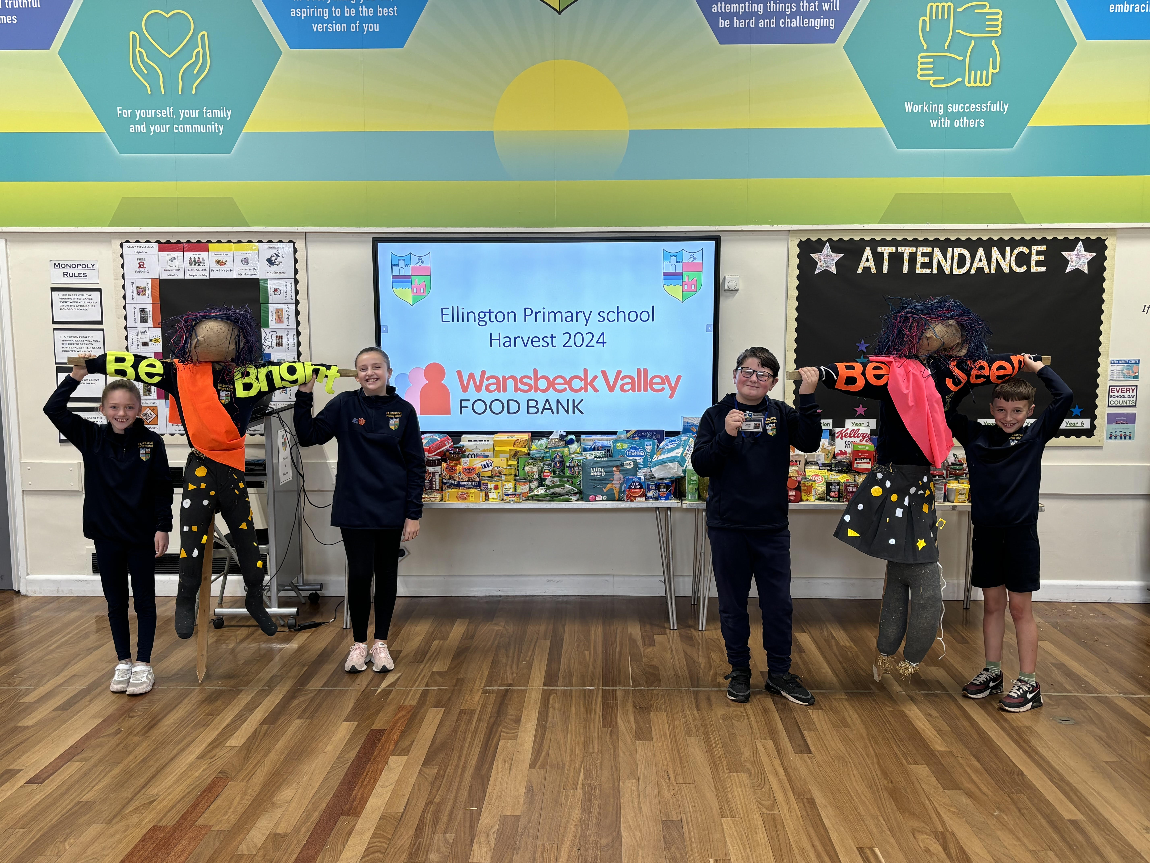
Be Bright, Be Seen!
To mark Be Bright, Be Seen week, Reception and Year 5 worked together to build two scarecrows which will live on our school field!

